Slide 1
WRONG PART RECEIVED
Expertise, Commitment, Passion,
and Quality
2026 V1.0
www.zettaone.com

Slide 2
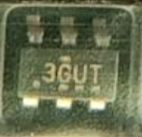
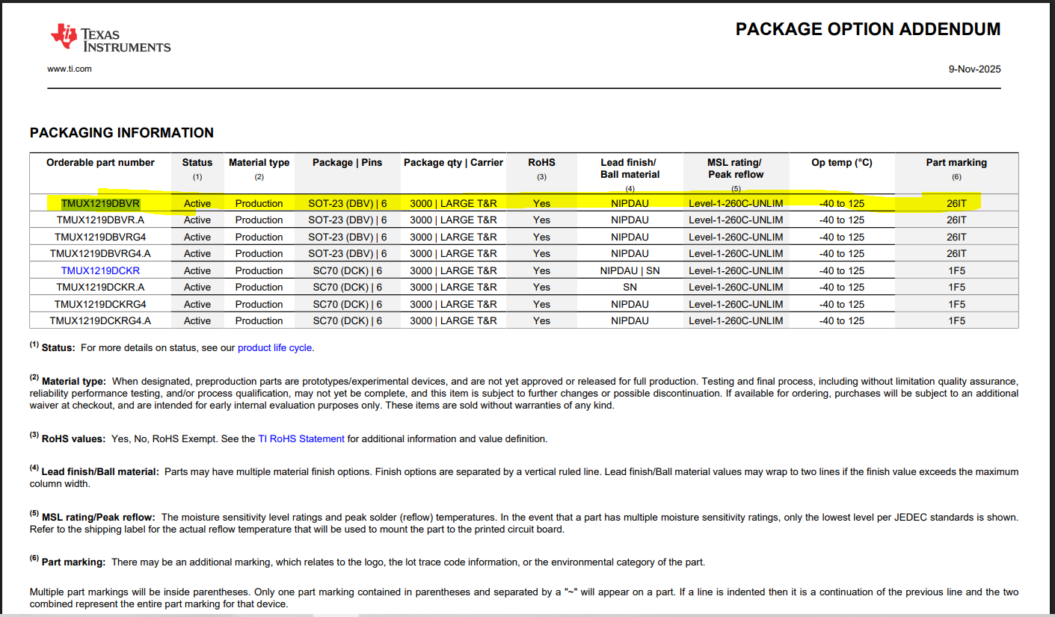
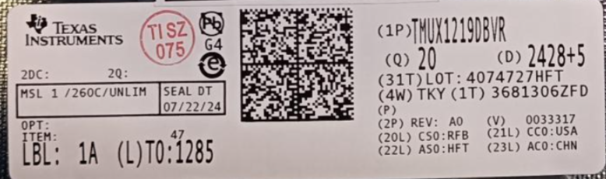
WRONG PART RECEIVED:
PID Number | ZPJ262700453
Supplier | TEXAS INSTRUMENTS
PO Number | ZKPO202627-1634
Issue | Wrong Part Received REQ BM: 26IT REC BM: 3GUT
MPN | TMUX1219DBVR
Desecription | IC SWITCH SPDT X 1 3OHM SOT23-6
Invoice Number | 641242010
GRN Number /QTY | 26202095 / 20 NOS
Rejection QTY | 20NOS
Fail Rate | 100%
RECEIVED TOP MARKING DETAILS:
MARKING DETAILS:
SUPPLIER LABLE:

Slide 3

Thank You
HEAD OFFICE, R&D & SALES | R&D & SALES | R&D | EMS FACILITY, R&D & SALES | SALES & TECH SUPPORT
BANGALORE | CHENNAI | PUNE | KRISNAGIRI | USA
Zettaone Technologies India Pvt. Ltd. G Floor, Plot No 89/B,90/A, West Avenue 9, Electronic City Phase1, Bangalore - 560100 Email: Sales@zettaone.Com | Zettaone Technologies India Pvt Ltd # 94, 1st Floor, 3rd Cross Street, Thirumalai Nagar Annexe, Perungudi, Chennai, 600096, Tamilnadu Email: Sales@zettaone.Com | Zettaone Technologies India Pvt Ltd #29, Kohinoor B-Zone, Office No: 307, 3rd Floor, Old Mumbai to Pune Highway, Revenue Village of Pimpri, Tal Haveli, Pune, Maharashtra – 411019, Email: Sales@zettaone.Com | Zettaone Technologies India Pvt Ltd No: P-4A, Sidco Industrial Estate, Krishnagiri-635001. Tamilnadu, India. Email: Sales@zettaone.Com | Zettaone Technologies Inc 10642 N Portal Avenue, Cupertino, Ca - 95014, USA Office : +1 714 975 8048 Email: Us-sales@zettaone.Com
Copyright © 2026 Zettaone Technologies

