Slide 1
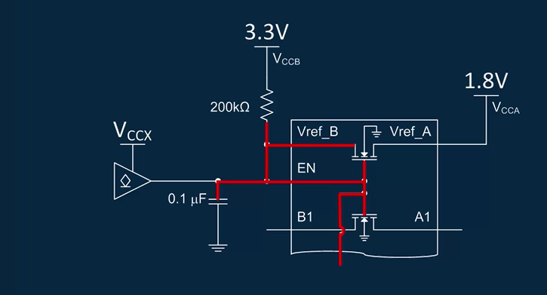
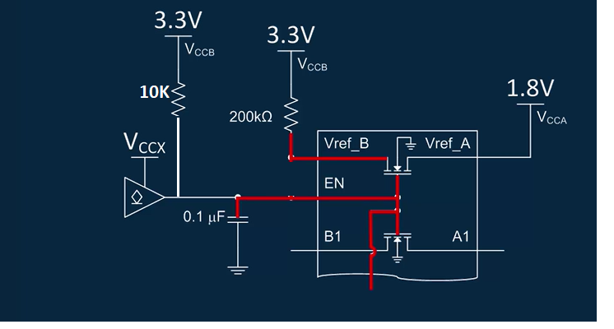
https://training.ti.com/TLM-LSF-Enable?cu=1134826
Circuit suggested from TI
Implementation of LSF0102 for I2C open drain application:
Enable is not connected to VREFB, instead driven by external
open-drain circuit with a pull-up. Can you please check
and provide the feedback on this.

