Slide 1
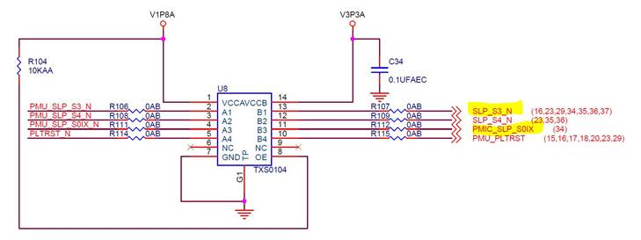
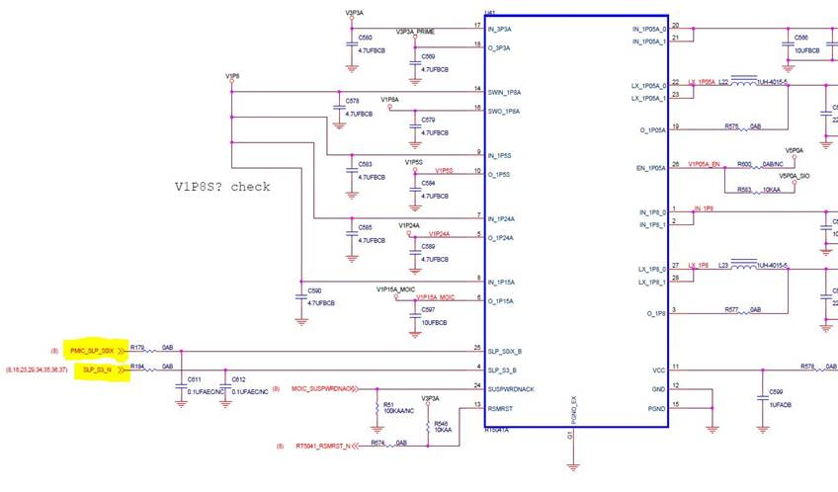

Slide 2
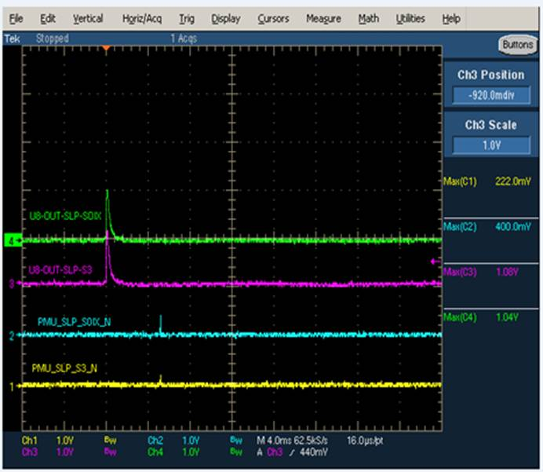
1.CH1 : PMU_SLP_S3_N |  | 2.CH2:PMU_SLP_S0IX_N
3.CH3:SLP_S3 |  | 4.CH4:PMIC_SLP_S0IX

Slide 3
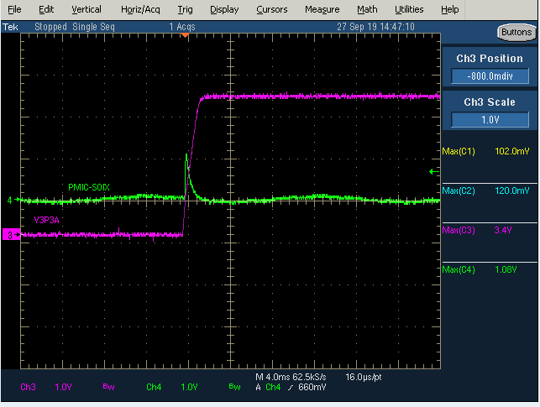
CH4: TXS0104 pin 3
CH3 : VCCB(3.3V)

