Slide 1
TXU0101DTQR : Footprint discussion

Slide 2
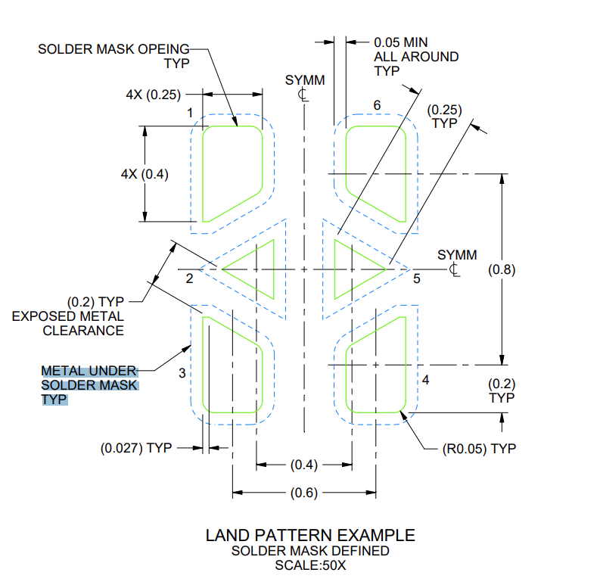
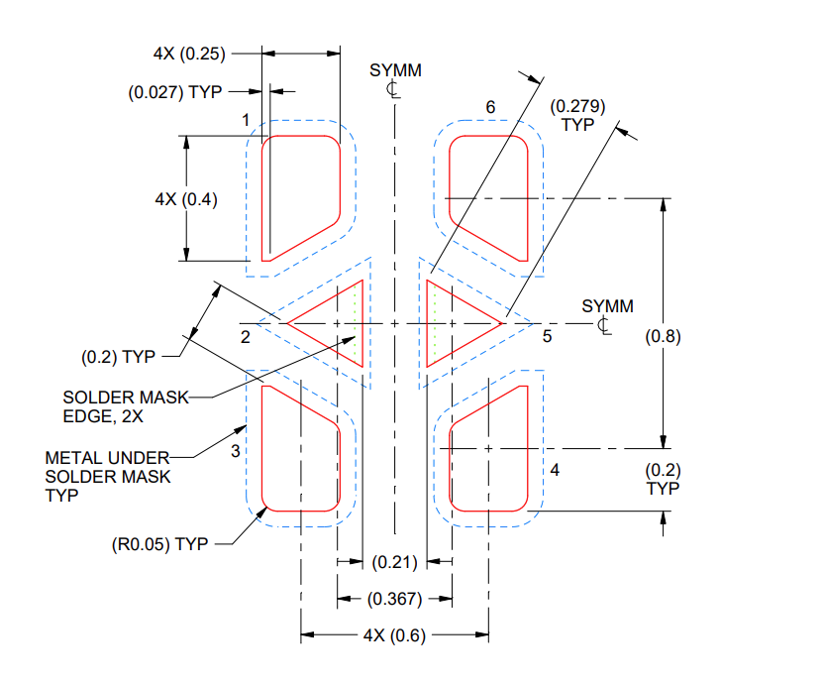
By following the 0.21mm as air gap between the past mask. Past mask is coming inside the solder mask which is violating the image representation in datasheet.
Land Pattern recommendation from Datasheet
Our Decal Image
Past Mask recommendation from Datasheet
White line is paste mask, which is inside the solder mask.

Slide 3
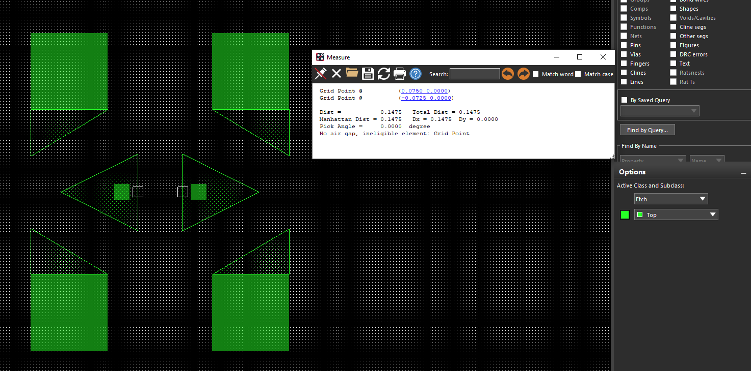
In Ti CAD file from ultra librarian : Paste mask and solder mask is just overlapped and the air gap is 0.147mm (approx). Which is not as per datasheet.

