Slide 1
TXU0104 VCCA VCCB short to GND
Subhead here
Presenter’s Name

Slide 2
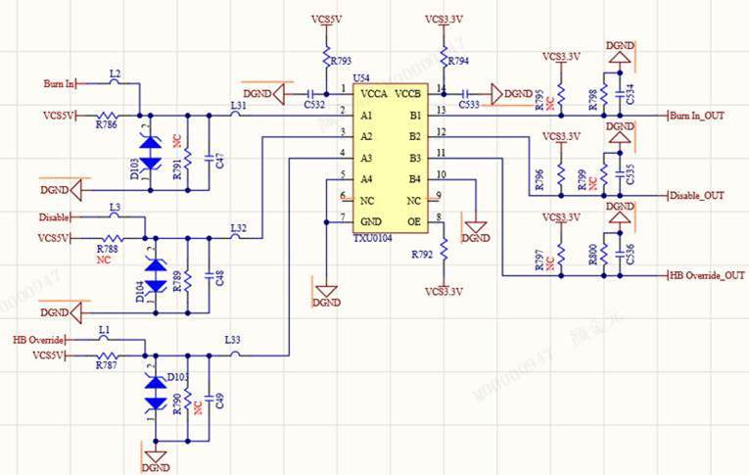
Schematic

