Slide 1
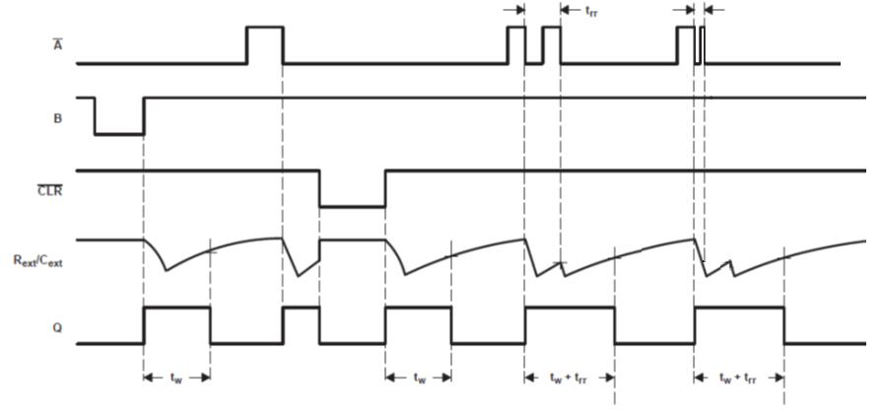
Is it possible to transit
When Rext/Cext is discharging?
Is there any limitation of timing?
At this time does Q output remain H?

Slide 2
At the point of Function Table, it may be possible to use.
Is it correct?

