Slide 1
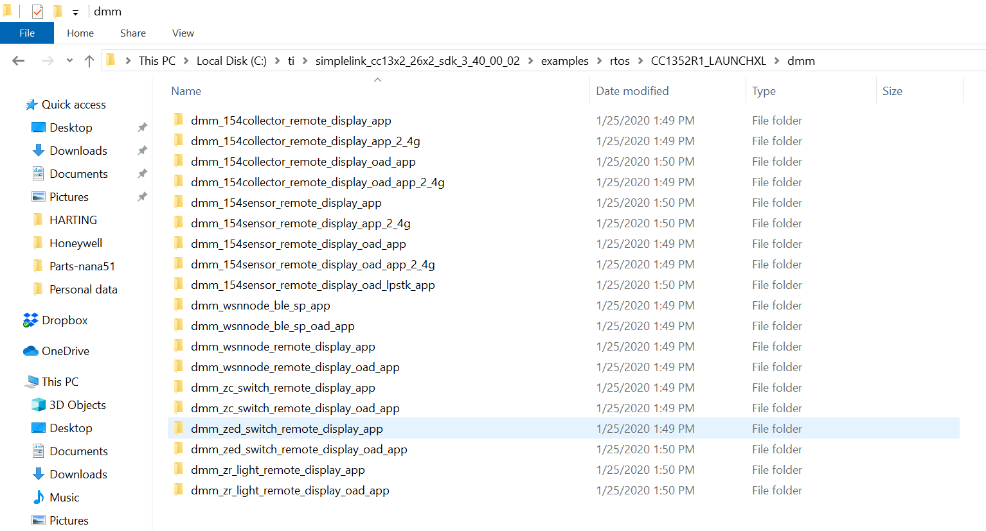
Refer to question number 1

Slide 2
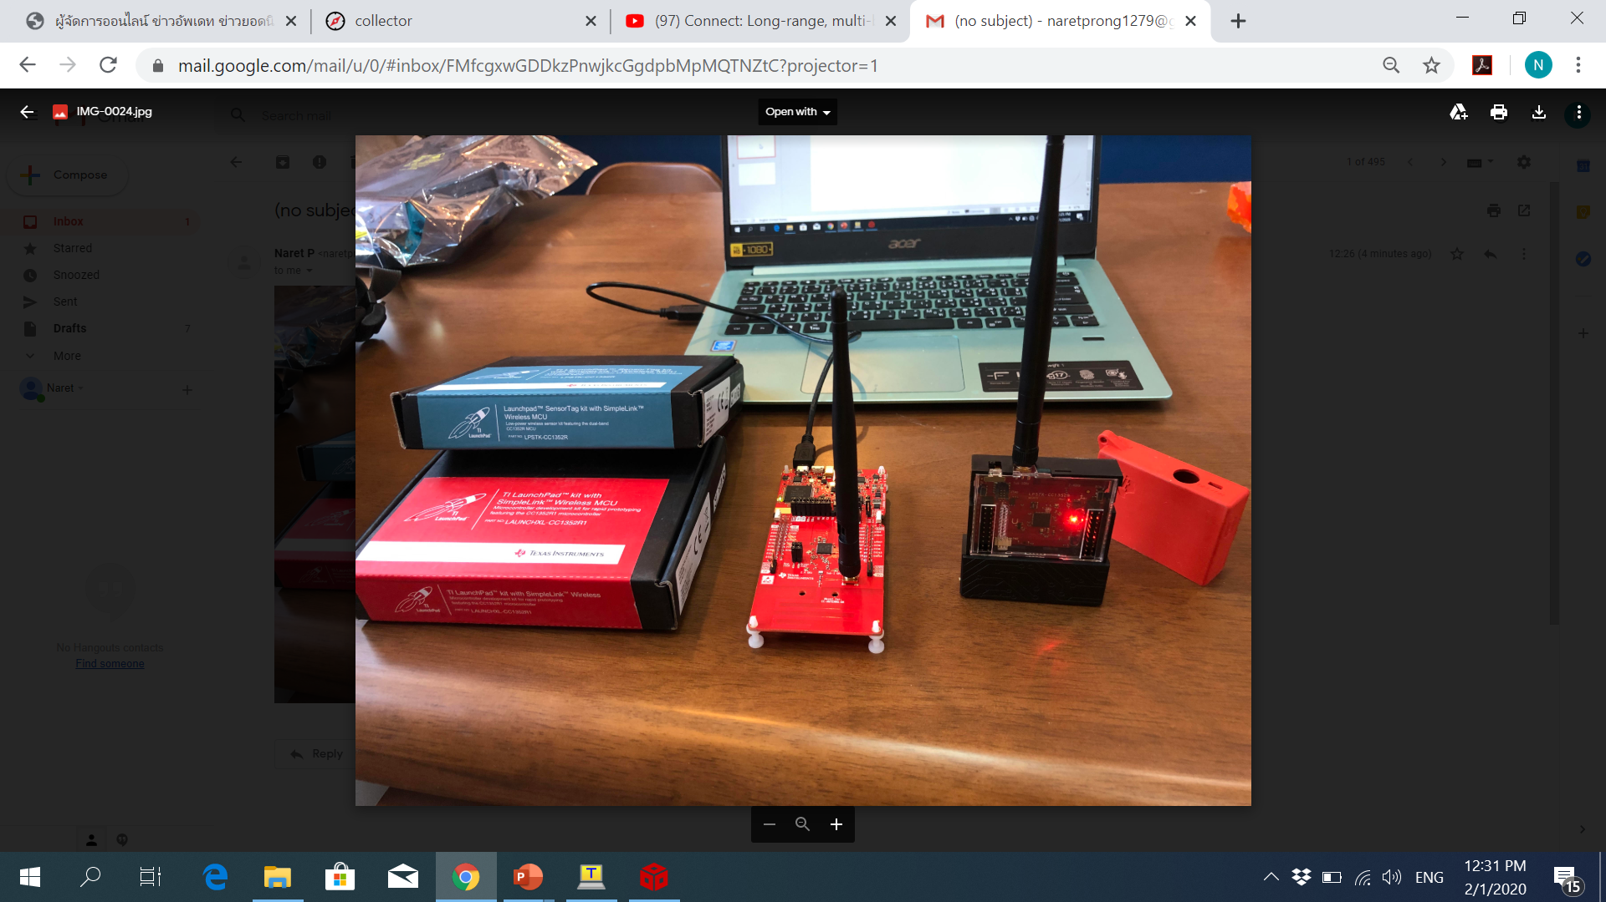
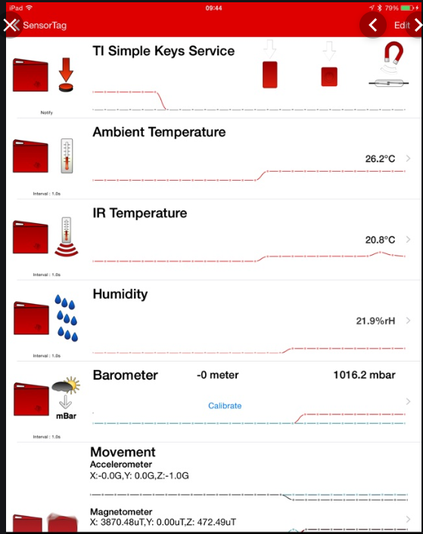
Refer to question number 2
Sub 1Gzh
Sensor
BLE
Collector

Slide 3
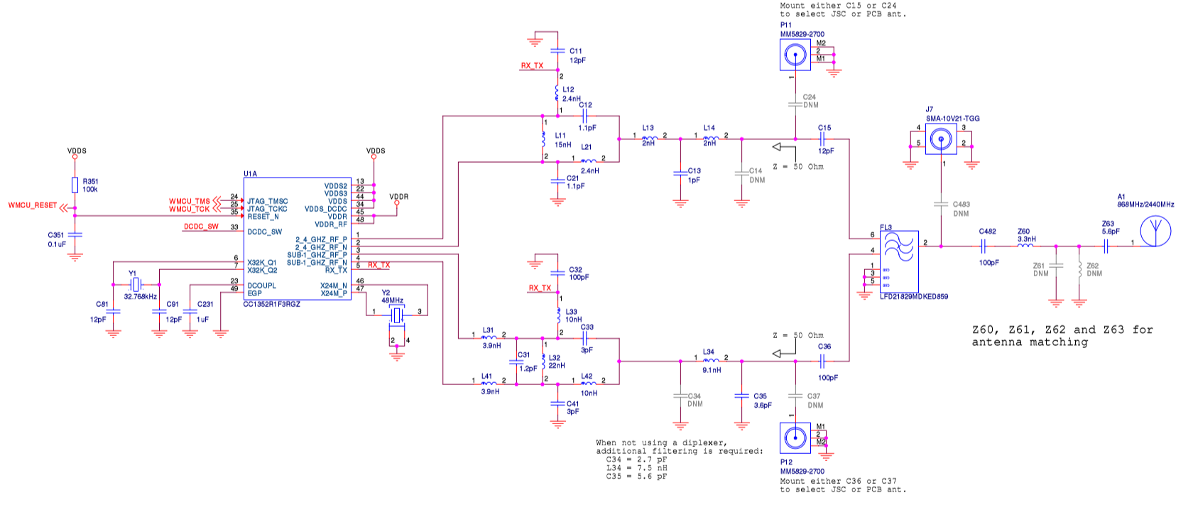
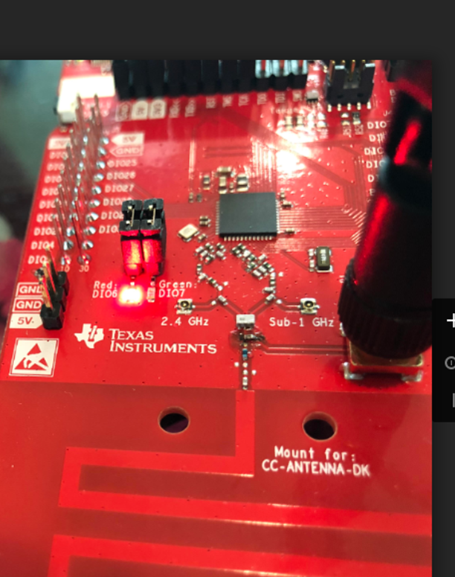
Refer to question number 3
-change capacitor location to use J7 SMA-10V21-TGG
-used antenna same as Sensor tag

