Slide 1
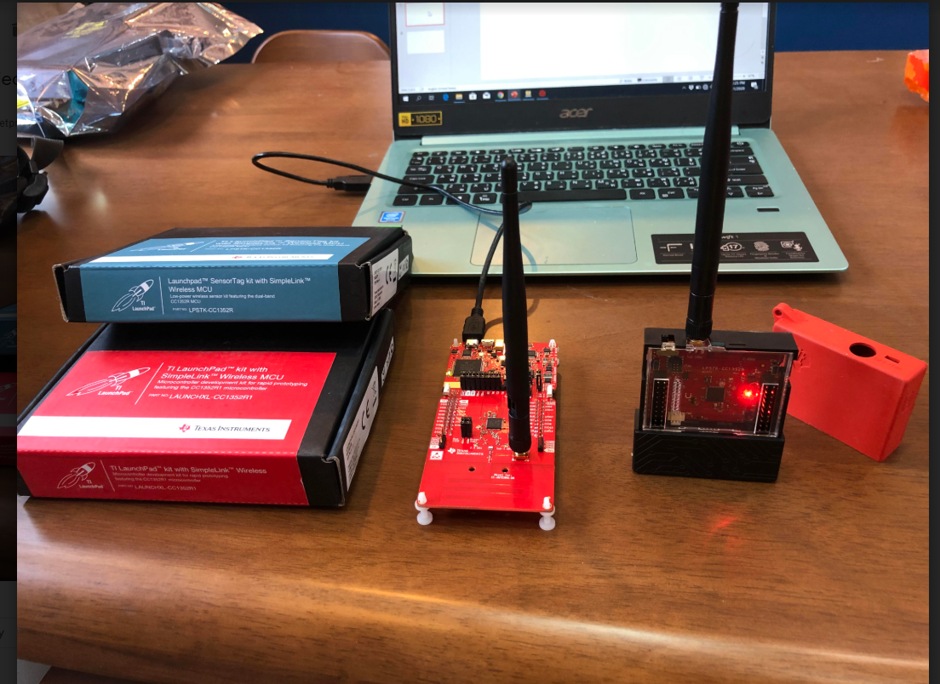
Hardware
1)LPSTK-CC1352R 1 pcs( sensor)
2)LAUNCHXL-CC1352R1 pcs(collector)

Slide 2
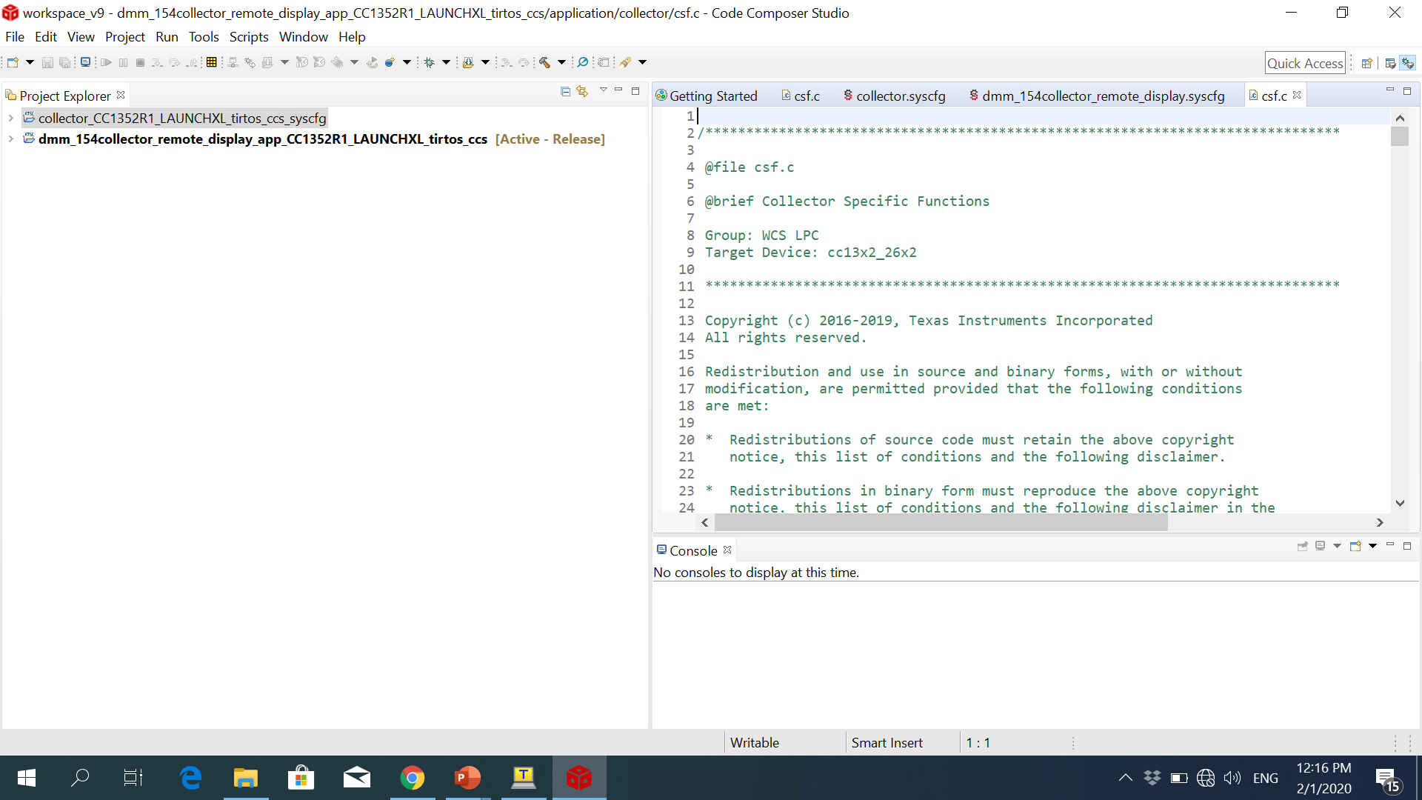
Software: shown below in CCS

Slide 3
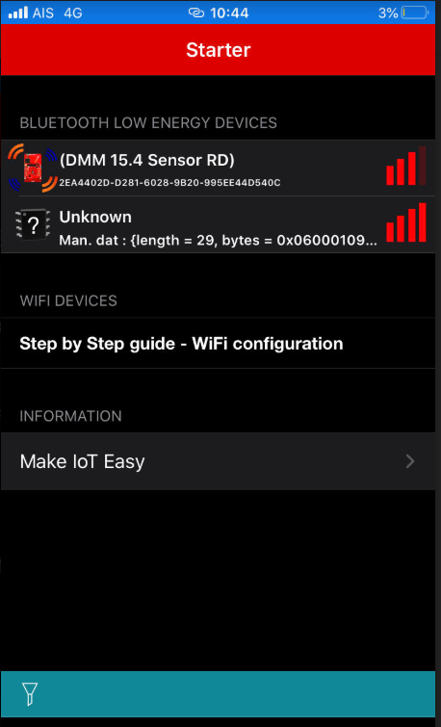
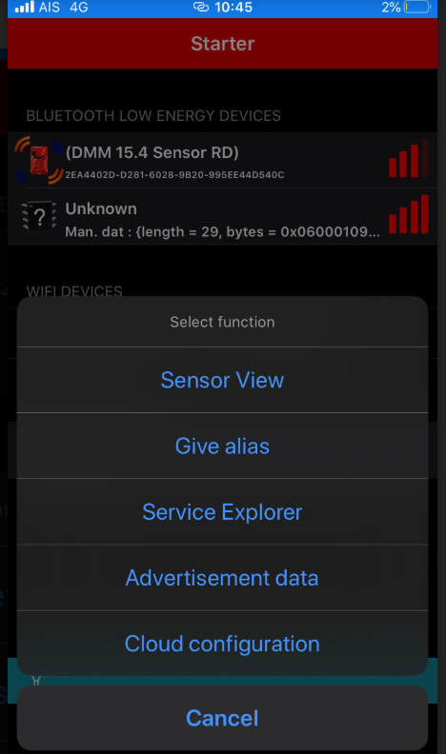
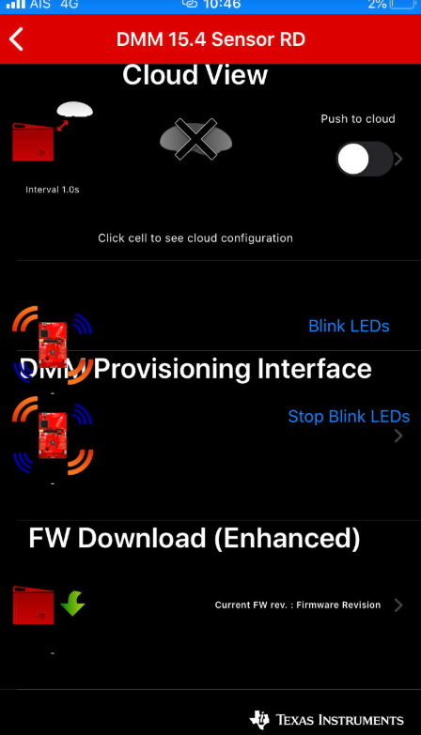
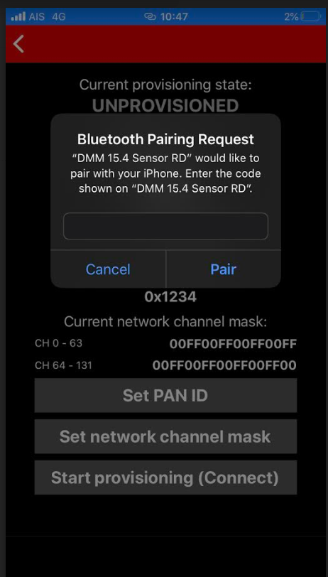
Simple link starter App
Step 1
Step 2
Step 3
Step 4
How to get code on DMM 15.4 Sensor RD

Slide 4
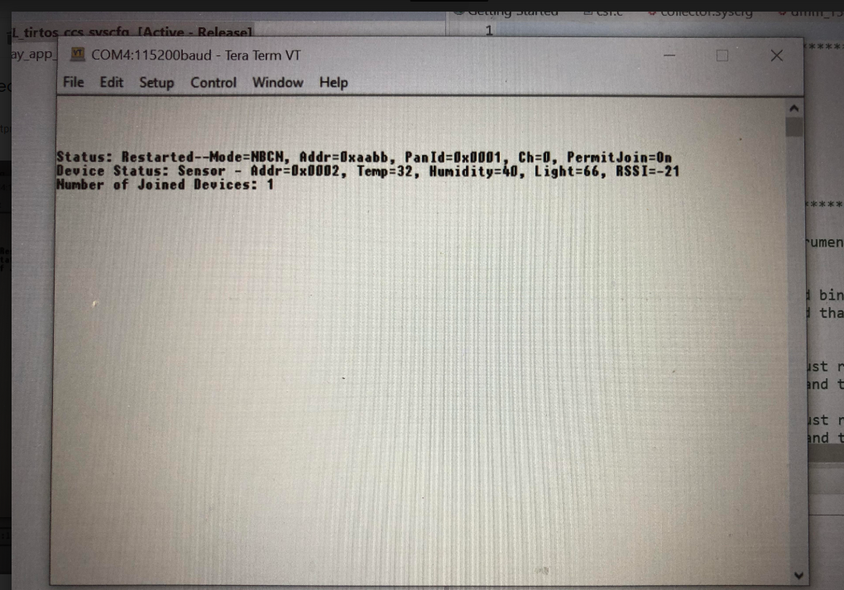
UART intrface

