Slide 1
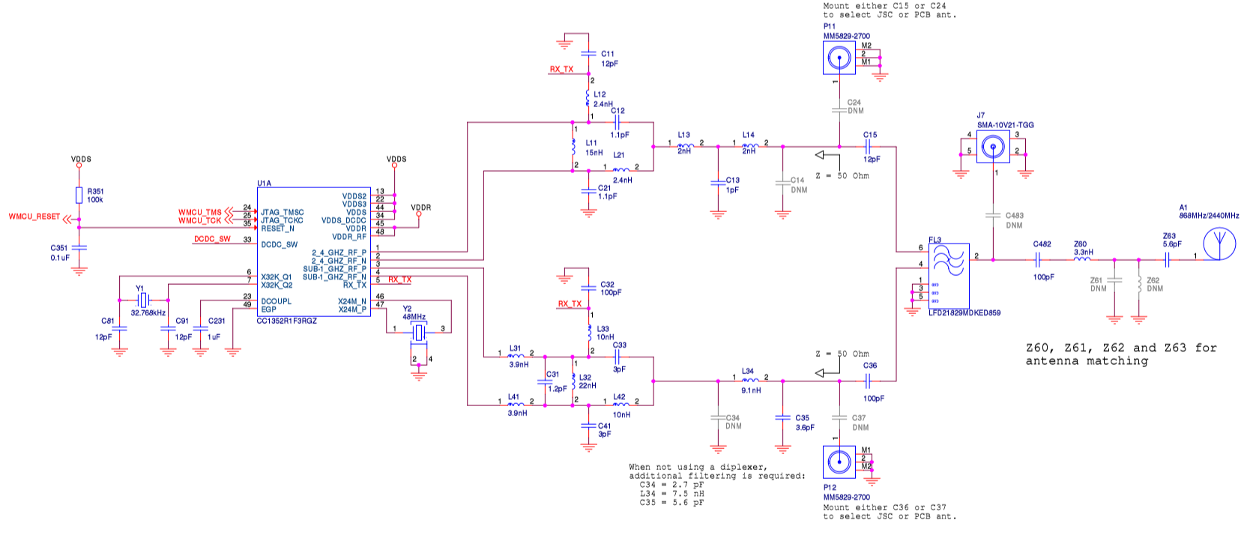
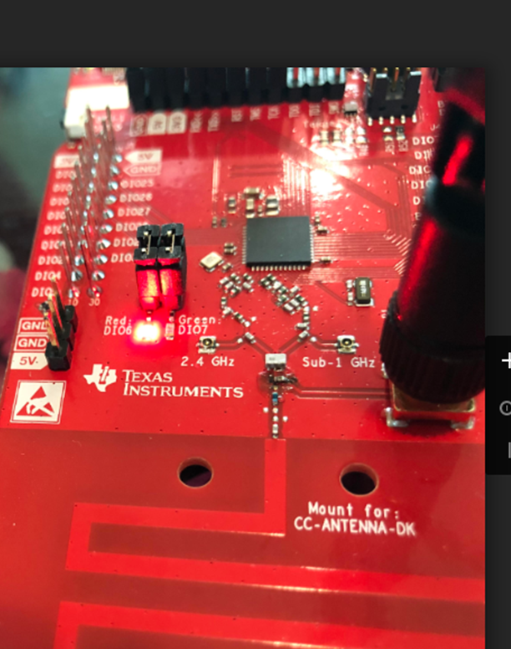
Change capacitor location to use J7 SMA-10V21-TGG

