Slide 1
Smart RF Studio Continuous RX bug
V2.20.1 with LaunchXL-CC1352P1 Launchpads

Slide 2
With an interference source nearby, measured RSSI may either go up or down
For nearby channels, RSSI goes up (expected behavior)
For far away channels, RSSI goes down (unexpected)
  Interference causes RSSI to go even lower than the typical noise floor!
At the tested distance, we know that CC1352P RX sensitivity performance will still suffer from the interference, even if on a far-away channel
  Low noise floor shown in Smart RF studio =/= good rejection performance when actually receiving packets
If filtering is applied, at what layer?
  Is the Smart RF Studio GUI tool performing any extra filtering before displaying the data?
  Is the RSSI calculation on the chip actually behaving differently based on where the interferer is located?

Slide 3
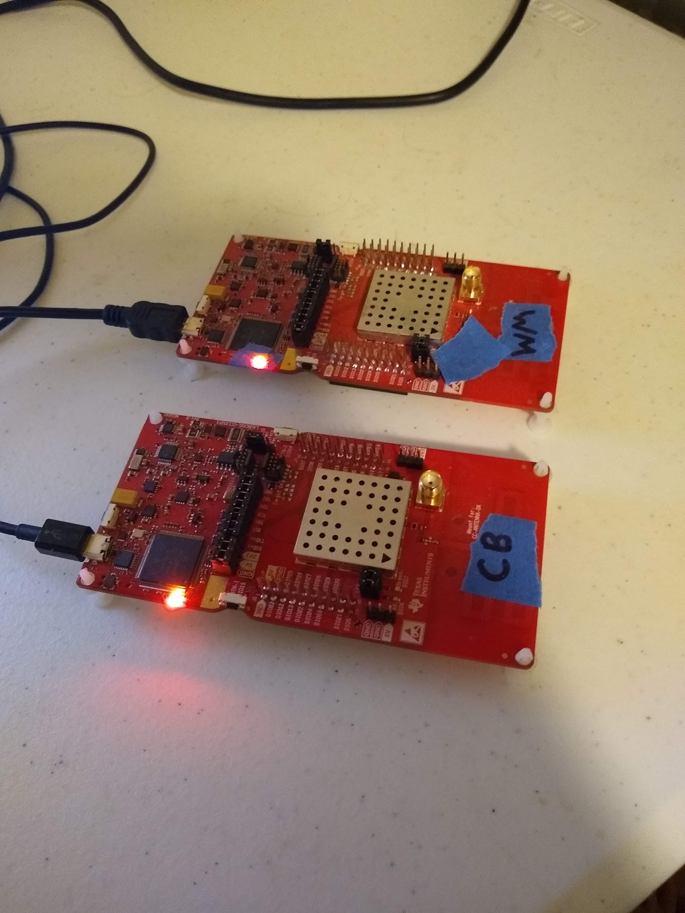
WM continuous TX on varying channels, CB continuous RX on 902.4 MHz. 200kbps PHY

Slide 4
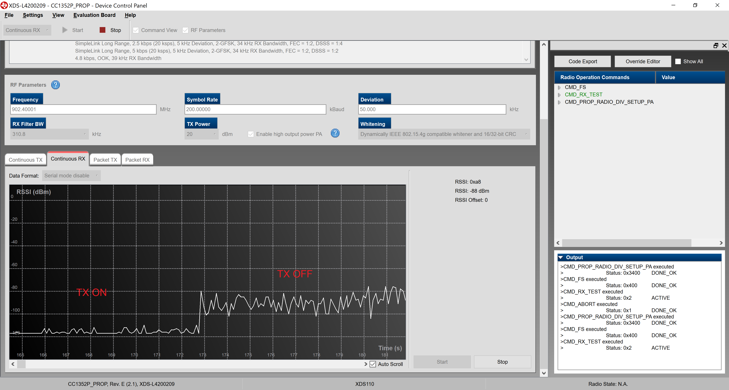
927.6MHz Modulated

Slide 5

915.2 Modulated

Slide 6

904.0 Modulated

Slide 7
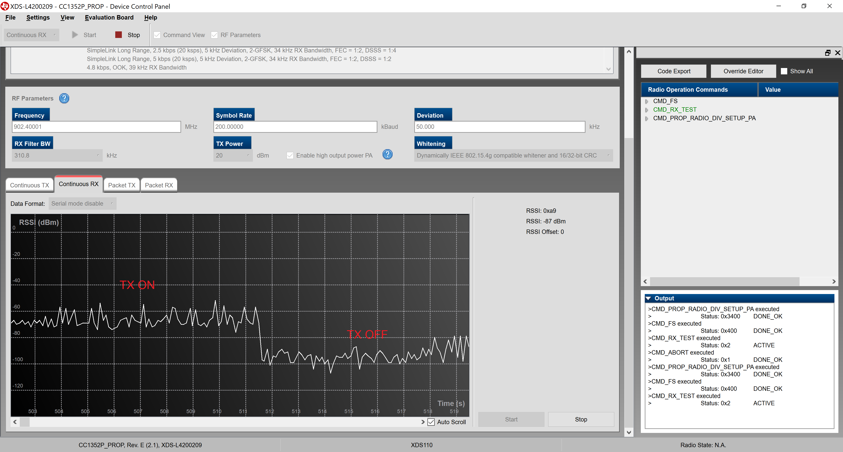
902.8 Modulated

Slide 8

902.4 Modulated

