Slide 1
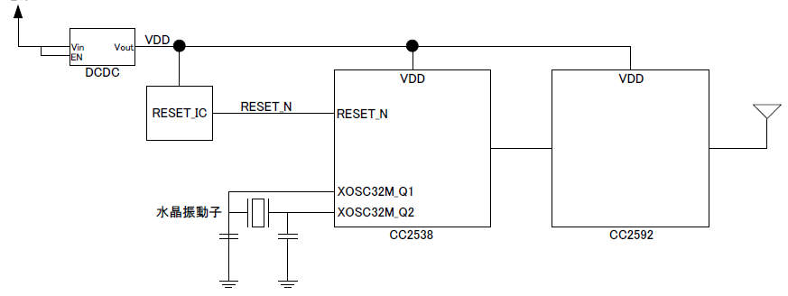
Customer circuit
Vbat
32MHz crystal
Figure 1

Slide 2
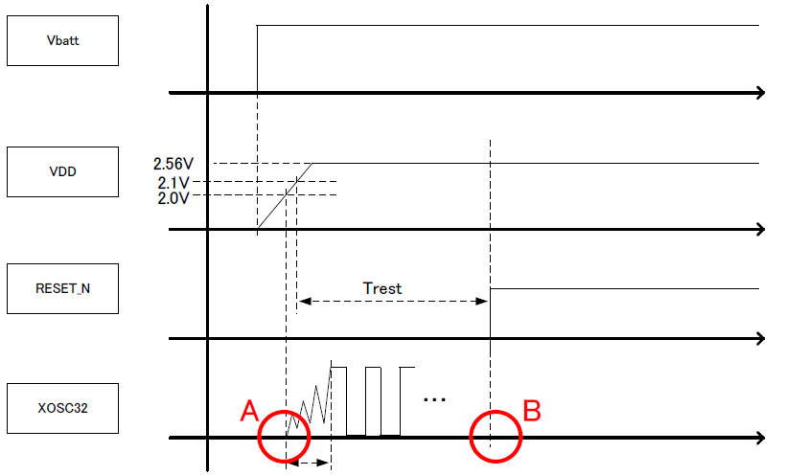
Power up sequence
crystal stabilization time
Which of the points A or point B in Fig.2 does the crystal start?
Figure 2

