Slide 1
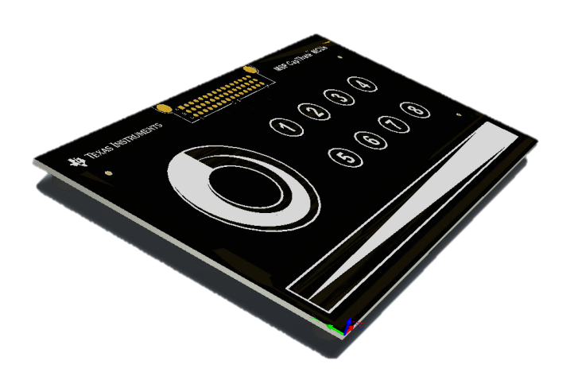
MSP with CapTIvate™ Technology
CapTIvate Signal Conditioning Overview: Tuning the Conversion Gain and Conversion Count Parameters
May 2016
Notes:
[SCRIPT]
MSP with CapTIvate™ Technology

Slide 2
CapTIvate Signal Conditioning Overview
The CapTIvate peripheral, available on certain MSP microcontrollers, contains several unique features for controlling the resolution, sensitivity, and dynamic range of capacitive measurements. These features enable sensing solutions that are highly optimized for a wide variety of design careabouts, such as ultra low power, high sensitivity for thicker overlays, and large parasitic capacitances.
The CapTIvate peripheral features are controlled by setting tuning values in the CapTIvate Design Center and CapTIvate Software Library. This training session will discuss how the peripheral features work, and how to tune them for different applications!

Slide 3
Topics
CapTIvate Charge Transfer
Signal Conditioning: Gain Stage
Signal Conditioning: Offset Subtraction Stage
Runtime Calibration Algorithm

Slide 4
CapTIvate Charge Transfer
How do we measure changes in capacitance?
Notes:
In order to understand how the gain and offset subtraction features of the CapTIvate peripheral benefit an application, we need to first understand the charge transfer process itself.

Slide 5

CapTIvate Charge Transfer
How do we measure changes in capacitance?
Variable
$$q=V C$$
Measured
Fixed

Slide 6
CapTIvate Charge Transfer
Vreg
Electrode Voltage
How do we measure changes in capacitance?
Vtrip
Integration Capacitor Voltage

Slide 7
CapTIvate Charge Transfer
Vreg
Electrode Voltage
How do we measure changes in capacitance?
Vtrip
Integration Capacitor Voltage

Slide 8
CapTIvate Charge Transfer
Vreg
Electrode Voltage
How do we measure changes in capacitance?
1
Vtrip
Integration Capacitor Voltage

Slide 9
CapTIvate Charge Transfer
Vreg
Electrode Voltage
How do we measure changes in capacitance?
1
Vtrip
Integration Capacitor Voltage

Slide 10
CapTIvate Charge Transfer
Vreg
Electrode Voltage
How do we measure changes in capacitance?
1
2
Vtrip
Integration Capacitor Voltage

Slide 11
CapTIvate Charge Transfer
Vreg
Electrode Voltage
How do we measure changes in capacitance?
1
2
Vtrip
Integration Capacitor Voltage

Slide 12
CapTIvate Charge Transfer
Vreg
Electrode Voltage
How do we measure changes in capacitance?
1
2
Vtrip
Integration Capacitor Voltage

Slide 13
CapTIvate Charge Transfer
Vreg
Electrode Voltage
How do we measure changes in capacitance?
1
2
Vtrip
3
Integration Capacitor Voltage

Slide 14
CapTIvate Charge Transfer
Vreg
Electrode Voltage
How do we measure changes in capacitance?
1
2
Vtrip
3
Integration Capacitor Voltage

Slide 15
CapTIvate Charge Transfer
How do we measure changes in capacitance?
When a user touches near the electrode, they present an additional capacitance to the network being measured. This increase causes the total number of charge transfers required to “fill” the integration capacitor to decrease!
This decrease in total number of charge transfers occurs because more charge is moved over during each transfer phase, filling up the integration capacitor more quickly. The CapTIvate Software Library analyzes the number of charge transfers that were required to fill the integration capacitor to determine if a user is present or not.

Slide 16
CapTIvate Charge Transfer
There are a few problems with this method in and of itself:
The input capacitance range of the system is restricted by the size of the integration capacitor.
There is no control over measurement resolution.
A user’s change may only make up a small percentage of the overall electrode capacitance during a touch, making the change in capacitance due to a touch very difficult to detect.
Solution: Gain and offset subtraction signal conditioning!

Slide 17
Topics
CapTIvate Charge Transfer
Signal Conditioning: Gain Stage
Signal Conditioning: Offset Subtraction Stage
Runtime Calibration Algorithm

Slide 18
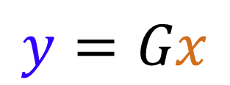
Signal Conditioning: Gain Stage
The gain stage provides the ability to scale the size of the electrode capacitance as it appears to the integration capacitor.
$$y=Gx$$
The charge associated with the input capacitance x is multiplied by the gain ratio G to produce the amount of charge y that is actually transferred to the integration capacitor.
This allows for a fixed size integration capacitor to be used on-chip, as the input capacitance is scaled with respect to it to control the measurement resolution.

Slide 19
Signal Conditioning: Gain Stage
Let’s look at an example case, in which there is:
A 20pF approximate electrode capacitance (varies with PCB layout and nearby conductors)
A 1pF effective touch capacitance (varies with overlay thickness, electrode size, and the user)
A 80pF integration capacitor (on-chip, fixed-size)
With a 1:1 ratio (no gain):
No-touch result: 4
Touched result: 4
Delta: 0
Not enough resolution to detect a touch
With a 24:1 ratio:
No-touch result: 96
Touched result: 92
Delta: 4
Some resolution to detect a touch
With a 240:1 ratio:
No-touch result: 960
Touched result: 920
Delta: 40
Enough resolution to detect a touch

Slide 20
Signal Conditioning: Gain Stage
Note that this example is for illustration only. In a real system, the integration capacitor trips at a different voltage (1.0V) than the voltage being applied to the electrode (1.5V), and there is some amount of tolerance to the size of the integration capacitor.
The important thing is that these factors invisible to the designer and the application, since the gain may be calibrated for each element to achieve the desired measurement resolution, regardless of minor variations in the system. In addition, the system may be recalibrated at runtime to maintain the desired sensitivity even when exposed to temperature and humidity variations.
Notes:
In order to understand how the gain and offset subtraction features of the CapTIvate peripheral benefit an application, we need to first understand the charge transfer process itself.

Slide 21
Signal Conditioning: Gain Stage
CapTIvate contains a coarse gain setting and a fine gain setting, allowing for precise control over measurement resolution.
There are 8 coarse gain steps and 20 fine gain steps, for a total of 160 settings.
Notes:
In order to understand how the gain and offset subtraction features of the CapTIvate peripheral benefit an application, we need to first understand the charge transfer process itself.

Slide 22
Signal Conditioning: Gain Stage
The 160 settings allow for the 10mm self capacitance buttons on the CAPTIVATE-BSWP panel to be configured with this input range:
9 to 892 charge transfers when idle
9 to 845 charge transfers when touched
0 to 47 counts of delta due to a touch
This range represents the application of the lowest transfer ratio setting out to the highest transfer ratio setting in the self capacitance measurement mode.
NOTE: For the proximity sensor on the CAPTIVATE-BSWP panel, the range is 8-331 charge transfers when idle. This is due to the larger parasitic capacitance of that sensor.

Slide 23
Signal Conditioning: Gain Stage
By adding the gain stage in the signal conditioning block, we’ve provided a way to accept a wide variety of input capacitances and control our measurement resolution accordingly.
There’s still one problem, however! Even at the highest ratio, the delta due to a touch for this button is only 47, deviating down from the untouched result of 892. This works out to about a 5.3% change. This is quite consistent with our example application in which we had 20pF of base capacitance and 1pF of touch capacitance (changing the system by 5%). However, we might want more than 47 counts of delta for a slider, wheel, or proximity sensing application. To solve this problem, we need the second stage in the signal conditioning block: the offset subtraction stage.

Slide 24
Topics
CapTIvate Charge Transfer
Signal Conditioning: Gain Stage
Signal Conditioning: Offset Subtraction Stage
Runtime Calibration Algorithm

Slide 25
Signal Conditioning: Offset Subtraction Stage
A challenge with capacitive sensing is overcoming the large difference in magnitude between an electrode’s inherent base capacitance and the capacitance change associated with a touch or proximity event. The touch capacitance (quantity of interest) is often 10-100 times smaller than the base parasitic capacitance of the sensing electrode itself to earth and circuit ground.
$$C_{touch}≪C_{earth}+C_{circuit}$$

Slide 26
Signal Conditioning: Offset Subtraction Stage
As a result, the measurement time becomes very large because the base parasitic capacitance must be measured along with the touch capacitance.
In our earlier example of a 20pF electrode with a 1pF touch, only a 5% change is capacitance is created due to a touch. What is needed is a way to compensate out the large base capacitance, so that the addition of a touch creates a larger percent change in capacitance. For example, if 10pF of the 20pF base capacitance is compensated for, then a 1pF change is now a 10% change in the overall measurement.

Slide 27
Signal Conditioning: Offset Subtraction Stage
The offset subtraction stage provides the ability to subtract a fixed amount of charge during each charge transfer, reducing the effect of the base parasitic capacitance.
$$y=Gx−S$$
The charge associated with the input capacitance x is multiplied by the gain ratio G (as discussed previously). Then a fixed amount S is subtracted off and not brought over into the integration capacitor.
This allows for a portion of the “DC” charge associated with an electrode’s parasitic capacitance to be subtracted out, increasing sensitivity to changes in capacitance.

Slide 28
Signal Conditioning: Offset Subtraction Stage
Integrated ↑
Subtracted Off →

Slide 29
Signal Conditioning: Offset Subtraction Stage
Since charge is removed each time a charge transfer step is performed, the total number of charge transfers required to “fill” the integration capacitor will increase as the amount of offset subtraction applied increases. This is because less charge is moved over each time!

Slide 30
Signal Conditioning: Offset Subtraction Stage
This results in an increase in the delta due to a touch as offset subtraction is added!

Slide 31
Topics
CapTIvate Charge Transfer
Signal Conditioning: Gain Stage
Signal Conditioning: Offset Subtraction Stage
Runtime Calibration Algorithm

Slide 32
Runtime Calibration Algorithm
As a designer, you don’t need to select the coarse gain, fine gain, and offset subtraction tap at all! This would be very time consuming because it would need to be done for every electrode individually.
Instead, the CapTIvate Software Library contains a runtime calibration algorithm that will automatically tune these parameters based on common inputs for all of the elements within the sensor.
Runtime Calibration Algorithm
CAPT_calibrateSensor()
CAPT_calibrateSensorWithEMC()
→ Coarse Gain [ ]
→ Fine Gain [ ]
→ Offset Tap [ ]
Conversion Count →
Conversion Gain →

