Slide 1
MSP430FR6989 Engineer’s Note
Enhances Scan Interface on 3LC Sensors;
Error types, Signal patterns, State machines…
Johann Zipperer
July 2018

Slide 2
Disclaimer
It is the purpose of this “Engineer’s Note” to show in simple cases the behavior of devices. It is not intended to show electrical or timing limits nor other performance values. It’s rather the opposite…
In some cases the device is operated out of specification limits to show a complex behavior on a single slide or picture.
The setups shown are simple and do not differ much of the ones you can quickly setup in your lab yourself. This one shown here just is documented and consumes less time from you.
This “Engineer’s Note” is also meant to be used as source material for “White Papers”, “Application Notes” and “Technical Briefs” when common interests are sensed and found suitable.
This paper is neither reviewed nor corrected for grammar and spelling

Slide 3
Problems/Questions Addressed…
2-LC Sensors for rotation pickup are widely addressed on TI papers…
Quadrature decoder state machines are documented well on the internet.
Focused here are state machines for 3LC sensor systems, their use cases, their possible error patterns, and its corresponding signals. We also show some example state machines…
Not addressed here:
- timing state machine (widely addressed SLAA639)
- picking proper components (addressed in SLAA642)
- ESI-Osc calibration (addressed in SLAA609)
Notes:
PES View consists of six panes entitled ‘Scorecard’, ‘Milestones’, ‘Status’, ‘Manufacturing’, ‘Financials’ and ‘High Priority Actions’.
Place a link to the archived version of the PES view (every PM should be archiving the PES view at each monthly review) on top right corner of the slide

Slide 4
Prerequisite
Read and understand the DS of the ‘FR6989 device and the ESI chapter in UG
Understand the ESI basic function. Including base knowledge of physics…
Have read through the code of the ‘FR6989 EVM demo on 2LC solution, and played with it…

Slide 5
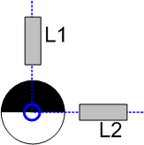
2D LC-Systems Recap….
A rotation pick up circuit with the ESI module uses in our cases 2 or three LC tank circuits. Inductor geometries of the tank is chose to be very sensitive to field distortions caused by an pieces of metal nearby. The ESI interface this can sense the presence of a metal and depending on the sensing pattern a rotation is detected.
After the final application is assembled the sensitivity is adjusted for good relative detection strengths.
For a 50/50 pattern shape during test rotations a rel. detection rate of 30-70% is expected.
Occasional recalibration during operation may be used to adjust the sensitivity throughout the live of the application in the field.
In the optimal case the axis of the rotor is aligning with the center line intersection of the both inductors. The rotor is mounted flat on the rotation axis and is not tilted to the mounting plane of the inductors.

Slide 6
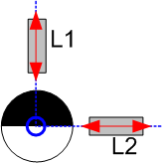
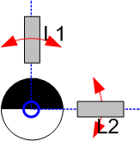
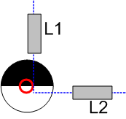
2-LC Systems mech. problems….
(1)
perfect
(1) A perfect aligned mechanic systems shows same sensitivity on both coils, the angles are detected exactly as predicted by design. The calibration functions has no problems to adjust the DAC values to achieve 50% rel. reading.
(2) High manufacturing spread in positioning of the inductors lead to a sensitivity spread in the series. The calibration SW cannot find the optimum values anymore. Static variations can be caused by missing soldering fixtures, unit spread of inductor itself, asymmetry of magnetic properties e.g. if 180deg turned, geometry center of component does not match magnetic center; Temperature changes during operation, environmental fields during operation. Dynamic variations may be caused by misaligned axis (leaning), wobbly wheels etc.
(3) Angular misalignments can cause higher sensitivity in one axis than other; the angle resolution of the decoder is distorted. This could be caused by leaning coils (bent wires), magnetic asymmetry of component and/or PCB layout…
(4) Axial misalignment leads to an elliptic sensitivity that can be widely compensated by the calibration software. But in extreme cases the sensed signal patterns of L1 vs L2 differ a lot (appear distorted).
(2) variable distance
(3) angular misalignment
(4) axial misalignment

Slide 7
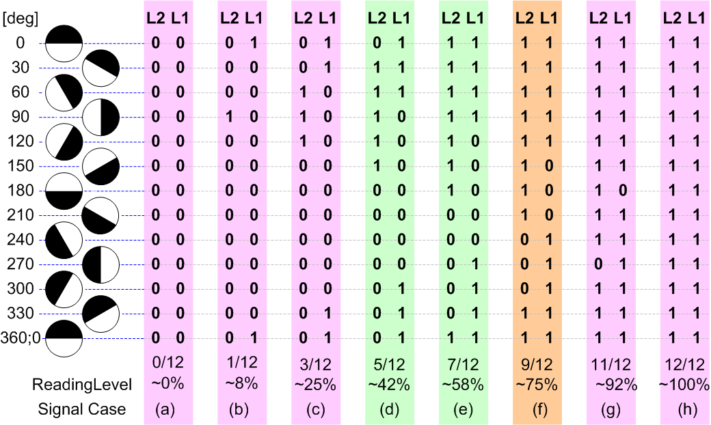
Signal patterns from weak to strong readings
When calibrated properly, the signal patterns detected would look like in the cases (d) and (e).
When the signal weakens the sequence of the patterns changes, and a reliable direction detection is not possible anymore cases (a)-(c).
When for some reason the sensitivity of the pickup system increases, the signal pattern would appear as in case (g) and (h). A direction detection is not possible anymore. For a reliable direction detection on an 90deg coil arrangement we need a rel. reading strength of approx. 30% to 70% (leaving 5% margin on both sides).
In our case a little above 25% up to 75% a reasonable pattern would be detectable. However high rotation speeds and/or to slow scan rates could cause that interims states are missed; therefore leave enough margin to make sure by increasing scan rate, improving reading, or lowering the max. rotation allowance for safe reading

Slide 8
Some environmental conditions e.g. temperature or static magnetic fields cause that the sensed signal strengths in the true application differs a lof from the lab conditions. Therefore care has to be taken…

Slide 9
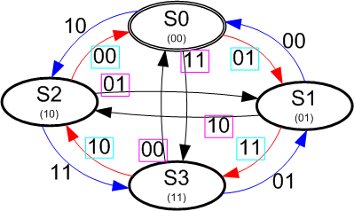
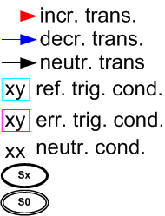
2LC State Machine as on ‘FR6989 EVM demo
FR6989 EVM example default
for.. | ESIPSM.ESIV2SEL=1 & ESIQ6EN=0
Data[hex] | St.Tr | Data [bin] [7..0] |  |  |  |  |  |  |  | Tr.=>next St | Action | Why
0x00 | S0.00 | 0 | 0 | 0 | 0 | 0 | 0 | 0 | 0 | 00=>S0 | . | static
0x43, | S0.01 | 0 | 1 | 0 | 0 | 0 | 0 | 1 | 1 | 01=>S1 | +; I6 | right turn
0x0C, | S0.10 | 0 | 0 | 0 | 0 | 1 | 1 | 0 | 0 | 10=>S2 | -; | left turn
0x89, | S0.11 | 1 | 0 | 0 | 0 | 1 | 0 | 0 | 1 | 11=>S3 | I7 | cross
0x04, | S1.00 | 0 | 0 | 0 | 0 | 0 | 1 | 0 | 0 | 00=>S0 | -; | left turn
0x01, | S1.01 | 0 | 0 | 0 | 0 | 0 | 0 | 0 | 1 | 01=>S1 | . | static
0x88, | S1.10 | 1 | 0 | 0 | 0 | 1 | 0 | 0 | 0 | 10=>S2 | I7 | cross
0x4B, | S1.11 | 0 | 1 | 0 | 0 | 1 | 0 | 1 | 1 | 11=>S3 | +;I6 | right turn
0X42, | S2.00 | 0 | 1 | 0 | 0 | 0 | 0 | 1 | 0 | 00=>S0 | +;I6 | right turn
0X81, | S2.01 | 1 | 0 | 0 | 0 | 0 | 0 | 0 | 1 | 01=>S1 | I7 | cross
0X08, | S2.10 | 0 | 0 | 0 | 0 | 1 | 0 | 0 | 0 | 10=>S2 | . | static
0X0D, | S2.11 | 0 | 0 | 0 | 0 | 1 | 1 | 0 | 1 | 11=>S3 | -; | left turn
0X80, | S3.00 | 1 | 0 | 0 | 0 | 0 | 0 | 0 | 0 | 00=>S0 | I7 | cross
0X05, | S3.01 | 0 | 0 | 0 | 0 | 0 | 1 | 0 | 1 | 01=>S1 | -; | left turn
0X4A, | S3.10 | 0 | 1 | 0 | 0 | 1 | 0 | 1 | 0 | 10=>S2 | +;I6 | right turn
0X09 | S3.11 | 0 | 0 | 0 | 0 | 1 | 0 | 0 | 1 | 11=>S3 | . | static
Shown here is the 2LC state machine as implemented on the ‘FR6989 EVM demo. The red marked transitions build a state ring for mathematical negative rotation direction. The blue state ring for mathematical positive direction. Bit6 is used for update indication, Bit7 for error indication. Here only right turning rotations are indicated as interrupt….

Slide 10
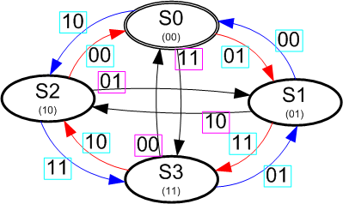
2LC Alternate State machine as of EVM demo
FR6989 EVM example commented out
for.. | ESIPSM.ESIV2SEL=1 & ESIQ6EN=0
Data[hex] | St.Tr | Data [bin] [7..0] |  |  |  |  |  |  |  | Tr.=>next St | Action | Why
0x00, | S0.00 | 0 | 0 | 0 | 0 | 0 | 0 | 0 | 0 | 00=>S0 | . | static
0x43, | S0.01 | 0 | 1 | 0 | 0 | 0 | 0 | 1 | 1 | 01=>S1 | +;I6 | right turn
0x4C, | S0.10 | 0 | 1 | 0 | 0 | 1 | 1 | 0 | 0 | 10=>S2 | -;I6 | left turn
0x89, | S0.11 | 1 | 0 | 0 | 0 | 1 | 0 | 0 | 1 | 11=>S3 | I7 | cross
0x44, | S1.00 | 0 | 1 | 0 | 0 | 0 | 1 | 0 | 0 | 00=>S0 | -;I6 | left turn
0x01, | S1.01 | 0 | 0 | 0 | 0 | 0 | 0 | 0 | 1 | 01=>S1 | . | static
0x88, | S1.10 | 1 | 0 | 0 | 0 | 1 | 0 | 0 | 0 | 10=>S2 | I7 | cross
0x4B, | S1.11 | 0 | 1 | 0 | 0 | 1 | 0 | 1 | 1 | 11=>S3 | +;I6 | right turn
0x42, | S2.00 | 0 | 1 | 0 | 0 | 0 | 0 | 1 | 0 | 00=>S0 | +;I6 | right turn
0x81, | S2.01 | 1 | 0 | 0 | 0 | 0 | 0 | 0 | 1 | 01=>S1 | I7 | cross
0x08, | S2.10 | 0 | 0 | 0 | 0 | 1 | 0 | 0 | 0 | 10=>S2 | . | static
0x4D, | S2.11 | 0 | 1 | 0 | 0 | 1 | 1 | 0 | 1 | 11=>S3 | -;I6 | left turn
0x80, | S3.00 | 1 | 0 | 0 | 0 | 0 | 0 | 0 | 0 | 00=>S0 | I7 | cross
0x45, | S3.01 | 0 | 1 | 0 | 0 | 0 | 1 | 0 | 1 | 01=>S1 | -;I6 | left turn
0x4A, | S3.10 | 0 | 1 | 0 | 0 | 1 | 0 | 1 | 0 | 10=>S2 | +;I6 | right turn
0x09 | S3.11 | 0 | 0 | 0 | 0 | 1 | 0 | 0 | 1 | 11=>S3 | . | static
The state machine here indicates rotation in both directions via Bit6 interrupt.
Note!: Bit6 as successful motion detection and
Bit7 as error indication come exclusive from each other
Using Bit6 and Bit7 as vector would allow an 3rd interrupt event !!!

Slide 11
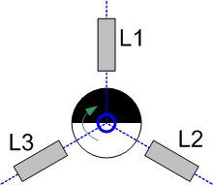
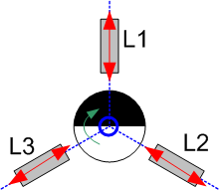
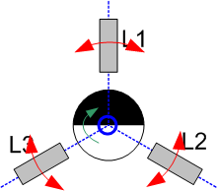
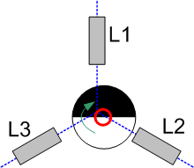
3LC vs. 2LC Systems
(1)
perfect
3LC systems are used for two main purposes
finer angular resolution here 60deg vs. 90deg
higher sensitivity; therefore larger distances possible between wheel & coils
Higher dynamic range when using advanced state machines like bi-modal
or with observers/predictors
In general the same signal pattern problems are can be show as with 2LC systems.
Analyzing the signal patterns reveals that different type of sequences can be used to decode rotation and direction…
In case (B) and (C) a simple state machine can be used with 120deg angular resolution (good for relative reading strengths 7.5% - 25% )
Cases (G) and (H) allow a 60deg angular resolution (here for relative reading strength of 40-60%)
Cases (M) and (N) are theoretically possible with 120deg angular resolution; such large signals are rather exotic cases and are not further considered. The corresponding state machine would look similar as the one for cases (B) and (C)…
A wide range state machine that combines for (B,C) and (G,H) would allow a relative reading strength from 7.5%... 60% at an angular resolution of 120deg.
(2) variable distance
(3) angular misalignment
(4) axial misalignment

Slide 12
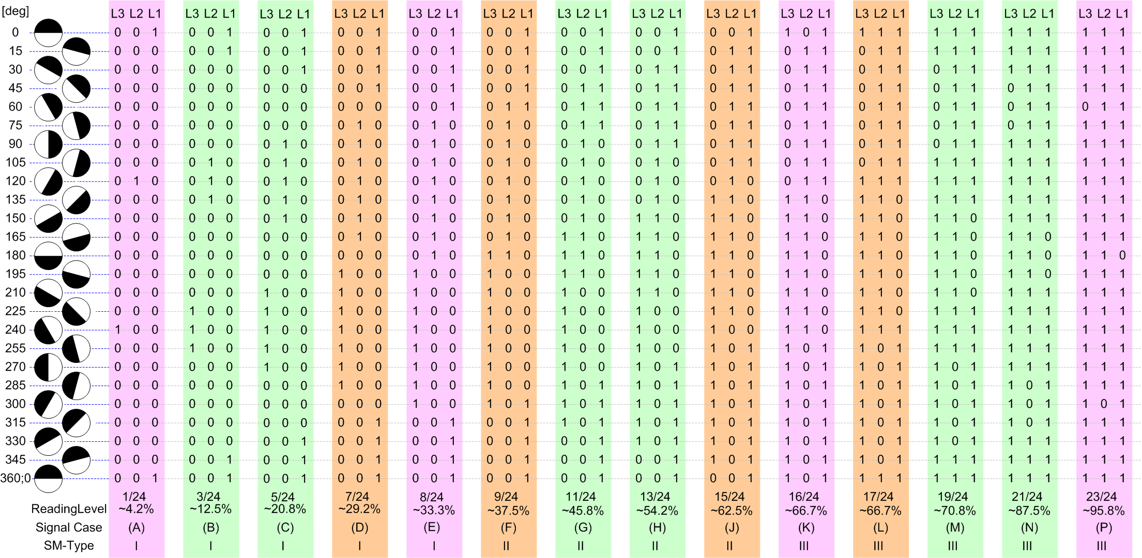
Three LC Sensor State Machine Signal Pattern

Slide 13
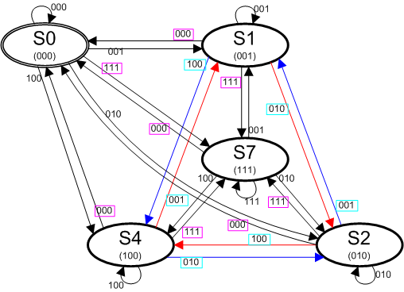
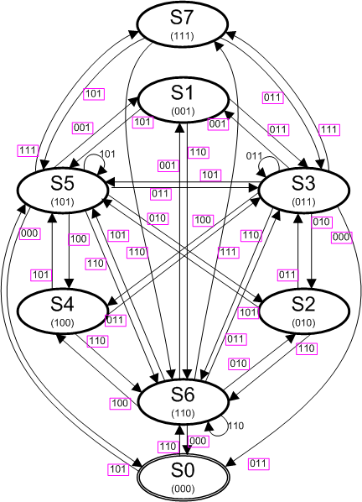
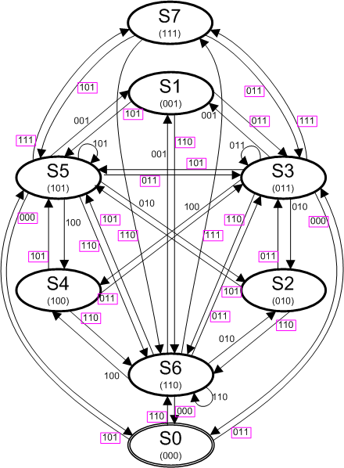
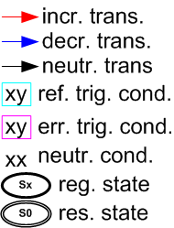
Three Sensor State Machine for… 120deg res.; indic. in both directions; all faulty state transitions detected (Type I SM)
This state machine is designed for signal cases (B) and (C).
You can see both state rings for positive and negative direction. In the above case (1) all undesired transitions trigger errors;
In the below case (2) errors are indicated only if the expected state rings are left.
This reduces the overall error int. handling
(1)
(2)

Slide 14
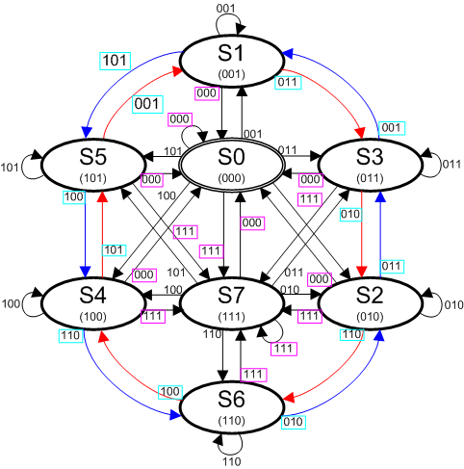
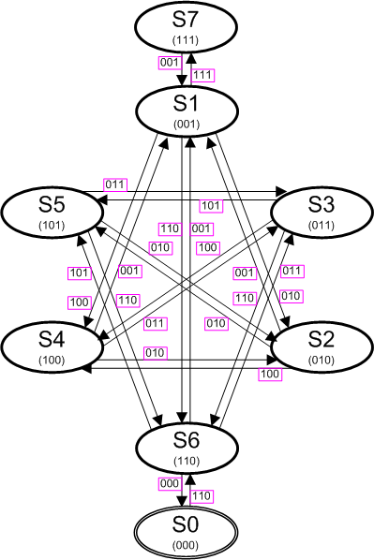
Three Sensor State Machine for… 60deg res.; indic. in both directions; all faulty state transitions detected (Type II SM)
This state machine is designed for signal cases (G) and (H).
You can see both state rings for positive and negative direction. Errors are indicated on transitions that change at least two readings, and do not return to the valid state rings…

Slide 15
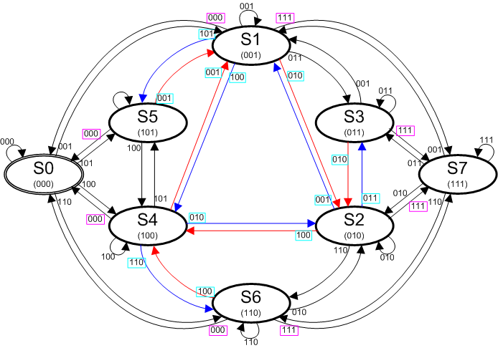
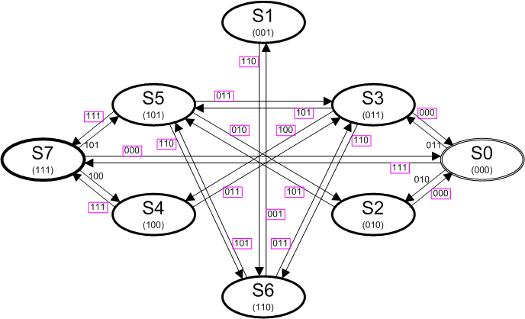
Three Sensor Bimodal State Machine for… 120deg res.; ind. In both directions; all faulty state transitions detected (Type I/II SM)
This state machine features the state rings of both state machines shown before. The direct transition from S1➔S2 is causing the same increment value as the transition S1➔S3➔S2.
Little back and forth movements do not cause counting errors due to the behavioral action symmetry in this state machine.
The angular resolution is 120deg
Idea!:
this state machine could be extended by coding BIT6 and BIT7 as 2bit vector to indicate large and little steps. A SW counter would then keep the correction values.. Such a state machine would the resolve 60deg (use also the inc/dec bit combo for software decoding…).

Slide 16
Backup
Idea for an even more complex approach!:
Use Bit6 as additional state address allows 16 states, and two state rings in both direction; the actual ring selection for a direction represents the history of the observer/estimator; the new inputs now allow to select between four valid state rings, two for each direction. Interrupts are fired to indicate wrong assumptions (in our case with 3LC sensors and one bit history a 16.6% rate of wrong assumptions is expected). Those are counted and corrected in SW.
Implementation is not shown jet…. check literature on (“Beobachter / Abschätzglieder” , in German control theory literatur)

