Slide 1
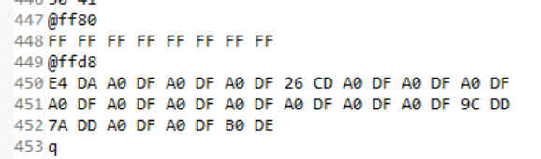
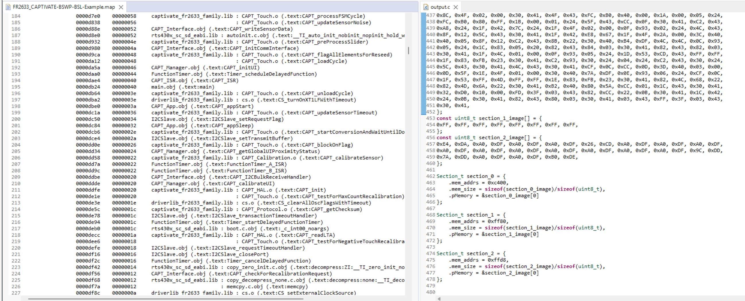
My application .txt
Vector table and Reset @ 0xFFFE
My application .map
My image file “output.c”

