Slide 1
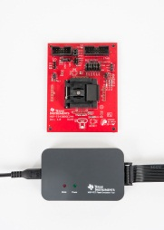
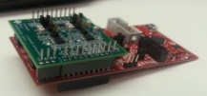
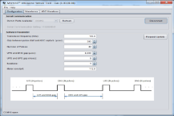
MSP430FR6043 MCU
MSP430FR6043
Temperatures | -40°C to 85°C
Voltage | 1.8V-3.6V
Features/Benefits
MSP430FR6043
16-bit
Up to 16 MHz
Metrology solution for Gas with best performance & low power
  < 1ns Zero Flow Drift
  < 4ns Standard Deviation
  <20 uA average measurement current
Ultrasonic Sub-system ( Integrated High Performance SD-ADC, Pulse Position Generator & Integrated PHY ) with Software Library Support
LEA ( Low Energy Accelerator ) for optimizing power
MTIF ( Metering Test Interface Module ) running in Sleep Mode
64 & 80-pin package options
Memory
Power & Clocking
Up to 64 KB FRAM (with segment protections
for code/data)
PMM with BOR, POR,PUC &SVS
System Module
Up to 12KB SRAM
LFXT, HFXT
MPY32
8KB Shared RAM for LEA
DCO, REFO, VLO
Data Protection
FLL
CRC16 / 32
Debug
Data Processing
Embedded Emulation
LEA
Serial Interface
Real-time JTAG/SBW
4 × UART + IrDA or SPI
Bootstrap Loader
IOs
2× I²C or SPI
Up to 64 GPIOs
Analog
Timers
Tools
USS Module
( PPG, PGA
12 bit 8MSPS SDHS )
12bit SAR ADC, COMP
Watchdog Timer
LCD Driver
MSP-FET:
Upto 248 Segments
MSP-TS430xxxx
- 80-pin target socket board
MSP-FET: Flash emulation tool
1× 16 bit TA w/ 5CC regs
  Gas Meter EVM
1 × 16 bit pure TA w/ 3CC
Real-Time Clock with calendar mode
Packages
64-pin QFN / LQFP
80-pin LQFP
MTIF in LPM3.5 mode
Target Applications
Ultrasonic Flow Meters
( Gas, water & Heat )
Distance Measurement
Occupancy Detectors
Level Sensing
Software
USS Software Library, GUI
MSP430Ware
TI Information - Selective Disclosure
Notes:
Target Applications, (Make Tools/Software -> Ecosystem)
MSP-FET:

