Slide 1
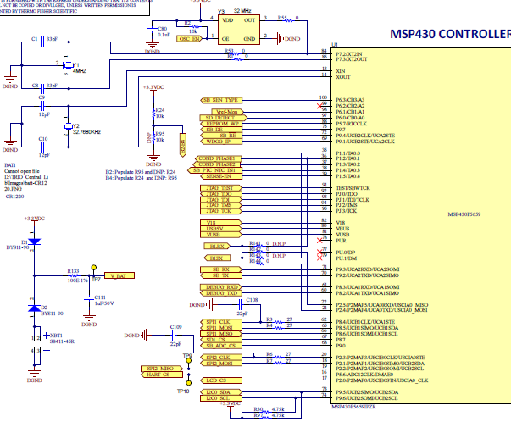
Schematic: Y1, Y3 are not used in the design, we are using Y2, 32.768K for 20MHz clock generation

Slide 2
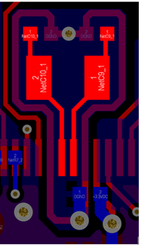
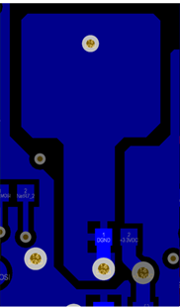
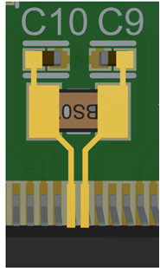
Layout snaps
TOP
BOTTOM
3D-TOP

