Slide 1
MSP with Captivate™ Technology Match electrode sensitivity using Ref Cap Example Algrorithm Dennis Lehman, MSP430 Applications Date 06/12/2020

Slide 2
Purpose
It is very common for multiple element sensors, such as keypads, sliders and touchpads to have elements with different sensitivities due to their individual parasitic capacitances
In most cases the default calibration method can offset these various parasitics to recover the required sensitivity based on the “target” conversion count
Doing it this way achieves a near equal sensitivity for all elements, but for some the sensitivity can vary dramatically from element to element
For keypads, this not much of an issue, but for slider and Touchpad sensors this can impact their linear performance.
Instead, calibrating to a desired “delta” count (using a know applied capacitance) allows each element to be tuned with more equal sensitivity, resulting in widely varying “target” conversion counts.

Slide 3
Limitations
The example code is provided as a concept demonstration and has not been validated 100% - “use at your own risk”
Adds 168 additional bytes of FRAM
6554 vs 6386
Slower than traditional calibration
Across temperature, each element’s sensitivity to temperature changes will be different

Slide 4
How To
Add CAPT_Sandbox.c and CAPT_Sandbox.h to project
Add #include <CAPT_Sandbox.h> to CAPT_Manager.c
Modify the following calibration parameters in Sandbox.h
To use default calibration
set CALIBRATION_METHOD (DEFAULT_CALIBRATION)
To use RefCap calibration
set CALIBRATION_METHOD (REFCAP_CALIBRATION)
Modify RefCap value (use 1pF or 1.5pF) (5pF too large in most cases)
Modify your target delta

Slide 5
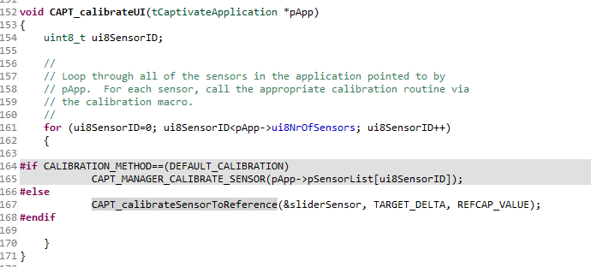
How To
Modify CAPT_Manager.c in 2 locations
Location #1
Substitute sliderSensor with your sensor name

Slide 6
How To
CAPT_Manager.c, Location #2
Substitute sliderSensor with your sensor name
.
.
.

Slide 7
Procedure to determine delta counts
In Sandbox.h, set CALIBRATION_METHOD (DEFAULT_CALIBRATION)
Test your sensor’s response and record deltas when finger touched
Ex. {50, 42, 25, 53}
Let’s say 3 of the 4 electrodes provide adequate delta to meet minimum touch and proximity thresholds
Use 50 as the desired delta count
In Sandbox.h, set CALIBRATION_METHOD (REFCAP_CALIBRATION)
Re-test your sensor’s response and verify all elements respond with approx. 50 counts of delta
Keep in mind depening on how the finger touches each element you may see some values greater or less than 50 at times.

Slide 8
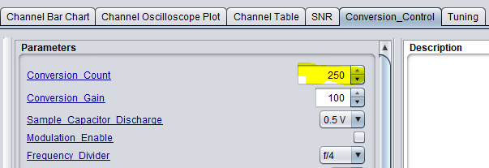
CapTIvate Design Center GUI
This parameter no longer applies – do not adjust when using RefCap calibration

Slide 9
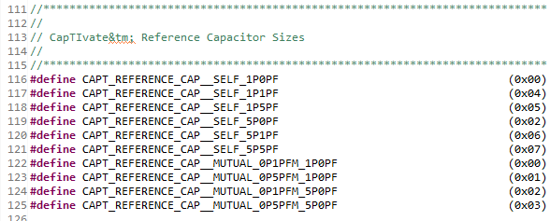
RefCap Values
From CAPT_HAL.h

Slide 10
Code attached

