Slide 1
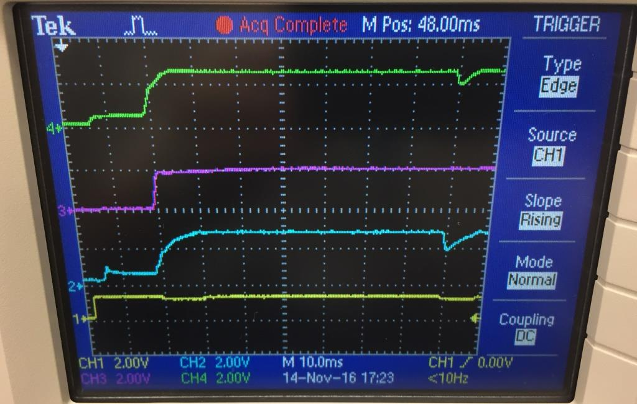
DVCC, DVIO Power ramp-up waveform 10msec/div
Ch4:
DVCC
(2.5V)
Ch3:
DVIO
Ch1:
Battery

Slide 2
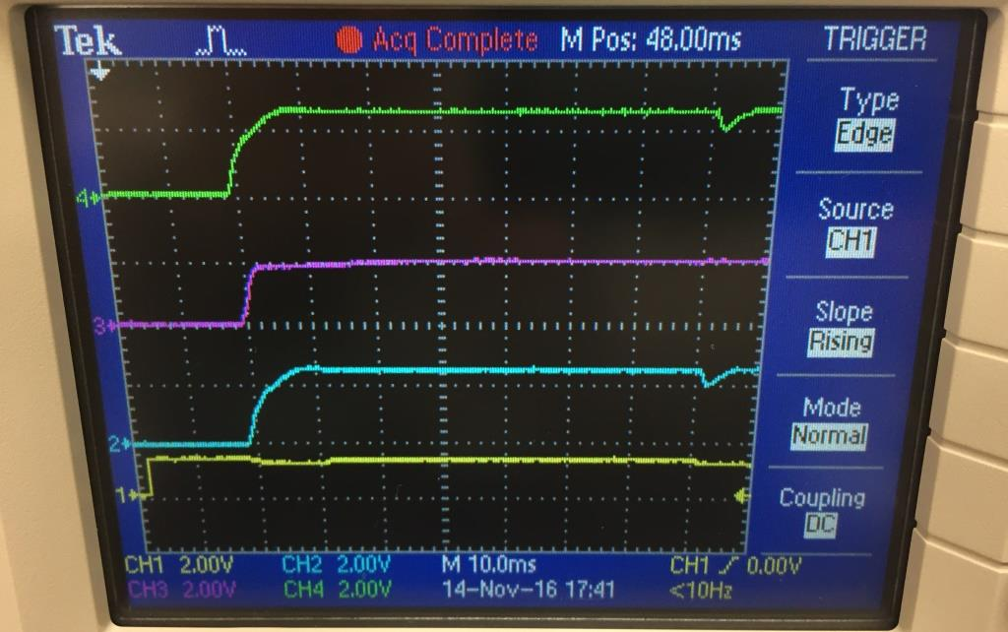
AVCC, DVIO Power ramp-up waveform 10msec/div
Ch4:
AVCC
(2.5V)
Ch3:
DVIO
Ch1:
Battery

