Slide 1
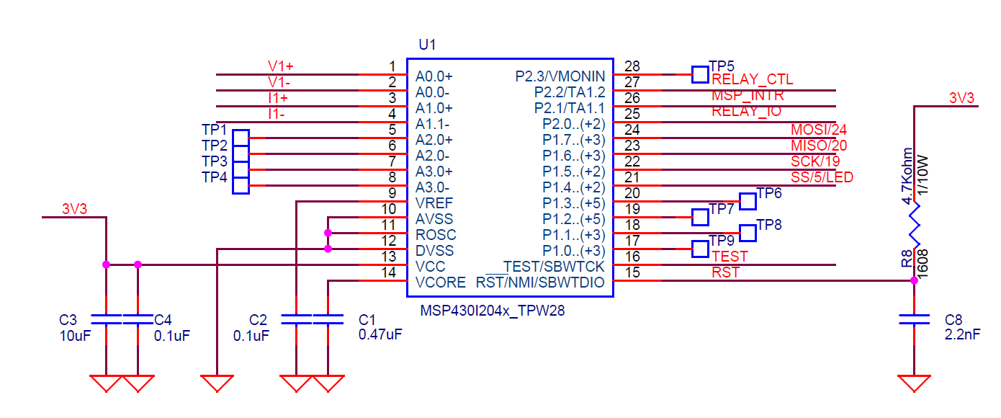
1st
→ Board : MSP-430G2 Launch Pad / MSP-FET Flash Emulation Tool
→ Program : IAR Embedded Workbench / Code Composer Studio 8.1.0
→ Result : target not detected

Slide 2
2nd
47kΩ
10nF
→ Board : MSP-430G2 Launch Pad / MSP-FET Flash Emulation Tool
→ Program : IAR Embedded Workbench / Code Composer Studio 8.1.0
→ Result : target not detected

Slide 3
3rd
MSP430i2041
1
28
10
2.2nF/10nF
11
GND
12
VDD
13
47kΩ
16
TEST
14
15
RST
→ Board : MSP-430G2 Launch Pad / MSP-FET Flash Emulation Tool
→ Program : IAR Embedded Workbench / Code Composer Studio 8.1.0
→ Result : target not detected

Slide 4
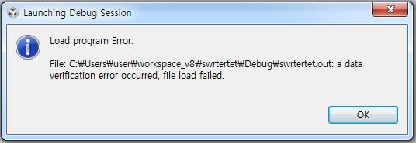
4th
MSP430i2041
1
28
20
TDO
10
2.2nF/10nF
19
TDI
11
18
TMS
GND
12
17
TCK
VDD
13
47kΩ
16
TEST
14
15
RST
→ Board : MSP-430G2 Launch Pad / MSP-FET Flash Emulation Tool
→ Program : IAR Embedded Workbench / Code Composer Studio 8.1.0
→ Result : data verification error

