Slide 2
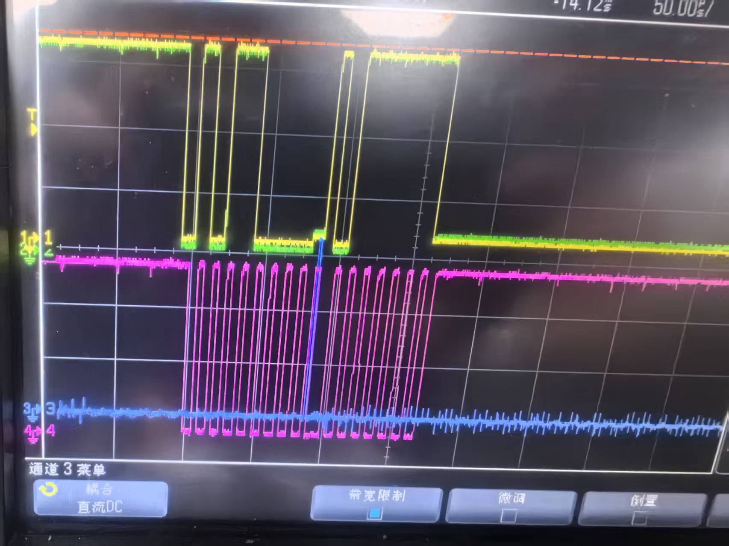
3600W LLC F280025 I2C issue
PC host send address 0xB0+ command 0x7F to I2C slave F280025 (100k bps), and then run I2C slave F280025 will pull SDA low (Marked yellow), I2C received ISR doesn’t trigger (Marked blue), also will pull SCL high (Marked Pink).
-1.Customer does not used FIFO, used RX/TX Buffer
Transmit and Receive by I2C received ISR.
-2.This issue can be remove by power cycle,
but will happen randomly again.
0xB0
0x7F
(Yellow: SDA; Pink: SCL; Blue: I2C received ISR toggle when 9 clock happen)

Slide 3
3600W LLC F280025 I2C Init code
void InitI2C(void)
{
//Initialize I2C IO
InitI2CGpio();
// Initialize I2C
I2caRegs.I2CMDR.bit.IRS = 0; //复位I2C模块，I2CSTR各个位复位到默认状态
I2caRegs.I2COAR.all = 0x58; //I2C own address register
I2caRegs.I2CMDR.bit.DLB = 0; //Digital loopback mode is Disabled
I2caRegs.I2CMDR.bit.MST = 0; //Slave mode
I2caRegs.I2CMDR.bit.XA = 0; //7-bit addressing mode
I2caRegs.I2CMDR.bit.FDF = 0; //Free data format mode is disabled
I2caRegs.I2CMDR.bit.FREE = 1; //The I2C module runs free
I2caRegs.I2CSAR.all = 0x59; // the 7-bit slave address that the I2C module transmits when it is in the master-transmitter mode.ode
// 100MHz
// master clock frequency = --------------------------- =100kHz
// (IPSC+1)[(ICCL+5)+(ICCH+5)]
I2caRegs.I2CPSC.all = 9; // I2C prescaler divide-down value
I2caRegs.I2CCLKL = 45; // Clock low-time divide-down value,NOTE: must be non zero
I2caRegs.I2CCLKH = 45; // Clock high-time divide-down value,NOTE: must be non zero
I2caRegs.I2CCNT=0x000; //Data count value
I2caRegs.I2CMDR.bit.IRS = 1; //The I2C module is enabled,Take I2C out of reset
DELAY_US(3000);
// I2caRegs.I2CDXR = 0x00; //Load data to clear XRDY flag
I2caRegs.I2CIER.bit.AAS = 1; //Addressed as slave interrupt enable
I2caRegs.I2CIER.bit.RRDY = 1; //Receive-data-ready interrupt enable
I2caRegs.I2CIER.bit.XRDY = 0; //Transmit-data-ready interrupt enable
// I2caRegs.I2CIER.bit.ARBL = 0;
// I2caRegs.I2CIER.bit.NACK = 0;
// I2caRegs.I2CIER.bit.SCD = 0;
// I2caRegs.I2CIER.bit.rsvd = 0;
I2caRegs.I2CEMDR.bit.FCM = 0;
I2caRegs.I2CCNT =0x0000;
I2caRegs.I2CFFTX.bit.I2CFFEN = 0;
EALLOW;
PieVectTable.I2CA_INT = &cpu_i2c_isr; //重映射中断服务函数
EDIS;
IER |= M_INT8; //I2C FIFO Interrupt
PieCtrlRegs.PIEIER8.bit.INTx1 = 1; //连接Y中断里的第几位
}

Slide 4
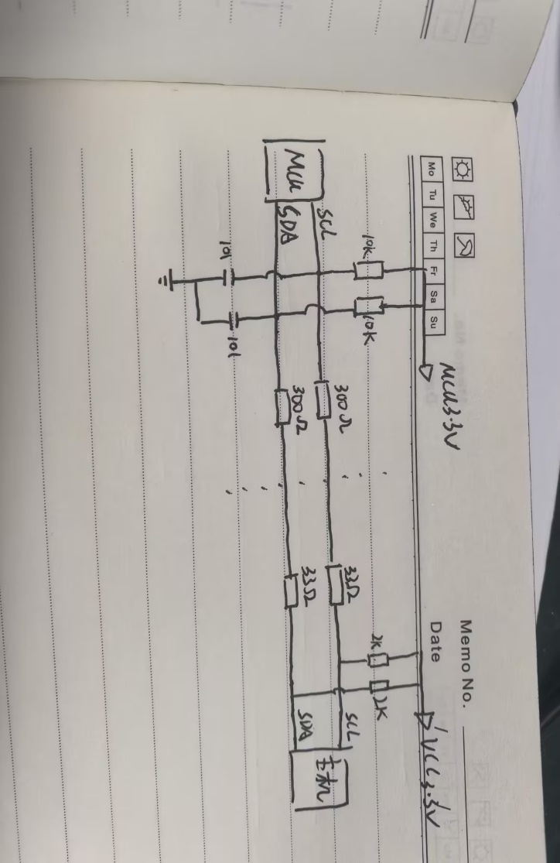
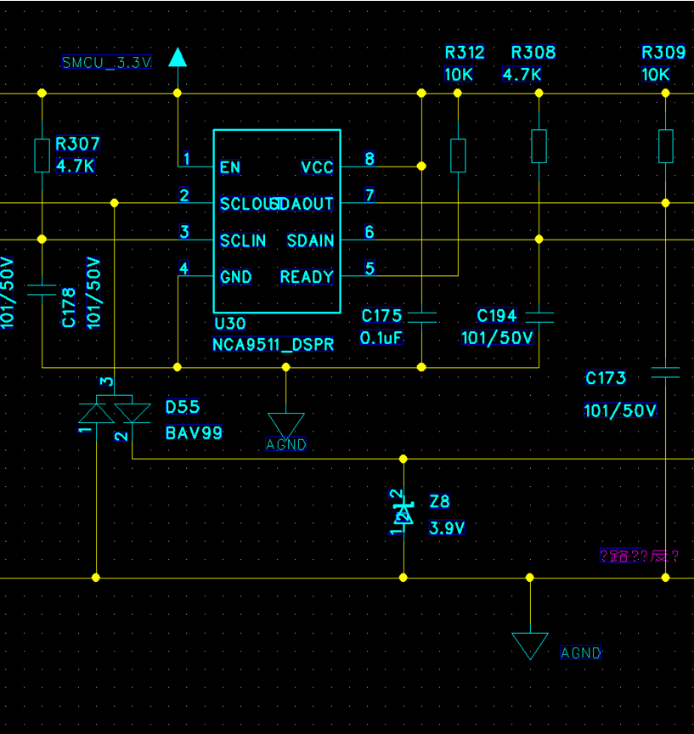
3600W LLC F280025 I2C Hardware Schematic

