Slide 1
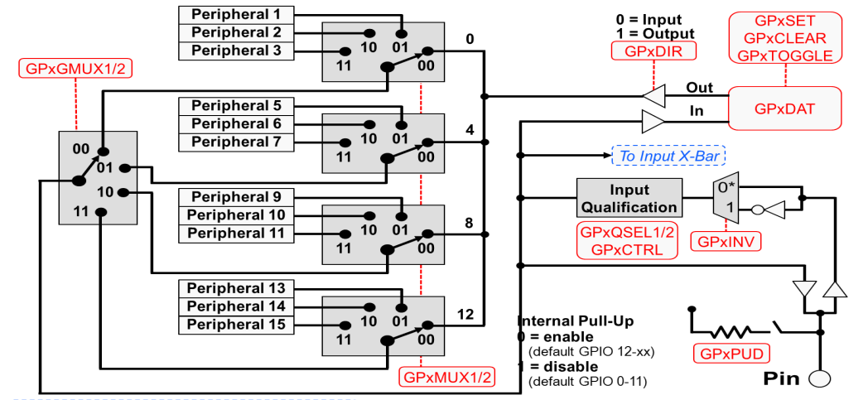
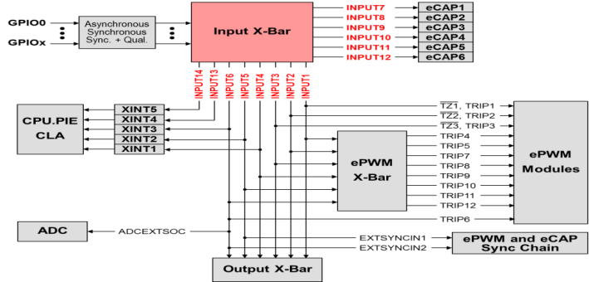
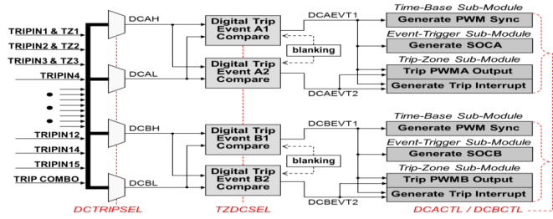
Digital Compare Sub-Module Signals
F28x7x GPIO Pin Block Diagram
F28x7x GPIO Input X-Bar
1
Output X-Bar muxed with Peripheral GPIO pins
2
3
Trip-Zone Features
Trip-Zone has a fast, clock independent logic path to high-impedance the EPWMxA/B output pins
Interrupt latency may not protect hardware when responding to over current conditions or short-circuits through ISR software
Supports: #1) one-shot trip for major short circuits or over current conditions #2) cycle-by-cycle trip for current limiting operation
Digital compare module inputs are:
Input X-Bar / ePWM X-Bar / Trip-zone input pins
A compare event is generated when one or more of its selected inputs are either high or low
Optional ‘Blanking’ can be used to temporarily disable the compare action in alignment with PWM switching to eliminate noise effects
Over
Current
Sensors
CPU
core
P
W
M
O
U
T
P
U
T
S
Digital
Compare
EPWMxTZINT
EPWMxA
INPUT X-Bar
Cycle-by-Cycle
Mode
ePWM X-Bar
eQEP1
TZ4
EQEP1ERR
EPWMxB
SYSCTRL
TZ5
CLOCKFAIL
One-Shot
Mode
CPU
TZ6
EMUSTOP

