Slide 1
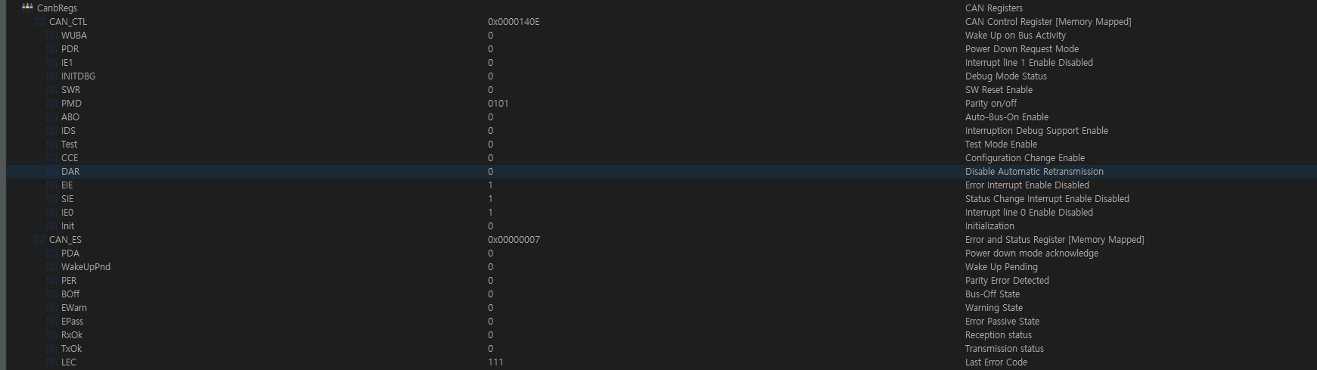
Reply
What is the CAN error status on DSP2 side?
The last error status is 111.
2. Is the auto re-transmission enabled?
The automatic retransmission is enabled

Slide 2
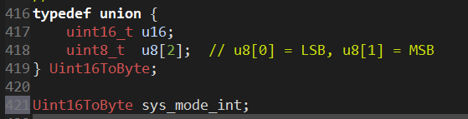
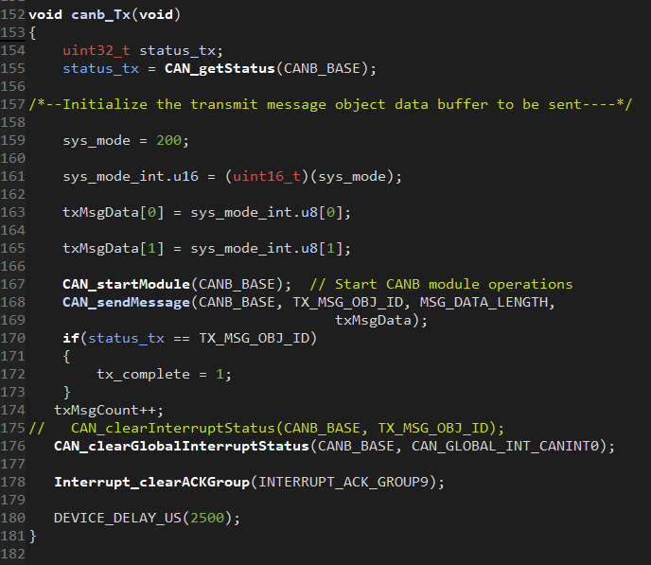
Reply
What the value are assigned to sys_mode_int.u8[0], and sys_mode_int.u8[1]?
sys_mode_int is a union containing a 16-bit variable and an array of two 8-bit variables.
In this union, sys_mode_int.u8[0] stores the lower 8 bits (LSB) and sys_mode_int.u8[1] stores the upper 8 bits (MSB).
The variable sys_mode has a value of 200, which is first stored as a 16-bit value and then split into its LSB and MSB components.
DSP-2

Slide 3
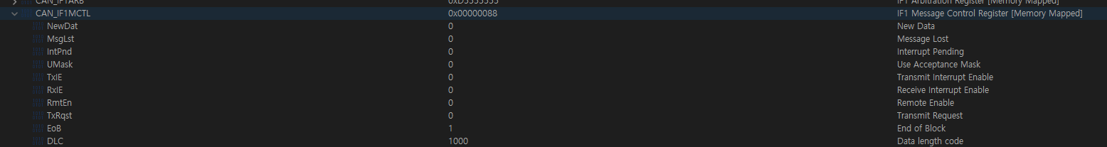
status
DLC is 1000 which is same as MSG_DATA_LENGTH(8)

