Slide 1
Issue #3 Details – F2837xD_SCI_Flash_Kernel
I wasn’t able to get this working on the F2837xD ControlCARD until I made the changes below
First set SW1:A Position 1 ON (Up) so that the emulator can be connected, and the Boot mode SW 1 to SCI Boot. (not required, I think)
Also note that SW1:A Position 2 should be ON (Up) (GPIO-28 (and pin 76 of the 180-pin controlCARD connector) will be coupled to the FTDI’s USB-to-Serial adapter. This allows UART communication to a computer via the FTDI chip)
Connect the emulator via CCS, and look up the location 0xD00 in memory. It was 0x025a. Change it to 0x815a. Then reset the CPU in CCS, and run in CCS.
Now reset the board, and run the command serial_flash_programmer.exe -d f2837xD -k F2837xD_sci_flash_kernels_cpu01-gpio2829.txt -a blinky_dc_cpu01.txt -b 9600 -p COM4 –v (where the project has been built with SCI_BOOT_ALTERNATE corresponding to GPIO 28,29)
  It will download the kernel to RAM, then select 1 to run DFU to CPU01 where the App will be Flashed
Then power off the board, switch boot mode SW1 to Flash boot, and power on the board. The LED will blink as expected.

Slide 2
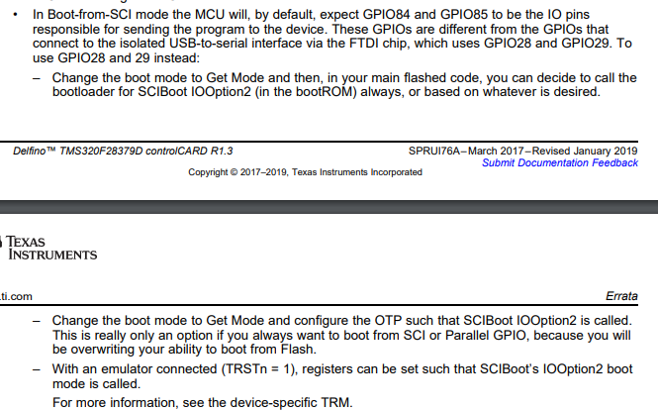
Issue #3 – Underlying logic for changes in previous slide
The SCI bootloader in ROM has two boot options but you need to use option 2 in order for it to work on the controlCARD
This is a by-product of wanting to use GPIO 28, 29 instead of GPIO 84, 85
The ControlCARD infosheet documents this.
This is described in the slide
“Standalone boot flow”
Refer to the slide
“Emulation boot flow”

Slide 3
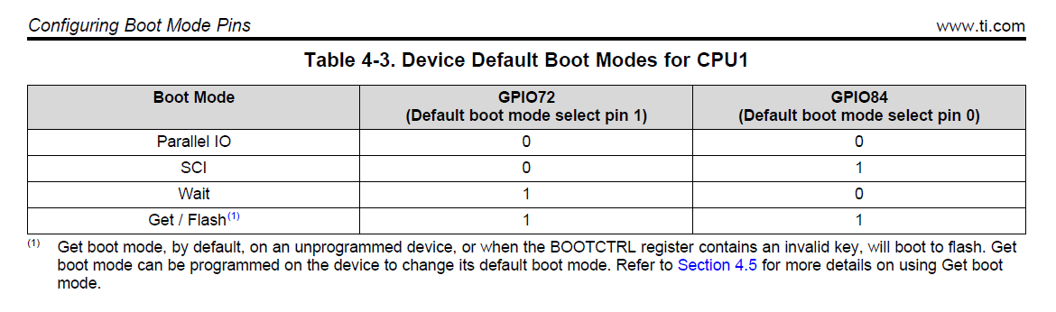
Issue #3 – Device Boot Modes – based on Boot Mode select pins
Basically, the Boot Mode select Pins help determine the Boot Mode. This is how the Boot ROM identifies the boot mode configuration.
The realized Boot Mode can be customized through the BOOTCTRL register (which is in OTP for Standalone mode).
In Get boot mode, the boot ROM reads the boot mode (BMODE) bit field in the BOOTCTRL register to determine which boot procedure to execute.
By default, Get boot mode executes flash boot when in standalone mode or wait boot when an emulator is connected to the device.

Slide 4
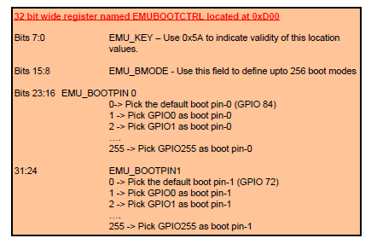
Issue #3 – EMUBOOTCTRL register (0xD00)
When connected to the device using an emulator, the EMU_BOOTCTRL register is used to determine the boot mode. This register allows the user to experiment with various boot mode settings before writing to the BOOTCTRL register in the user-configurable DCSM OTP.

Slide 5
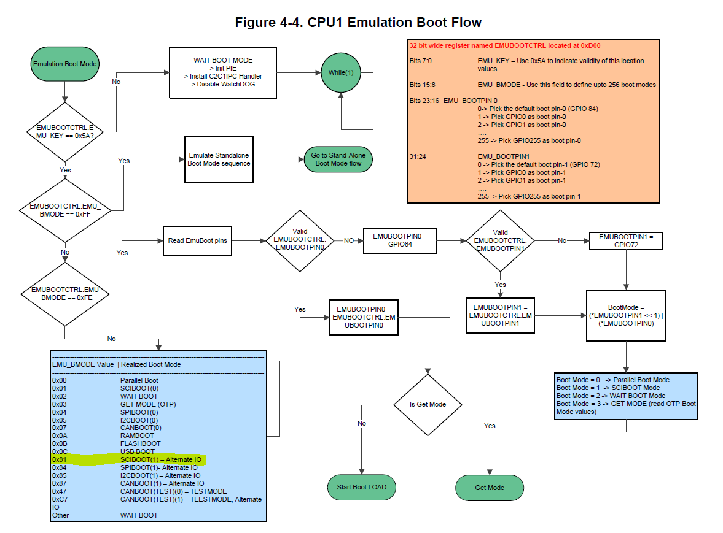
Issue #3 – Emulation Boot Flow

Slide 6
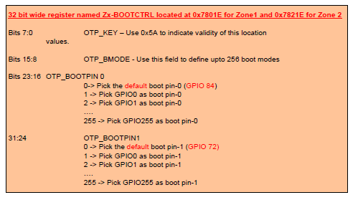
Issue #3 – Z1-BOOTCTRL register (0x7801E)

Slide 7
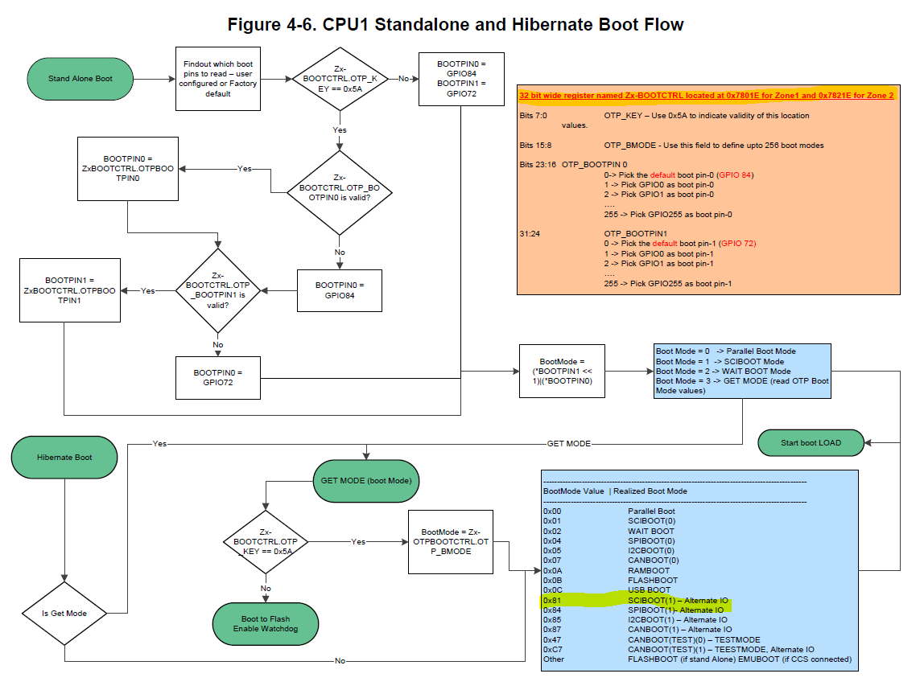
Issue #3 – Standalone Boot Flow

Slide 8
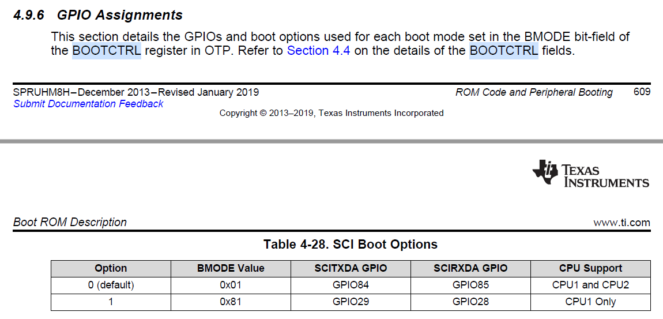
Issue #3 – SCI Boot Mode – Alternate IO
In order to use Alternate GPIOs (28, 29) for SCI Boot mode, we need to set BMODE field (bits 15:8) of the corresponding BOOTCTRL register (either EMUBOOTCTRL(0xD00) or Z1-BOOTCTRL (0x7801E which is in User configurable DCSM OTP) to 0x81)
Also need to set the KEY (bits 7:0) of the corresponding BOOTCTRL register to 0x5A.

