Slide 1
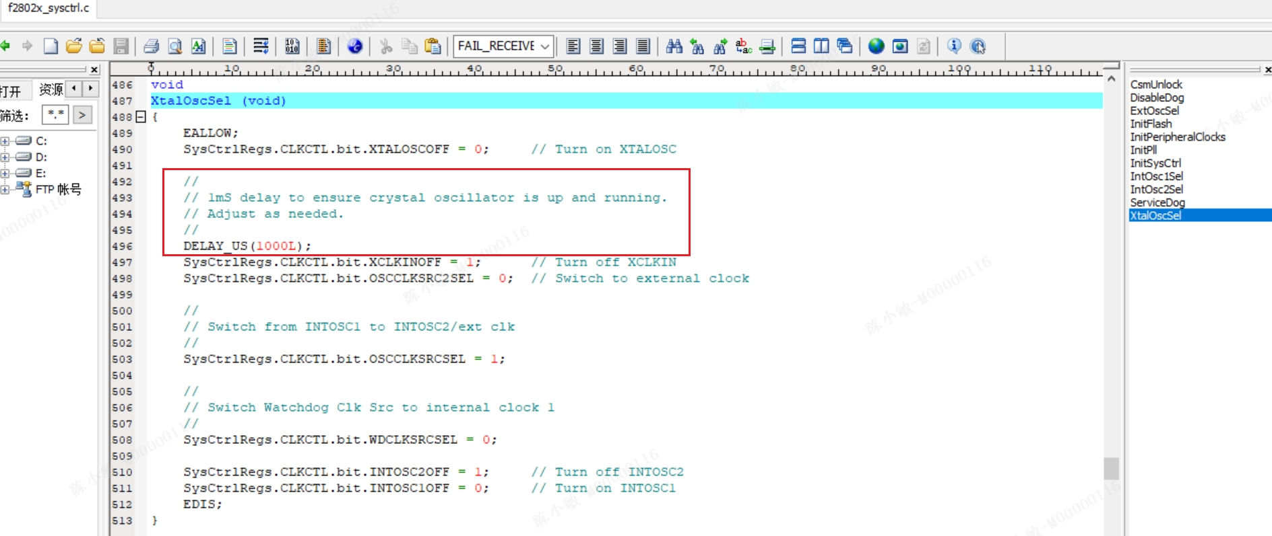
F28023 Clock Failure Issue
Issue Description:
My customer reported F28023 couldn’t run, and check the source code and there is a description: Adjust as needed, shown as below figure;
While increased the delay time, the device worked as expected; decreased the delay time, the device couldn’t run.

Slide 2
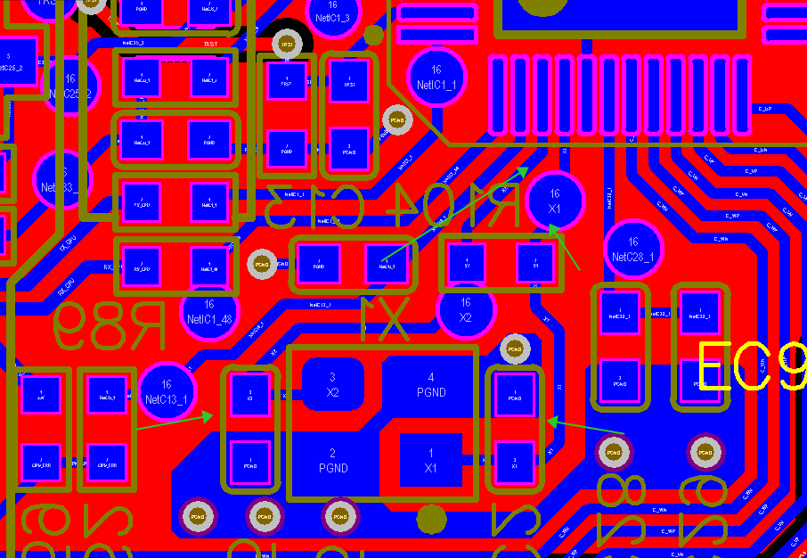
PCB Layout shown as below figure:
External Crystal:
P3SB 10.000M
8pf
15PPM temp drift
External Capacitor:
18pF
+/-5%
50V NPO
0603 package

Slide 3
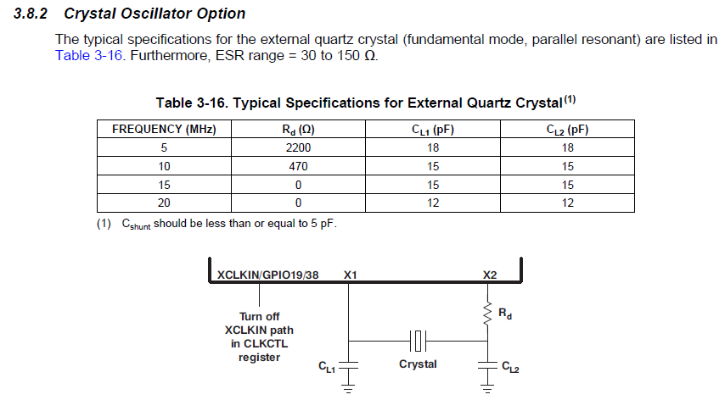
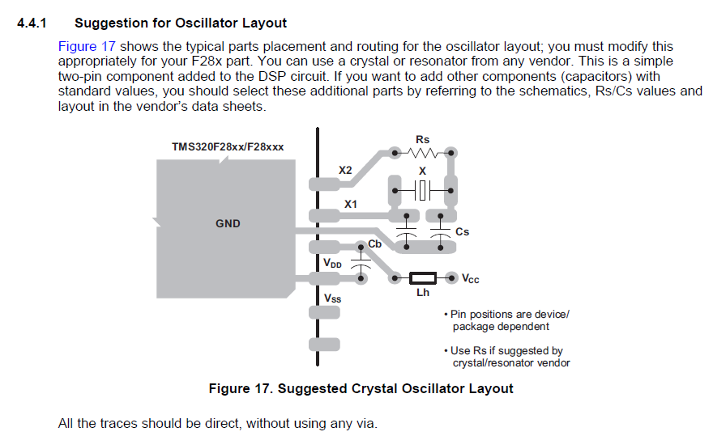
Crystal Oscillator Option description in datasheet
Suggested PCB Layout for Oscillator

Slide 4
Support Needs:
How to evaluate the delay time?

