Slide 1
F28035 Voltage Ripple Issue
Subhead here
Presenter’s Name

Slide 2
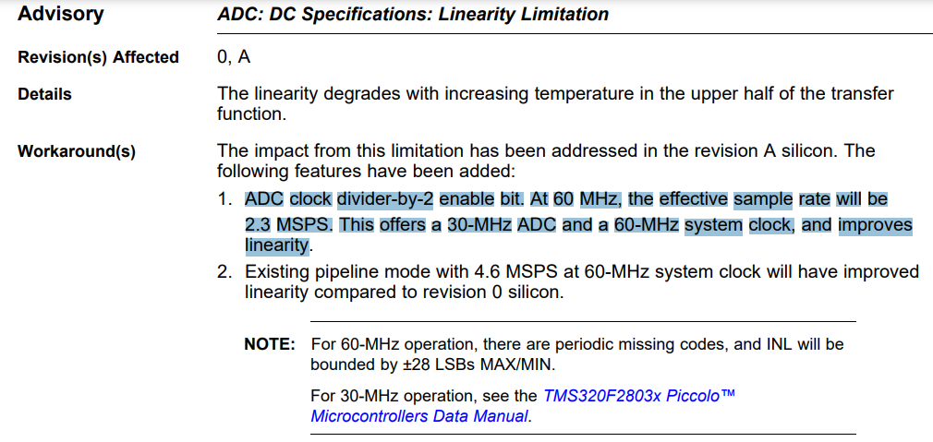
Overall Issue
Phenomenon
  Same Hardware Same Software on different Chip F28035PAG, Voltage ripple difference 400mV Vs 90mV;
  Check ABA between Bad Chip and Good Chip, the issue follow up Bad chip.
  Customer requires Voltage ripple less than 105mV during different load condition when DC output = 12.15V.
Analysis
  Check Offset Error, Periodically Calibrating on B5 Channel, no work；
  Check slow down ADC clock from 60MHz to 30MHz, Normal Load less than 100mV, work for Normal Load.
Next Action
  Test B2 Channel actual analog voltage when DC output = 12.15V, and then Calculated Digital Value during Bad Chip.
  PWM Timing, ADC SOC trigger Timing during High load condition, Need to clarify this or Test waveform. 3.3us -→ 1.67us
  Only change ACQPS when ADC clock constant 60MHz, maybe no work but have a try it on Bad chip;
  High Load Condition Vs Normal Load Condition, ADC B2 Channel waveform, also voltage loop or other loop feedback waveform. >> how about LSB value?
  We must decide that ADC error or ADC sampling point, any other root cause?

Slide 3
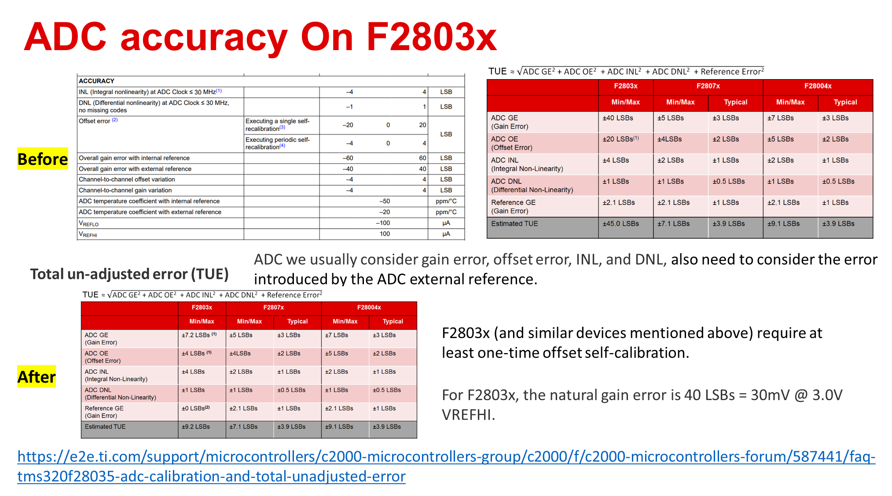

Slide 4
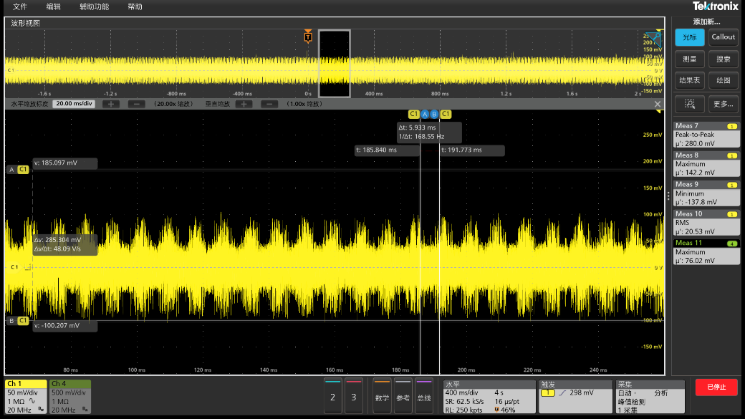
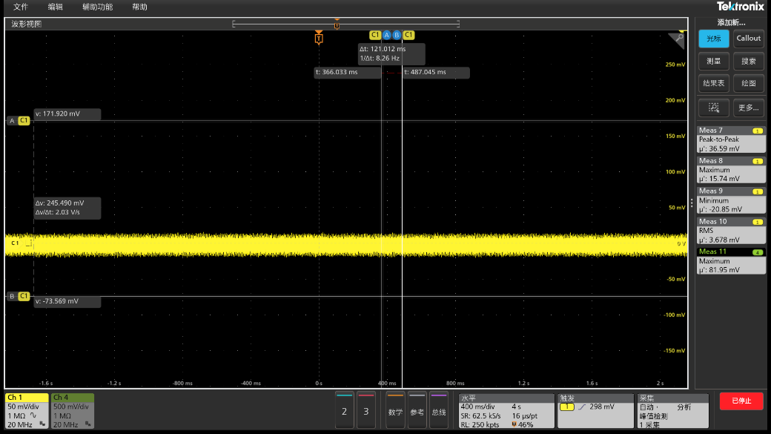
Bad Chip NG 20% load改前Before/后After
100mV
30mV
Before
After

Slide 5
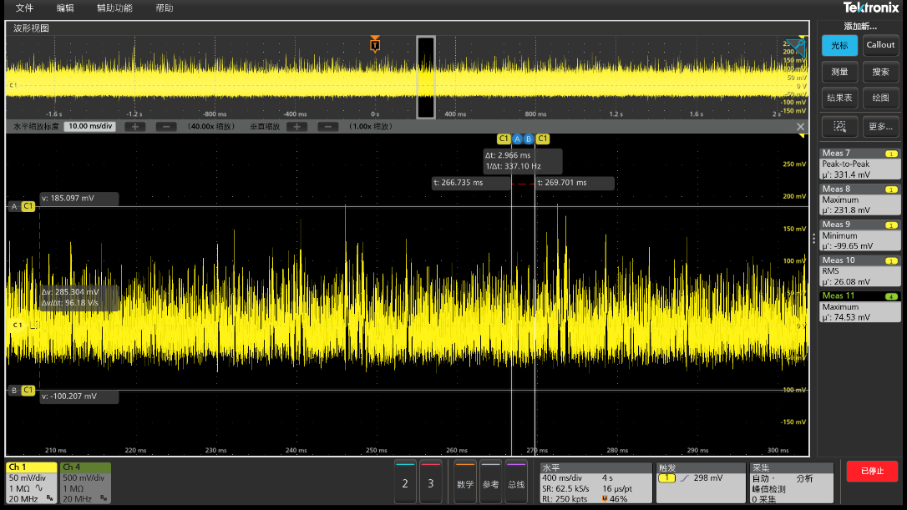
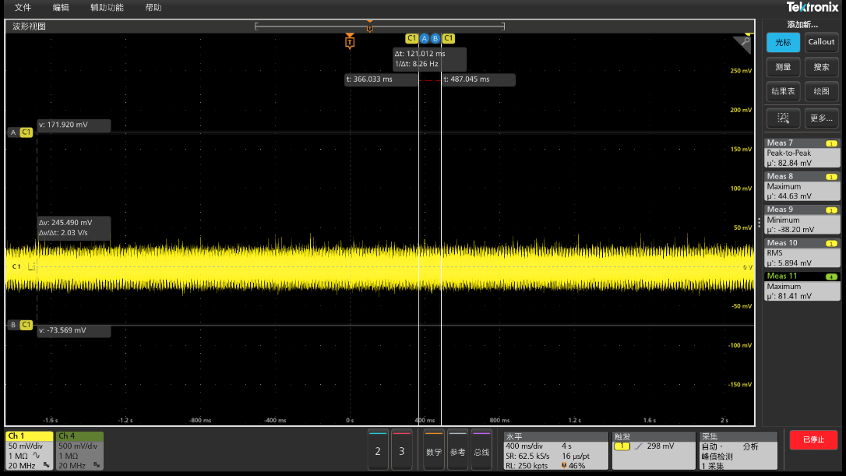
Bad Chip NG 100% load改前Before/后After

Slide 6
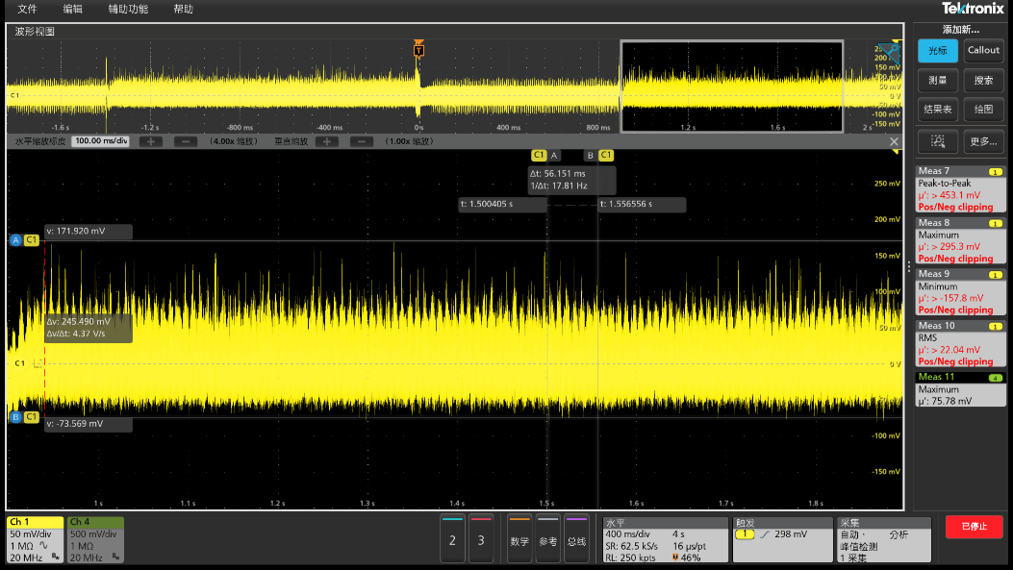
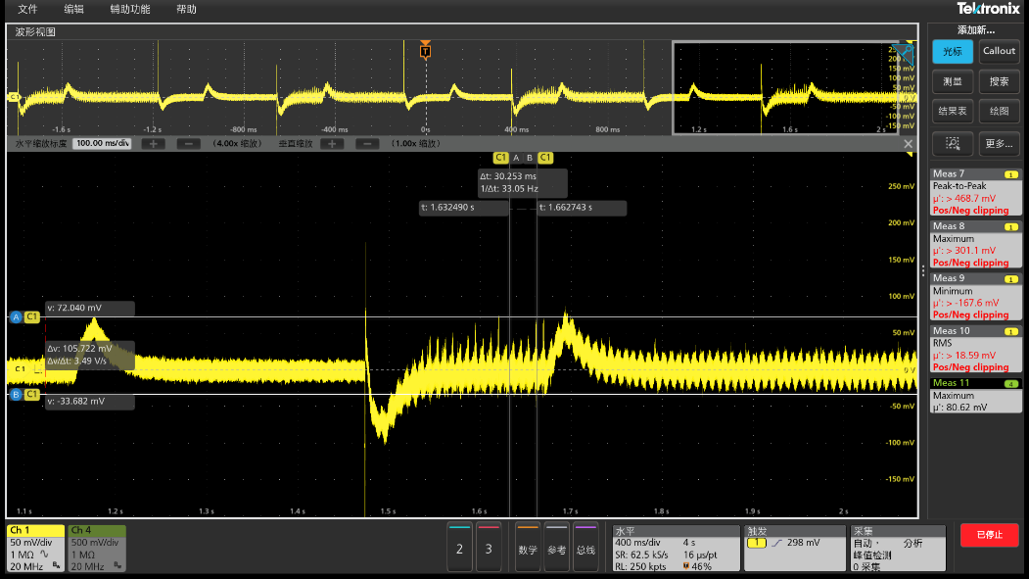
Bad Chip NG 20% switch 100% load改前Before/后After
245mV
90mV
16k
ADC sampling Point and ISR calculate Time

Slide 7
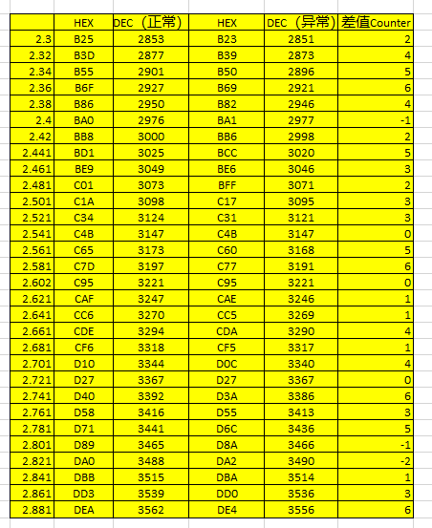
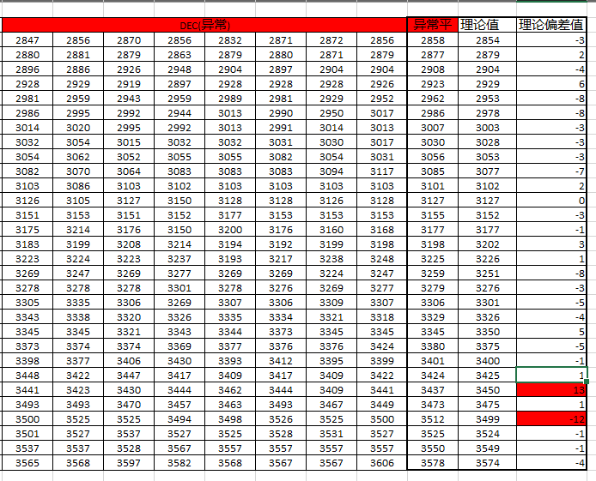

Bad Chip Vs Good Chip: F28035 Card
Actual: 2.52, Calculated Value 2.599,

Slide 8
Modify ACQPS = 29 when change Rs from 1k to 560 Ohm. No work.
No work// 30% load condition 400-500mV.
Test EOC2/EOC3 Signal Trigger missed when high load conditions.
ADC Freq and PWM Freq fixed 150K, Clarify Waveform
ADC Sampling Freq = PWM Update Freq. System still exist 16k Noise.
DC Bus Cap 120Hz Voltage Ripple same as Good chip F28035PAG, But bad chip has exist 16k Noise.
Open Loop Fixed Freq on Bad chip, 120Hz Sine wave. Exclude ADC sampling Freq.
Bad chip worse than Good chip, 3-4DB.

Slide 9
Next Action:

