Slide 1
Greatwall SPI Issue
Subhead here
Presenter’s Name

Slide 2
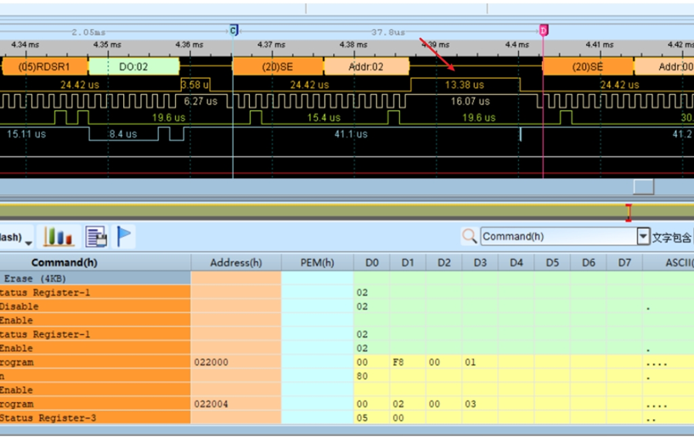
Greatwall SPI Issue
When the 28035 chip SPI module is operating external flash expansion, the instruction + address or instruction + data is split into two times and sent from the host to the slave. There is a certain delay (us) between the two times, and the CS bus will be abnormally pulled high, causing the flash to mistakenly interpret one instruction as two instructions. And then SPI communication issue happen during F28035 devices. Could you figure out why delay us between two command here? Why CS signal pull low here?

