Slide 1


Improvement proposal
ePWM and HRPWM
TMS 28xxx
ZAJC FRANC
Komenda, 30.6.2017

Slide 2

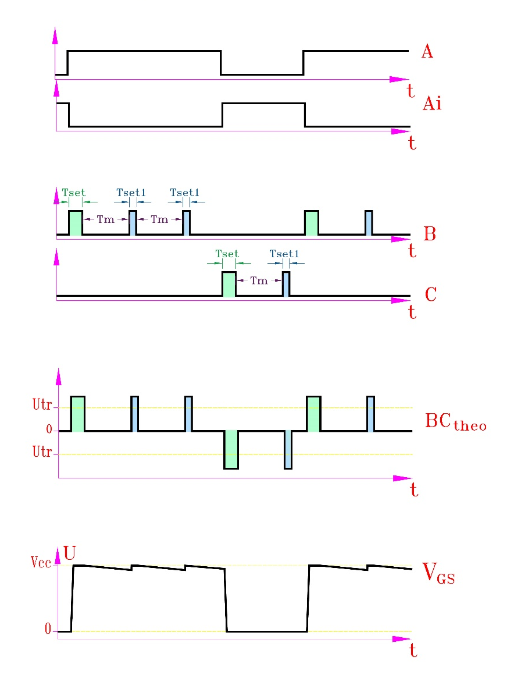

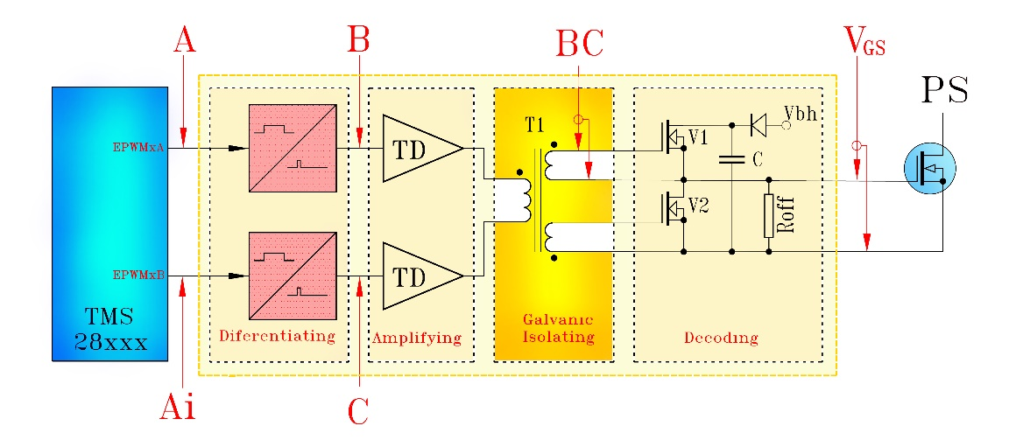

Zajc Franc, 30.6.2017
Novelty and its benefits
ePWMx
Transformer PWM data transmittion
Extremely low transformer Vs product
Stable & short propagation delay
Low side pulse amplification
High driving current
Simple decoding
Differentiating to pulses
transmitting
0 % - 100% duty cycle
@ no transformer saturation
Amplified pulses through
transformer isolation
Decoding

Slide 3
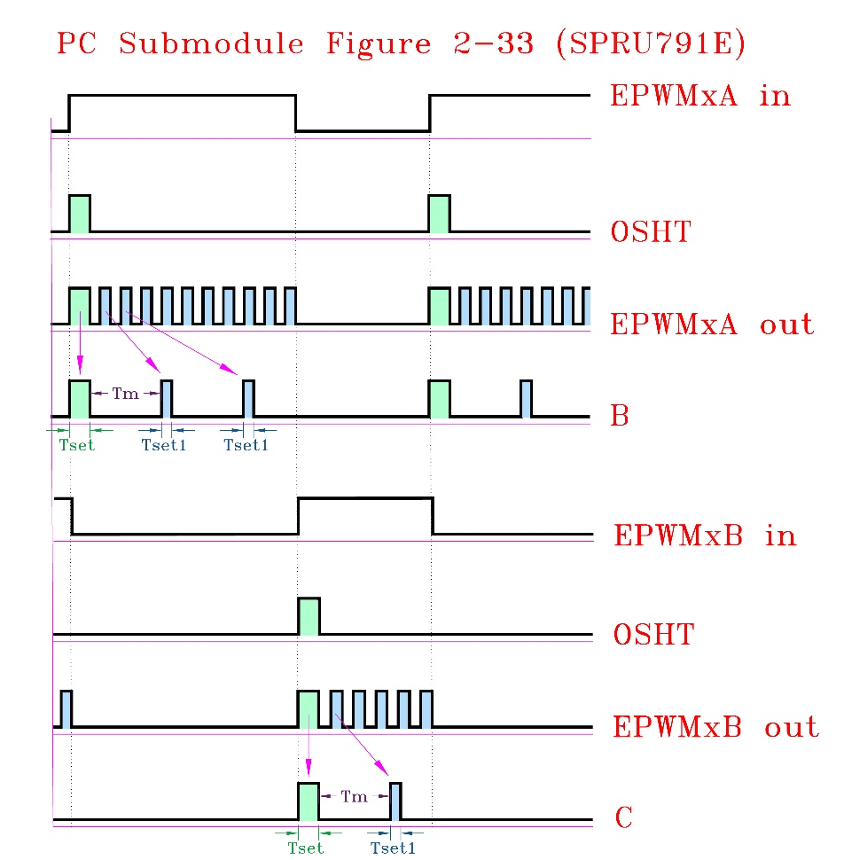
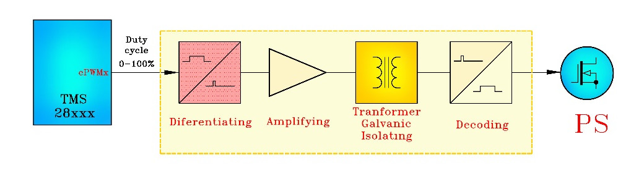


Zajc Franc, 30.6.2017
ePWM and HRPWM upgrade suggestion
Elimination of differentiating circuit by minor upgrade of OSHT and PSCLK timing

Slide 4
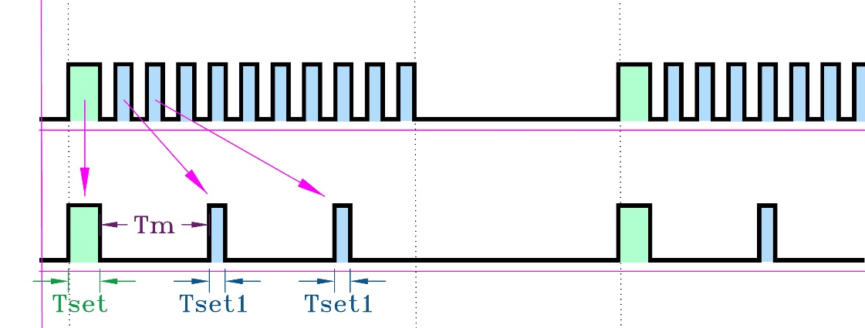
Zajc Franc, 30.6.2017
Proposed changes in OSHT and PSCLK timing
OSHT
PSCLK
OSHT = Tset => 5 ns ... 100 ns (step at least 1ns)
PSCLK = Tset1 => 5 ns ... 100 ns (step at least 1 ns)
Frequncy = Tm => 100 ns ... 2000 ns (step SYSCLK)

Slide 5
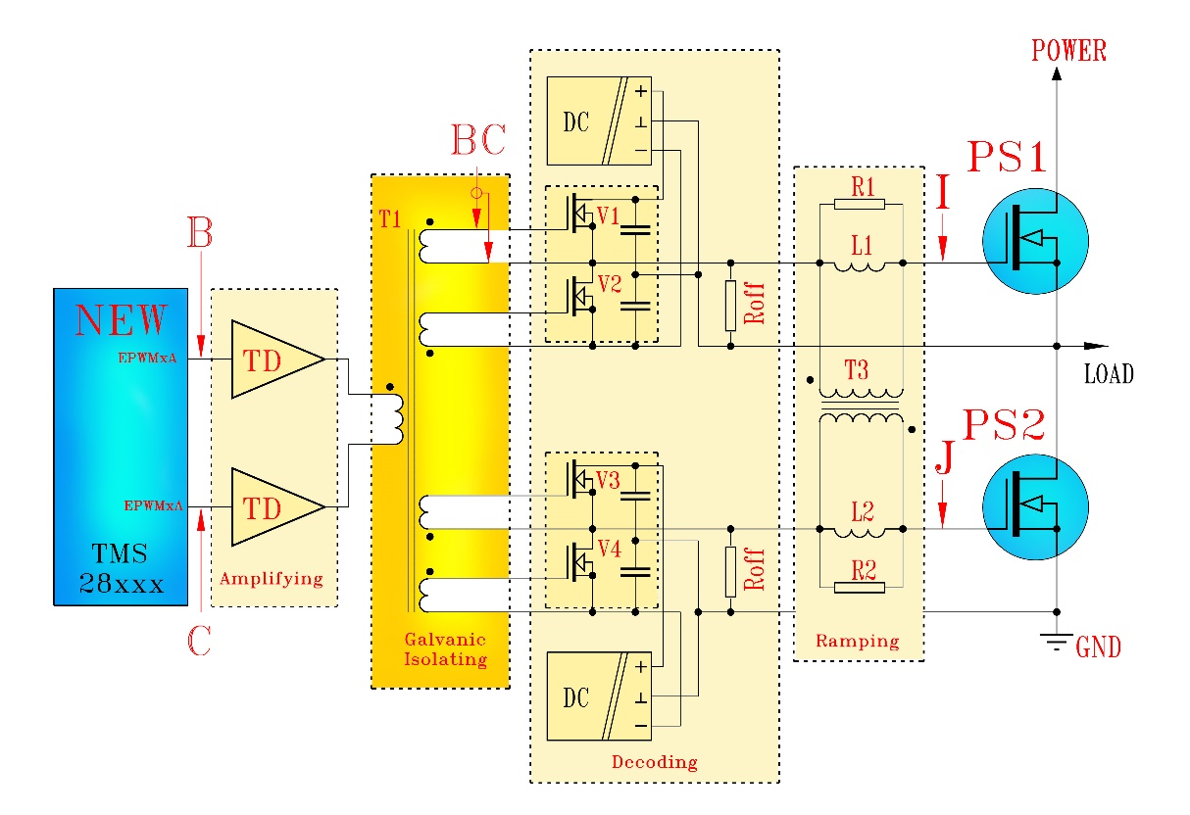


Zajc Franc, 30.6.2017
Application example
Near Zero Interlock Delay (NZID) driving principle
Short & extremely stable propagation delay
Short interlock delay (4 ns – 6 ns) (short enough to prevent reverse recovery)
70 % less swithing losses & EMI

