Slide 1
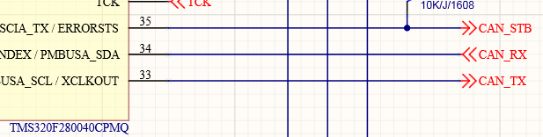
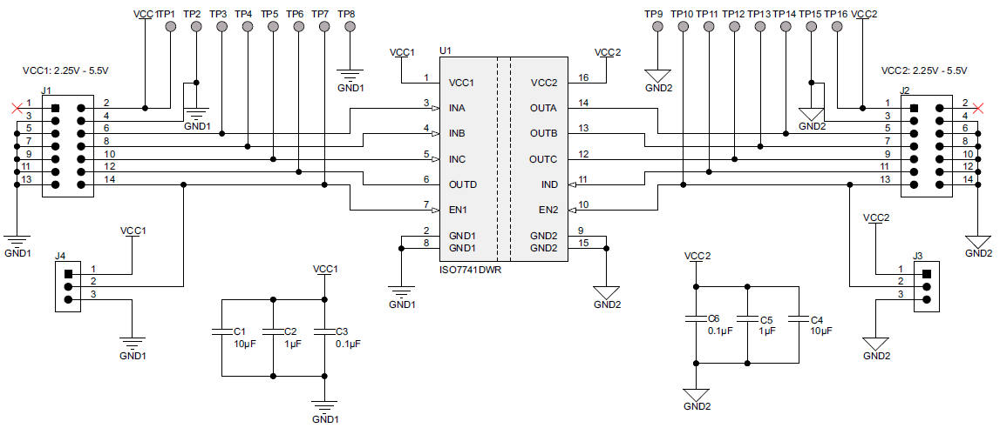
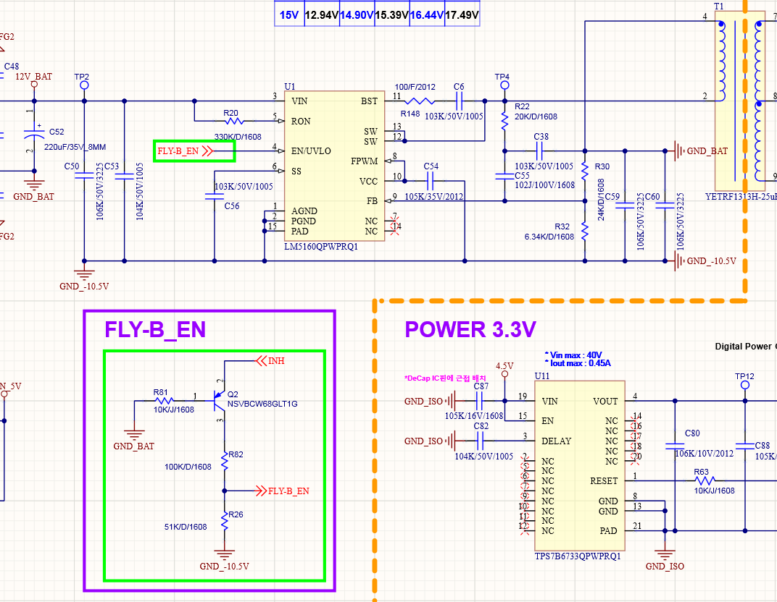
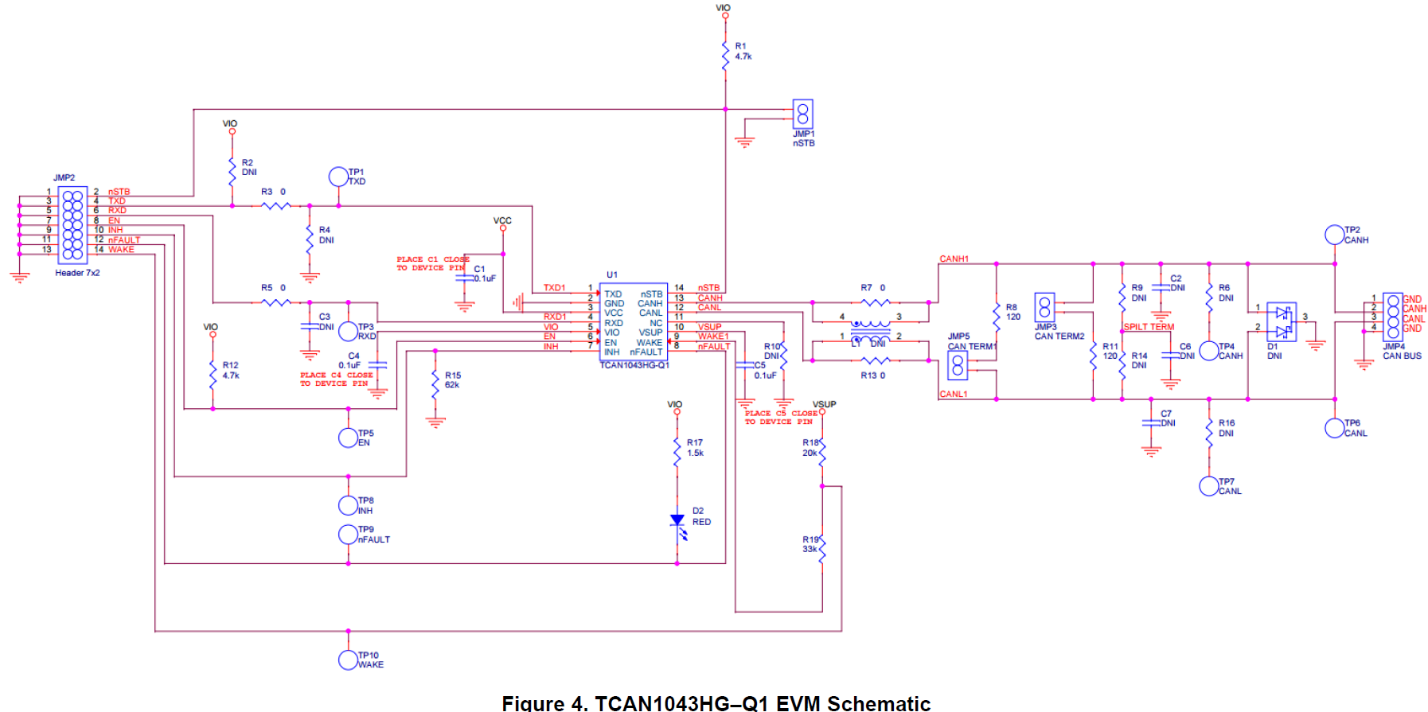
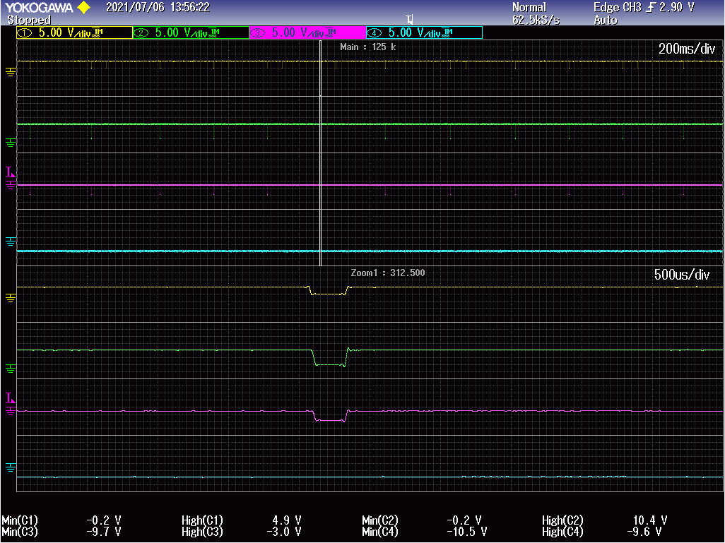
VCC1 : 3.3V
VCC2 : 5V
STB Low Output
Tx
Tx
STB
STB
Rx
Rx
④
③
① nSTB
①
② INH
③ FLY-B_EN
④ GND_-10.5V
②
MCU to STB signal low output
Change to High without maintaining STB Low

Slide 2
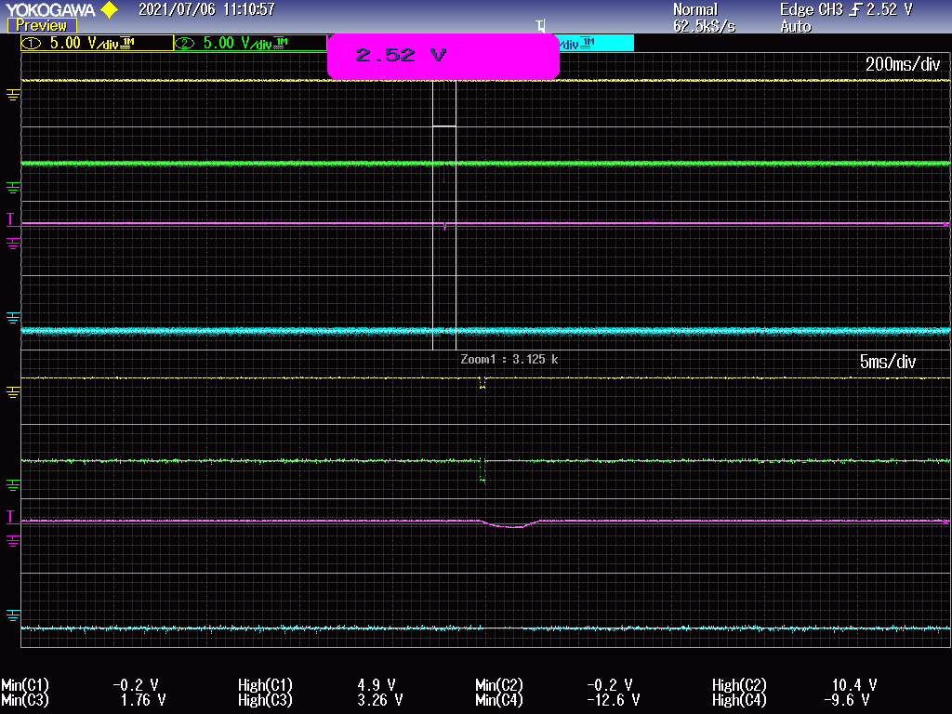
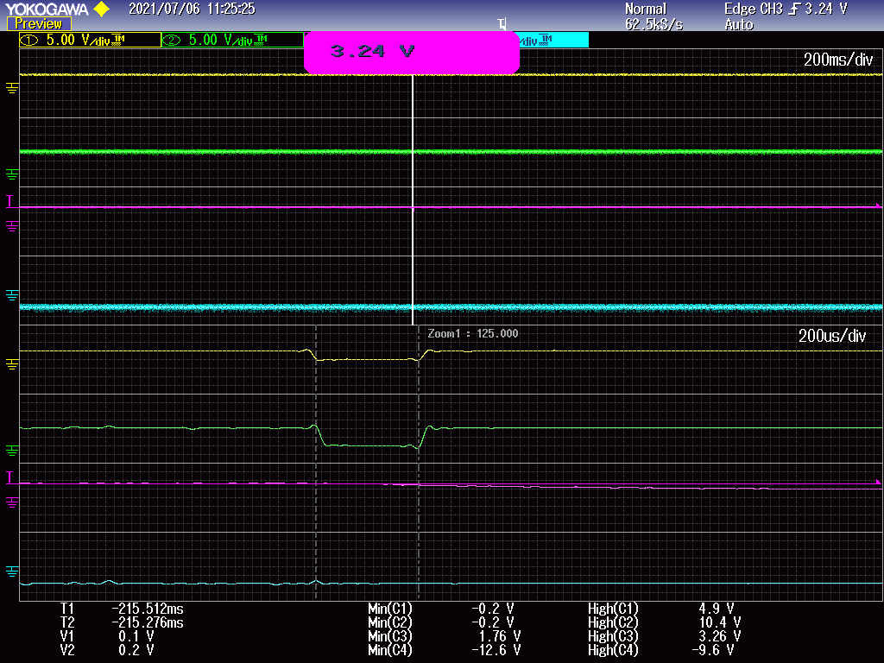

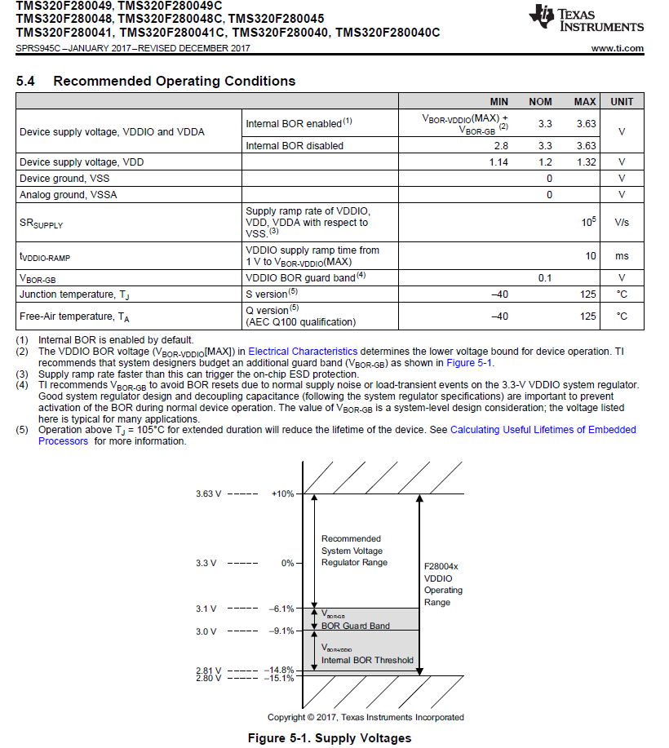
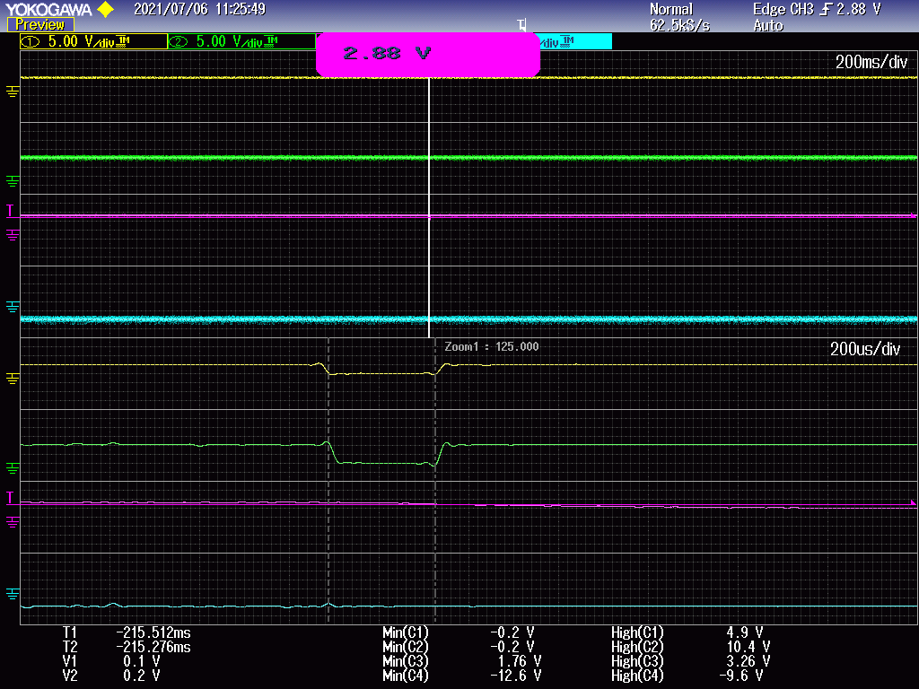
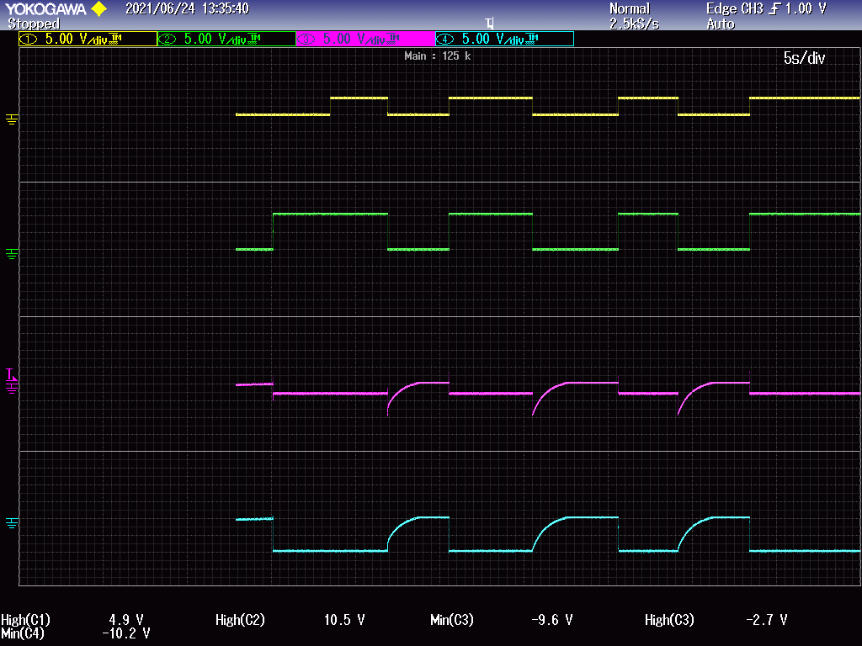
① nSTB
② INH
③ MCU 3.3V
④ GND_-10.5V
Operation situation when STB signal is randomly given a high or low signal without connecting to MCU
① nSTB
② INH
① nSTB
③ MCU 3.3V
④ GND_-10.5V
② INH
③ FLY-B_EN
④ GND_-10.5V
????

Slide 3
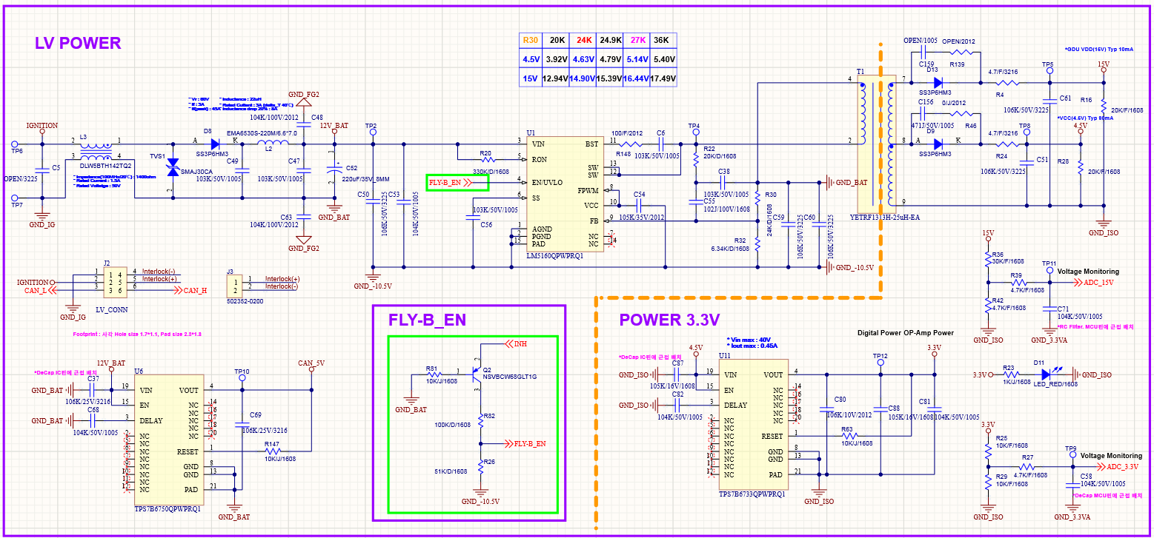
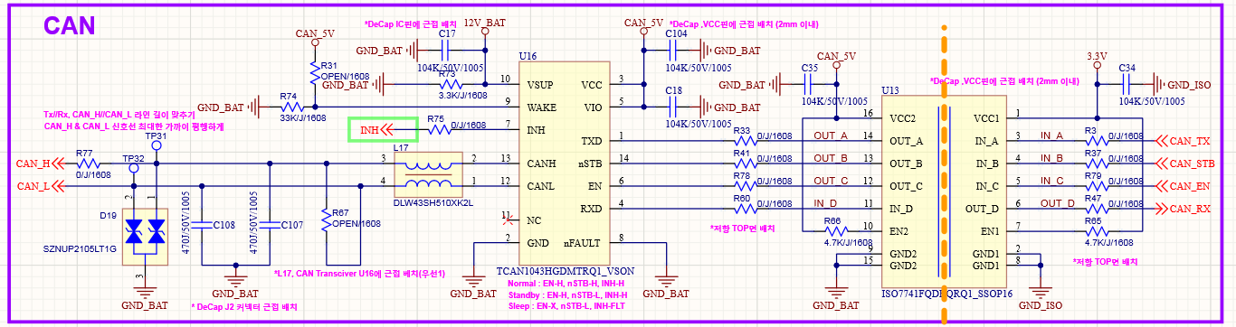

Slide 4
