Slide 1
MCAN Filtering and RX Configuration
TI – EP – ASM-IND
Zackary Fleenor

Slide 2
Introduction
Overview of MCAN module
Key Features
Conforms with CAN Protocol 2.0 A, B and ISO 11898-1:2015
Full CAN FD support (up to 64 data bytes); 1Mbps nominal bit rate; 8Mbps data bit rate
AUTOSAR and SAE J1939 support
Up to 32 dedicated transmit buffers
Configurable Transmit FIFO (up to 32 elements)
Configurable Transmit queue (up to 32 elements)
Configurable Transmit Event FIFO (up to 32 elements)
Up to 64 dedicated receive buffers
Two configurable receive FIFOs (up to 64 elements each)
Up to 128 filter elements

Slide 3
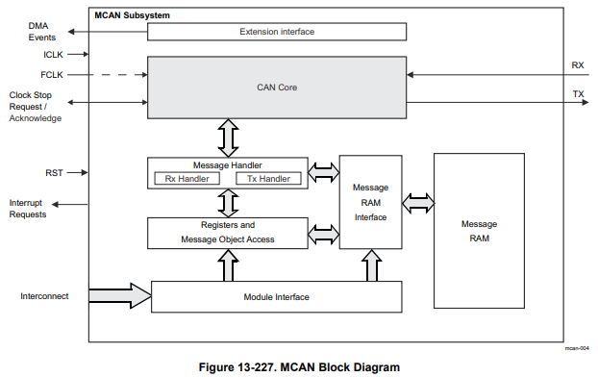
MCAN Block Diagram

Slide 4
Implementation Details
Acceptance filtering mechanisms
Filtering Features
Hardware-based acceptance filtering Two filter sets: standard and extended identifiers Multiple filter configurations are available Configurable for acceptance or rejection Individual filter enable/disable support
Filter Types
Range filter [from ID1 to ID2] Filter for dedicated message IDs [ID1 and ID2] Classic bit mask filter [ID1(MASK) and ID2] Global filter configuration [Accept/Reject Remote/Data Frames]

Slide 5
Acceptance Filtering Capabilities
Key filtering features and mechanisms
Hardware-based filtering support
Standard and Extended identifier filter sets
Range, Dedicated ID, and Bit mask filtering
Individual filter enable/disable
Sequential filter checking

Slide 6
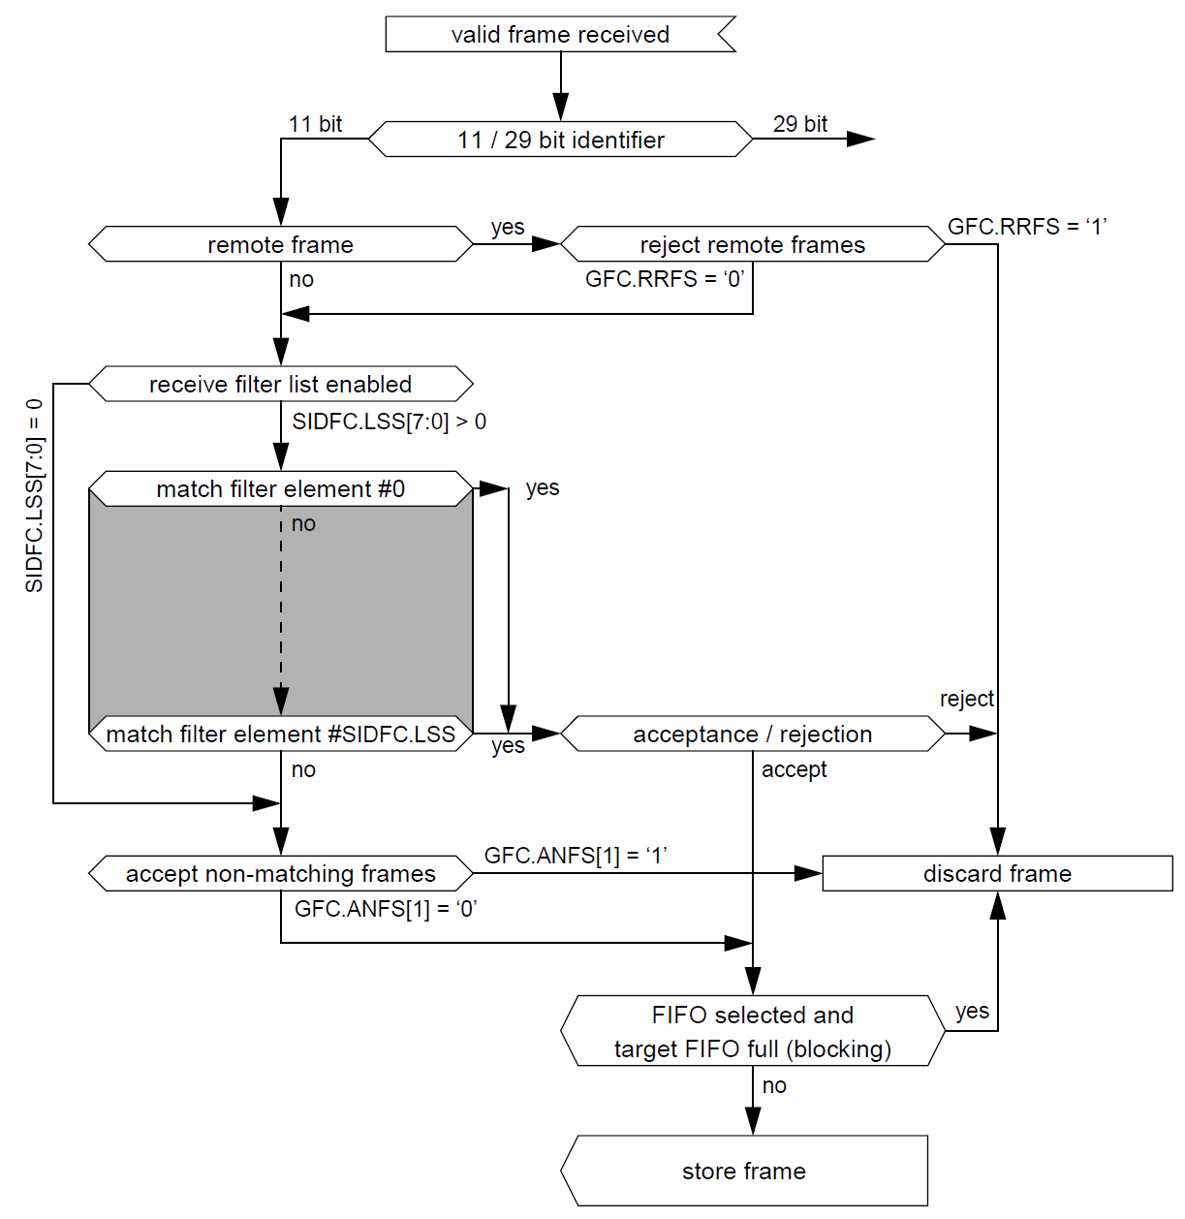
Standard ID Filter Flow

Slide 7
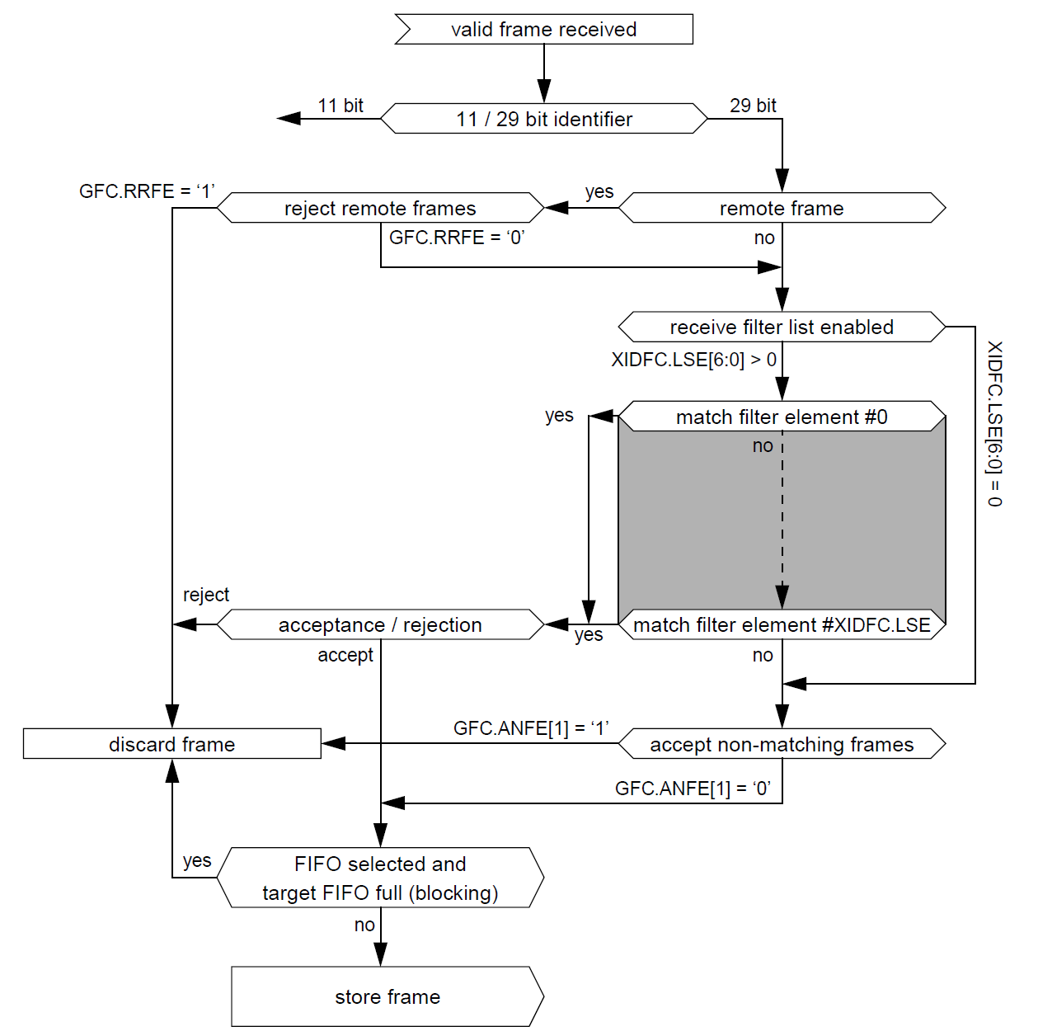
Extended ID Filter Flow

Slide 8
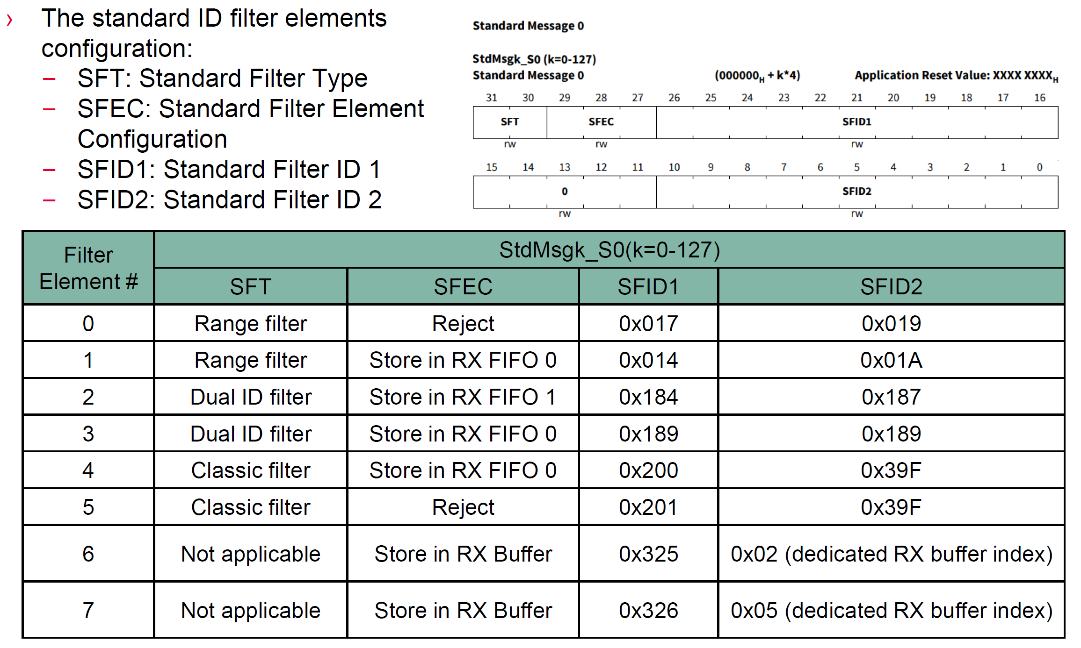
Standard ID Filter Configuration

Slide 9
Filter Configuration Options
Available filter types and configurations
Range filter [from IDx to IDy]
Dual ID filter support
Classic bit mask filtering
Acceptance or rejection filtering
Assignment to RX Buffers or FIFOs

Slide 10
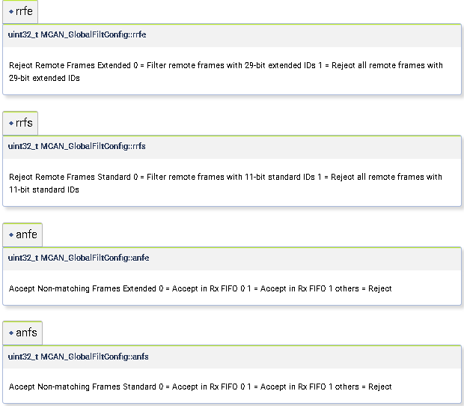
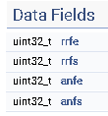
MCAN Global Filter
AM261x MCU+ SDK: MCAN_GlobalFiltConfig Struct Reference

Slide 11
MCAN_GlobalFilter Configuration
/* Global Filter Configuration parameters. */
.filterConfig.rrfe = false,
.filterConfig.rrfs = false,
.filterConfig.anfe = 0,
.filterConfig.anfs = 0,

Slide 12
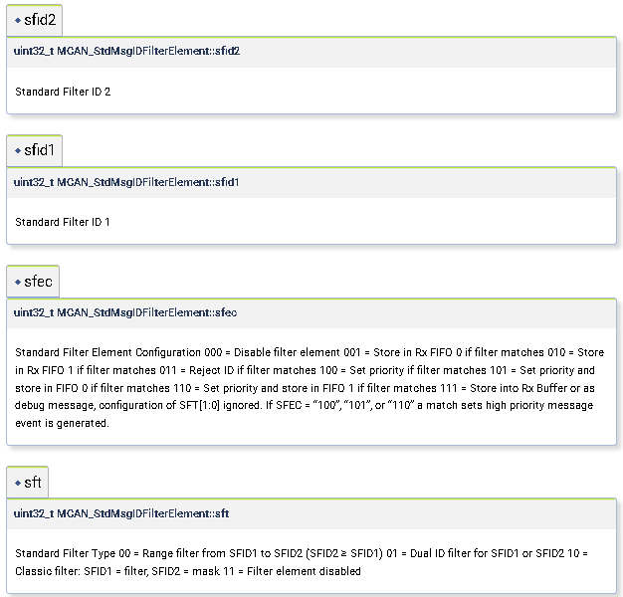
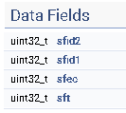
MCAN StdMsgID Filter
AM261x MCU+ SDK: MCAN_StdMsgIDFilterElement Struct Reference

Slide 13
MCAN_StdMsgIDFilterElement Configuration
MCAN_StdMsgIDFilterElement exFilterConfig0 =
{
.sfid1 = 0U,
.sfec = MCAN_STD_FILT_ELEM_BUFFER,
.sfid2 = 15U,
.sft = MCAN_STD_FILT_TYPE_RANGE,
};

Slide 14
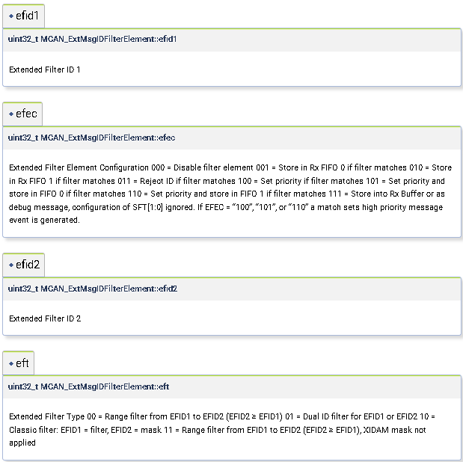
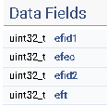
MCAN ExtMsgID Filter
AM261x MCU+ SDK: MCAN_ExtMsgIDFilterElement Struct Reference

Slide 15
MCAN_ExtMsgIDFilterElement Configuration
MCAN_ExtMsgIDFilterElement exFilterConfig0 =
{
.efid1 = 670U,
.efec = MCAN_EXT_FILT_ELEM_BUFFER,
.efid2 = 670U,
.eft = MCAN_EXT_FILT_TYPE_RANGE,
};

Slide 16
MCAN Message RAM – RX Configuration Options
Up to 64 Rx buffers and two Rx FIFOs can be configured in the Message RAM.
RX FIFO0 and RX FIFO1 Start Address: defines the start address of Rx FIFOs in message RAM.
Number of RX FIFO0 and RX FIFO1 Elements: each Rx FIFO can be configured to store up to 64 received messages.
RX FIFO0 and RX FIFO1 Watermark: the Rx FIFO watermark can be used to prevent an Rx FIFO overflow. If the Rx FIFO fill level reaches the Rx FIFO watermark, then an interrupt flag MCAN_IR.RF0W/ MCAN_IR.RF1W is set.
RX FIFO0 and RX FIFO1 Operation Mode:
Rx FIFO Blocking Mode: the Rx FIFO blocking mode is the default operation mode for the Rx FIFOs. If an Rx FIFO full condition is reached, then no further messages are written to the corresponding Rx FIFO until at least one message is read out and the Rx FIFO Get Index is incremented.
Rx FIFO Overwrite Mode: when an Rx FIFO full condition is reached, the next accepted message for the FIFO overwrites the oldest FIFO message.
RX FIFO0 and RX FIFO1 Element Size: defines the Rx FIFO element size.
RX Buffer Start Address: defines the start address of Rx buffer in message RAM.
RX Buffer Element Size: defines the Rx buffer element size.

Slide 17
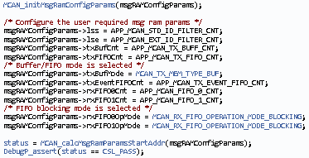
MCAN Message RAM Configuration

Slide 18
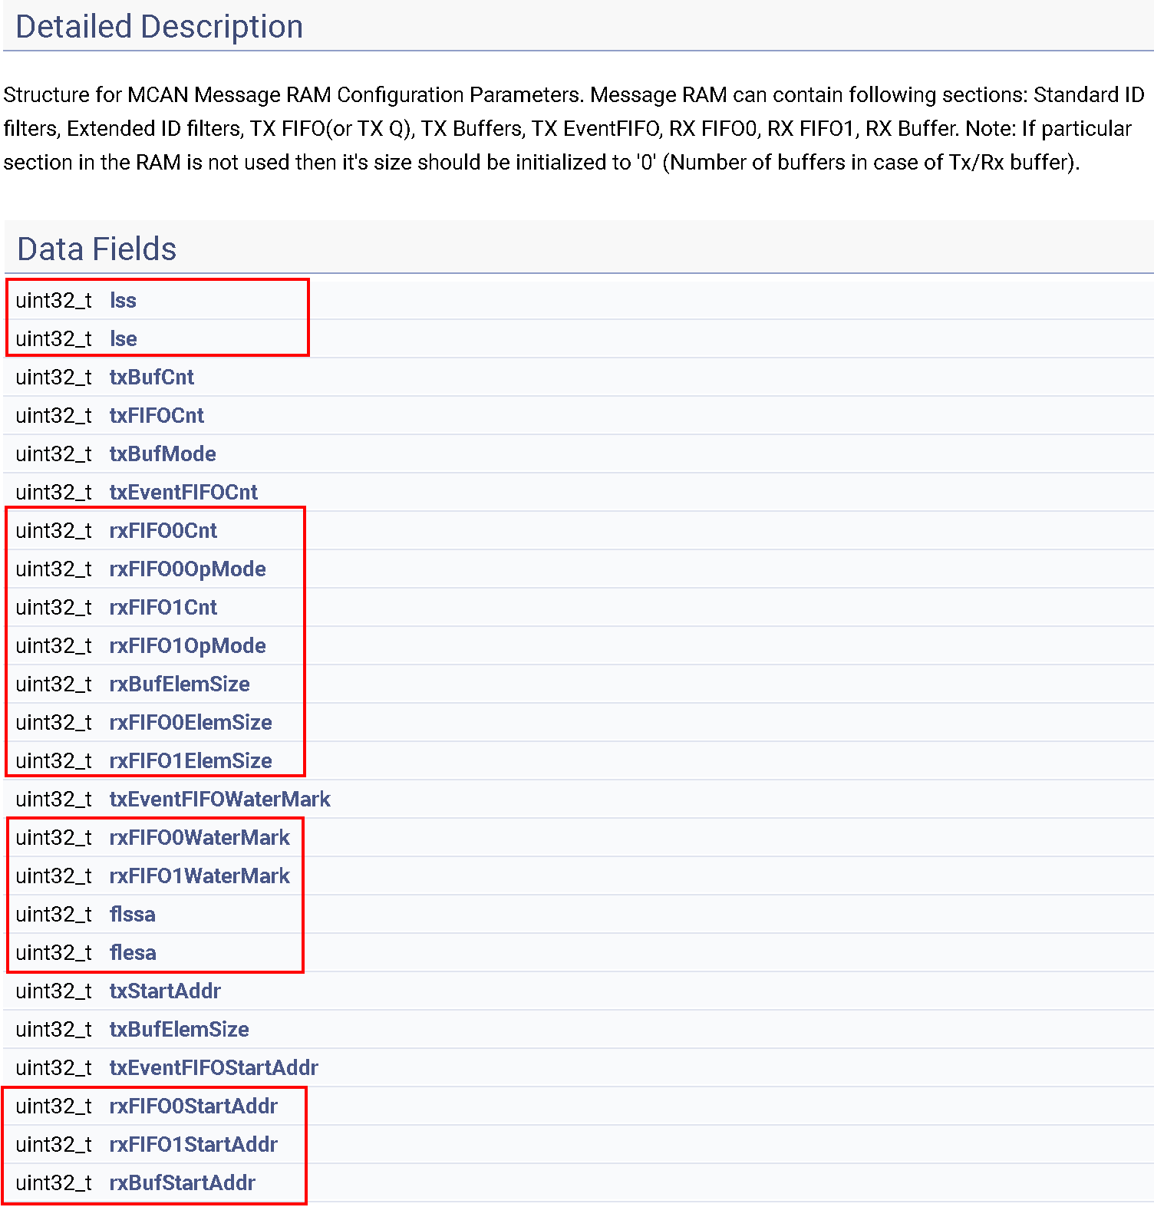
MsgRAM ConfigParams
AM261x MCU+ SDK: MCAN_MsgRAMConfigParams Struct Reference

Slide 19
AM261x MCU+SDK MCAN Configuration Example

Slide 20
Questions?

