Slide 1
Driver Lib based CCS Code Development
(Independent Project)

Slide 2
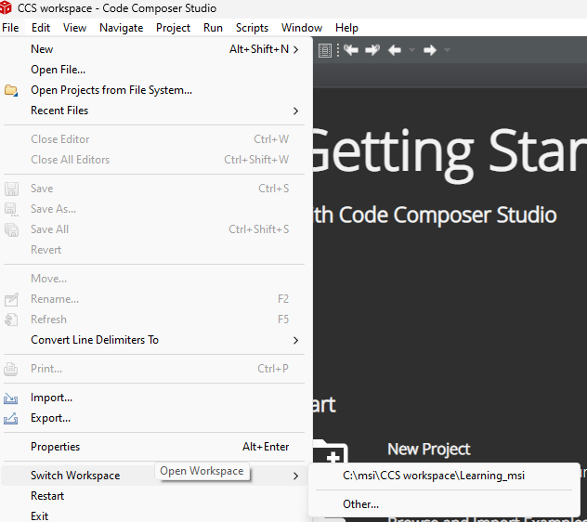
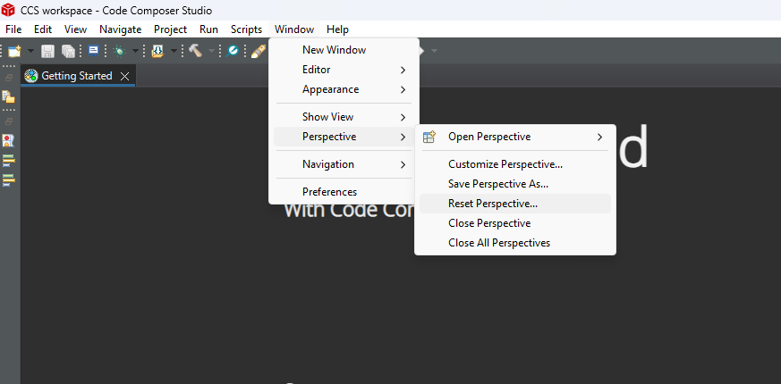
Create a New Project (Independent Project)
To make an independent Project, all the required source files must be included locally in the “created project”.
Avoid external dependencies on C2000ware paths
Create a New Project
Make a new workspace for the new project
After making the new workspace, Reset perspective as shown in the figure below

Slide 3
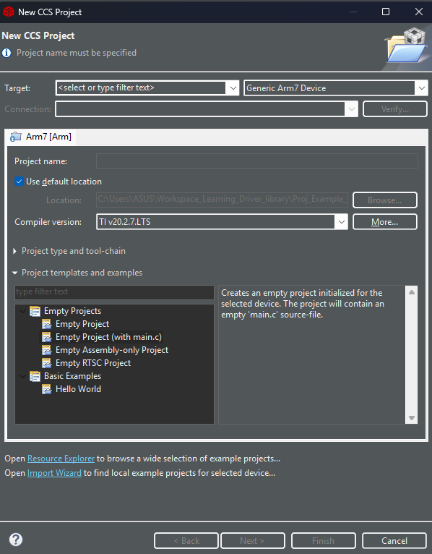
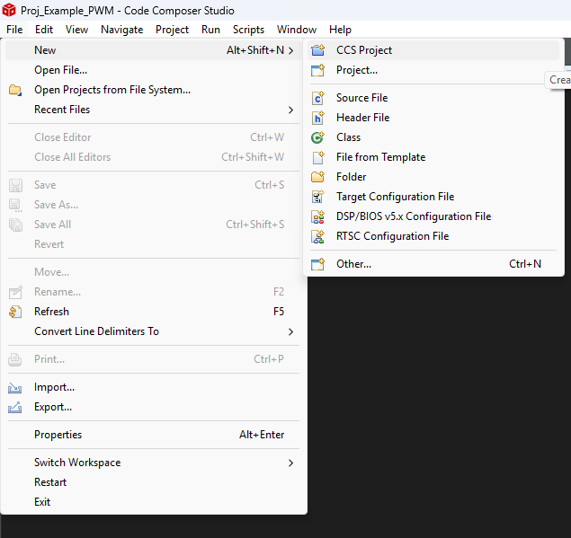
CCStudio Set-Up
Create new project in CCS Project
File >> New >> CCS Project

Slide 4
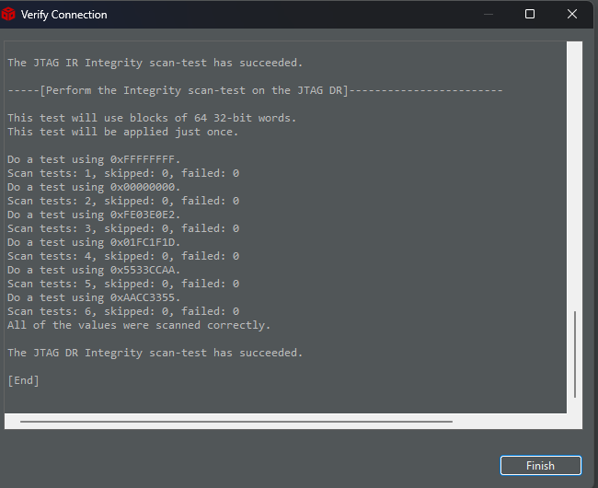
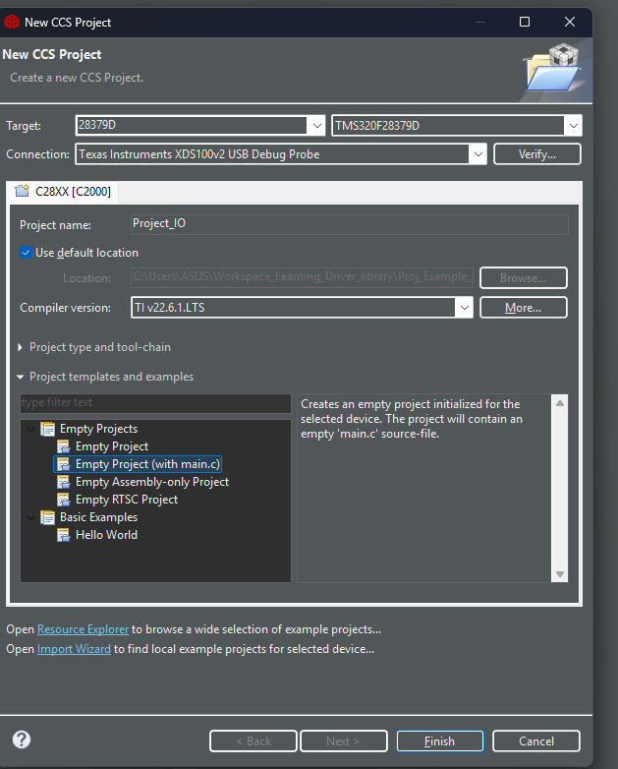
Set the Target
Target : TMS320F28379D
Connection: Texas Instrument XDS100v2 USB Debug Probe
Select Project Template: Empty Project(with main.c)
Project Name : as desired
Click Verify: it will show succeeded.
Click Finish

Slide 5
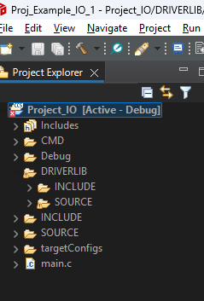
Make Folders
Made folders as shown below
  CMD
  DRIVERLIB
    INCLUDE
    SOURCE
  INCLUDE
  SOURCE

Slide 6
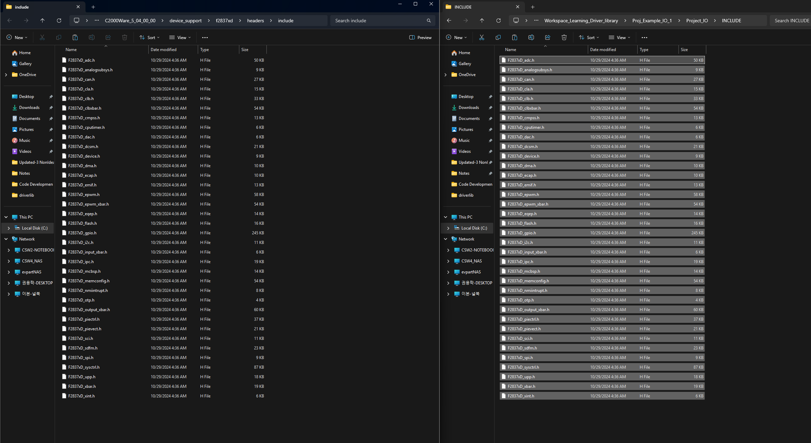
Transfer Device support Files : Header Files
Copy all header files from C2000ware and paste in the project INCLUDE folder
C2000Ware_5_04_00_00\device_support\f2837xd\headers\include
workspacefolder\Project_IO\INCLUDE
Paste
Copy

Slide 7
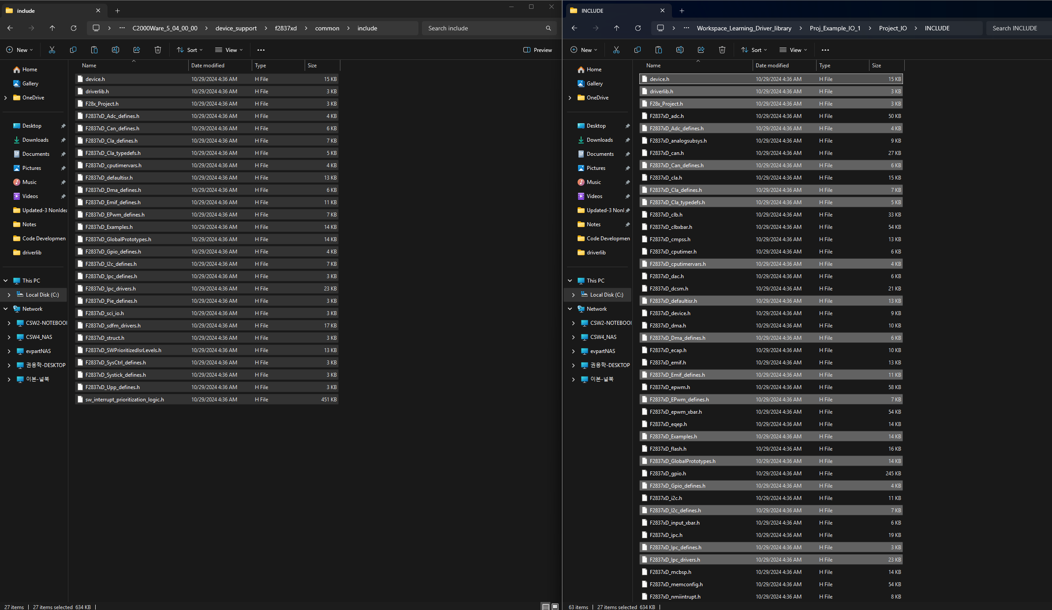
Transfer Device support Files : Header Files
Copy all header files from C2000ware and paste in the project INCLUDE folder
C2000Ware_5_04_00_00\device_support\f2837xd\common\include
Workspace Folder >>Project Folder >> INCLUDE
Copy
Paste

Slide 8
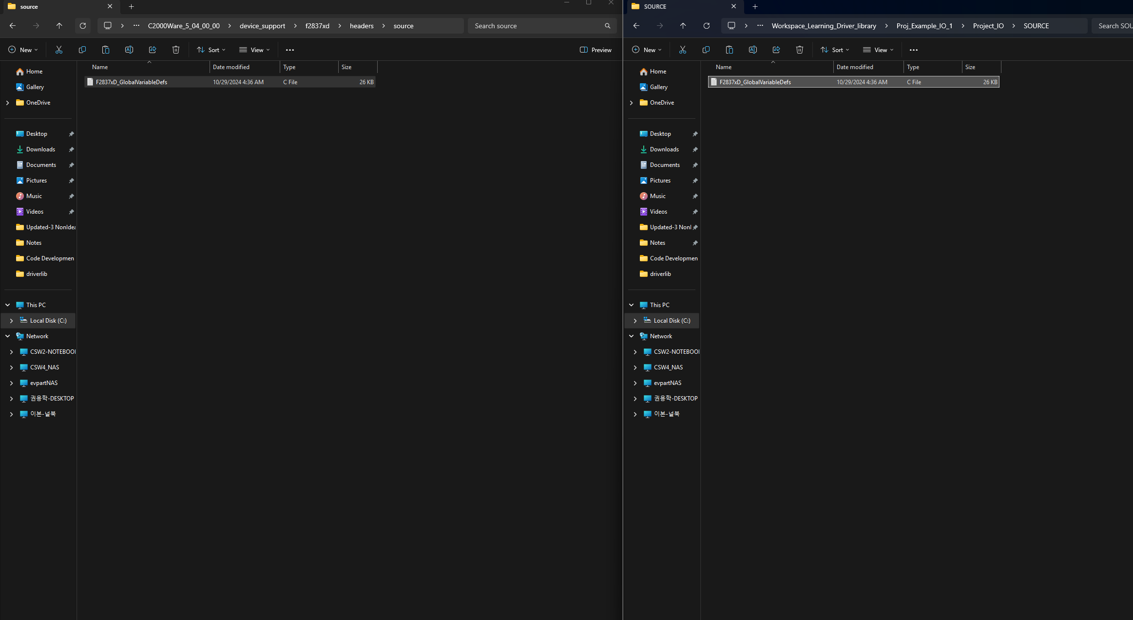
Transfer Device support Files : Source Files
C2000Ware_5_04_00_00\device_support\f2837xd\header\source
Workspace Folder >>Project Folder >> SOURCE
Copy
Paste

Slide 9
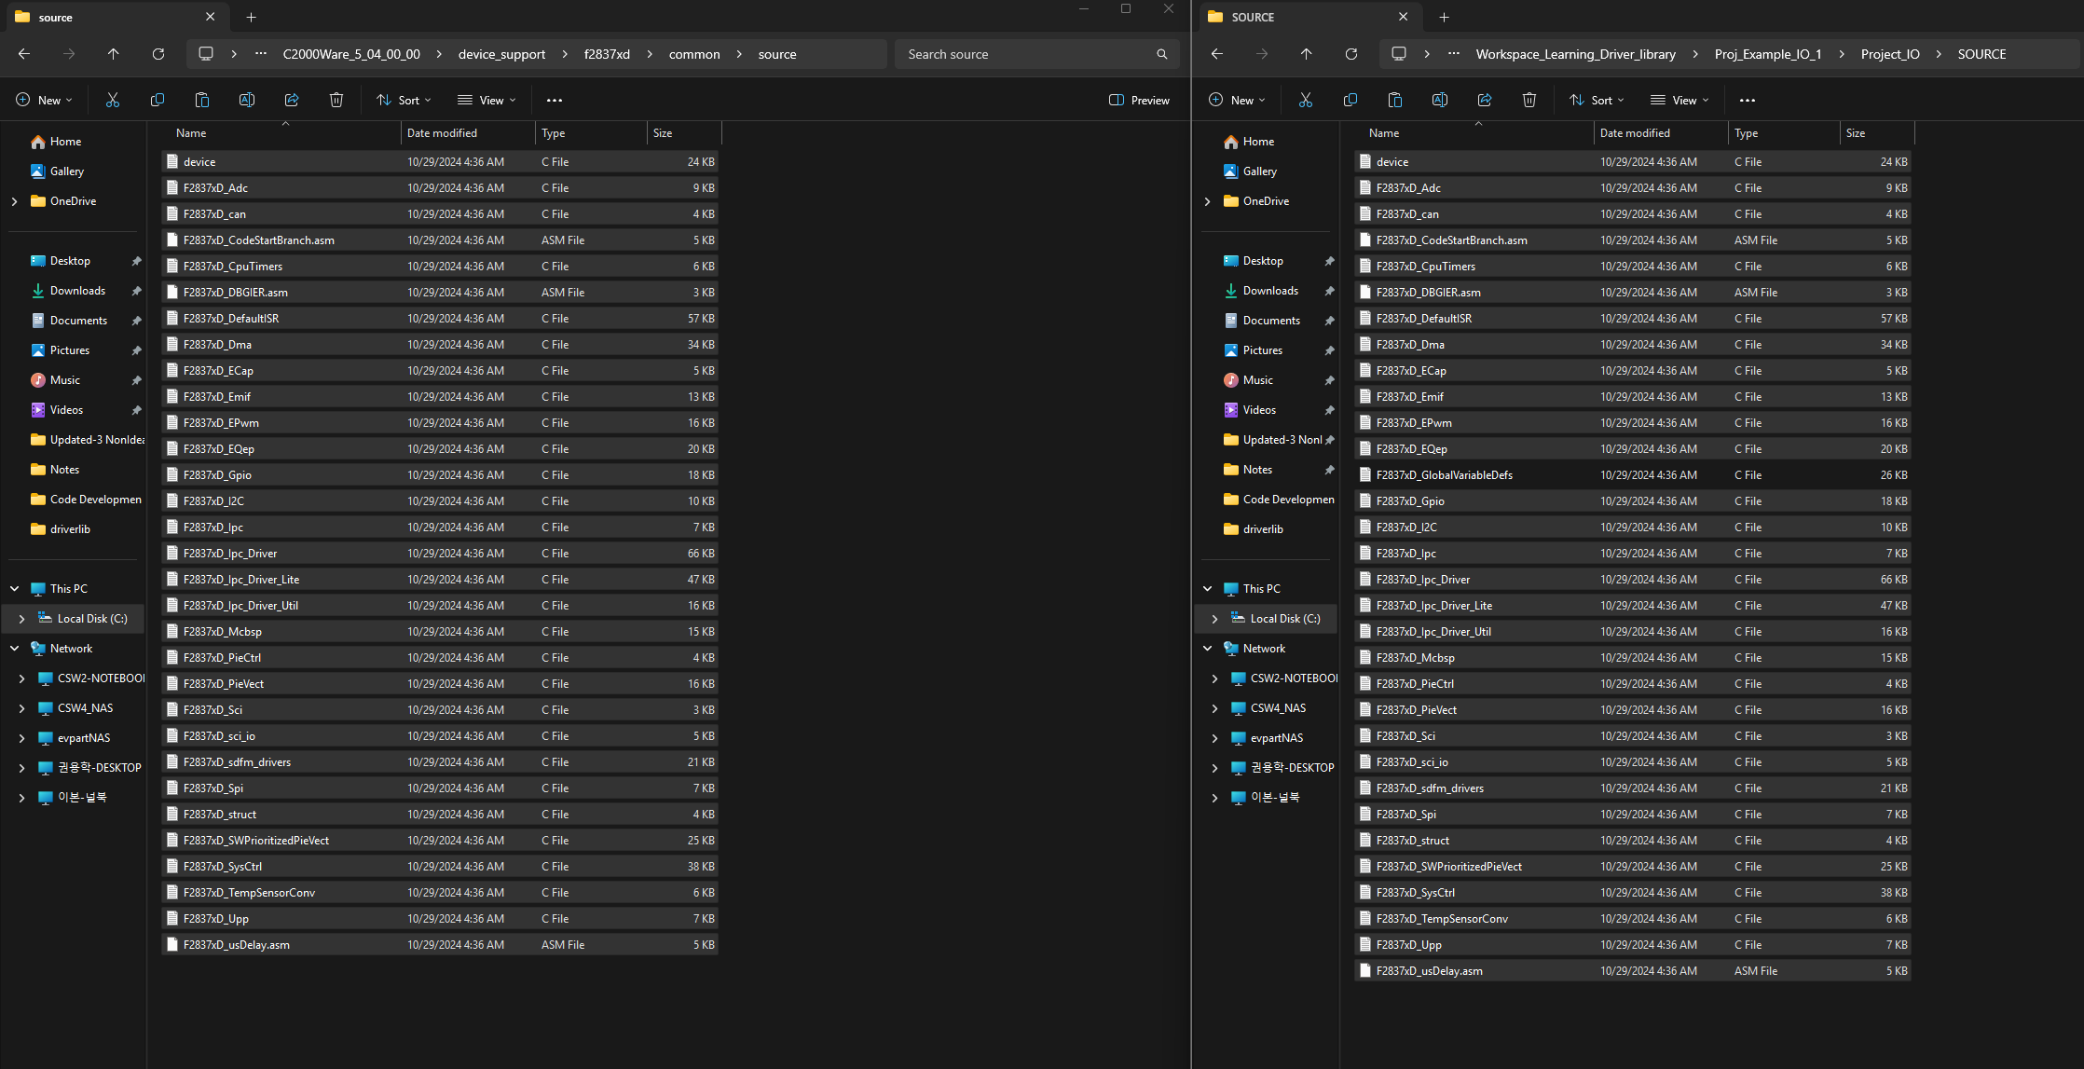
Transfer Device support Files : Source Files
Copy the linker file “F2837xD_RAM_lnk_cpu1.cmd” from the address shown and paste in the project’s SUPPORT folder in driverlib folder
C2000Ware_5_04_00_00\device_support\f2837xd\common\source
Workspace Folder >>Project Folder >> SOURCE
Copy
Paste

Slide 10
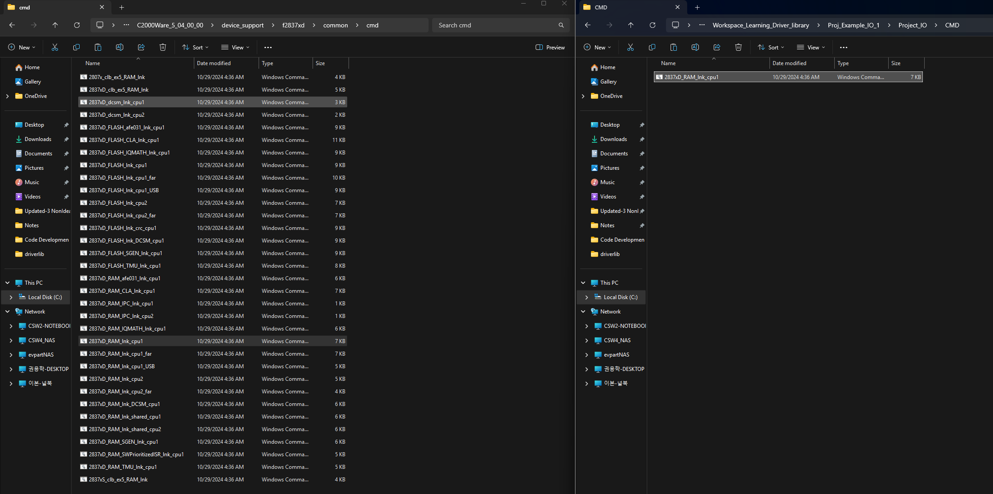
Transfer Device support Files : CMD
C2000Ware_5_04_00_00\device_support\f2837xd\common\CMD
Workspace Folder >>Project Folder >> CMD
Copy
Paste

Slide 11
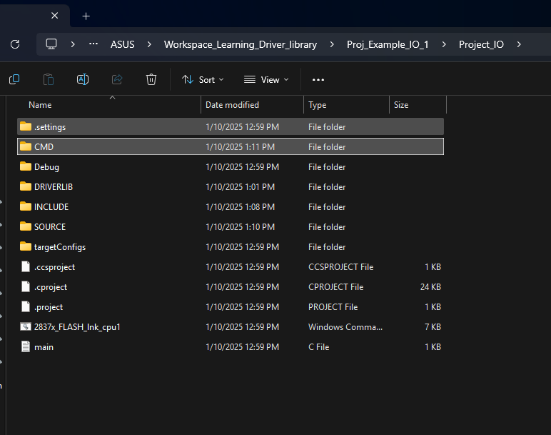
File Confirmation in the Project Folder

Slide 12
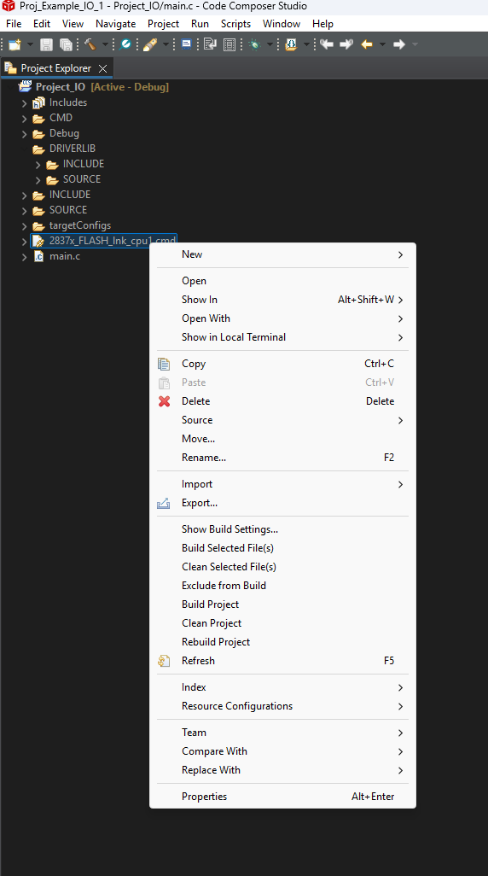
Delete RAM and FLASH file
Delete this RAM and Flash file

Slide 13
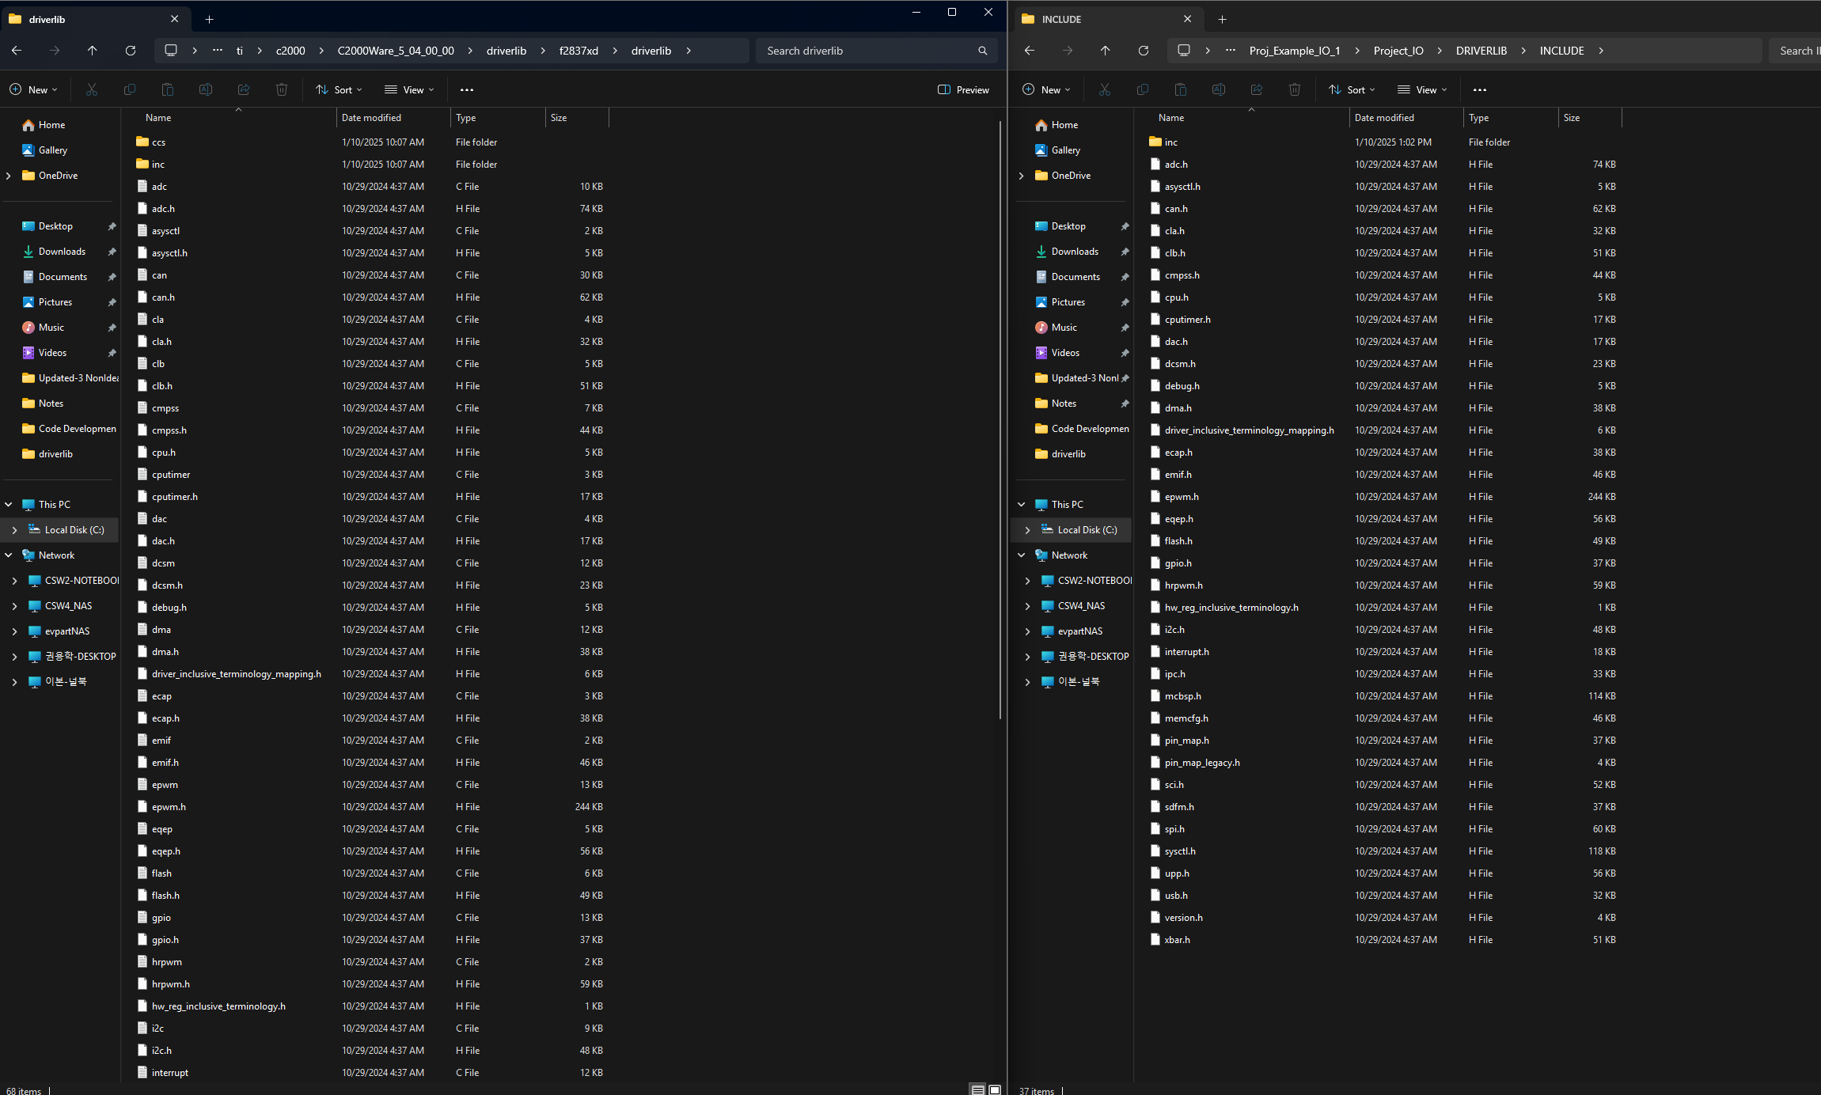
Transfer Driver Library files : Header files
C2000Ware_5_04_00_00\driverlib\f2837xd\driverlib
Workspace Folder >>Project Folder >> DRIVERLIB >> INCLUDE
Copy all Header file (.h)
Paste

Slide 14
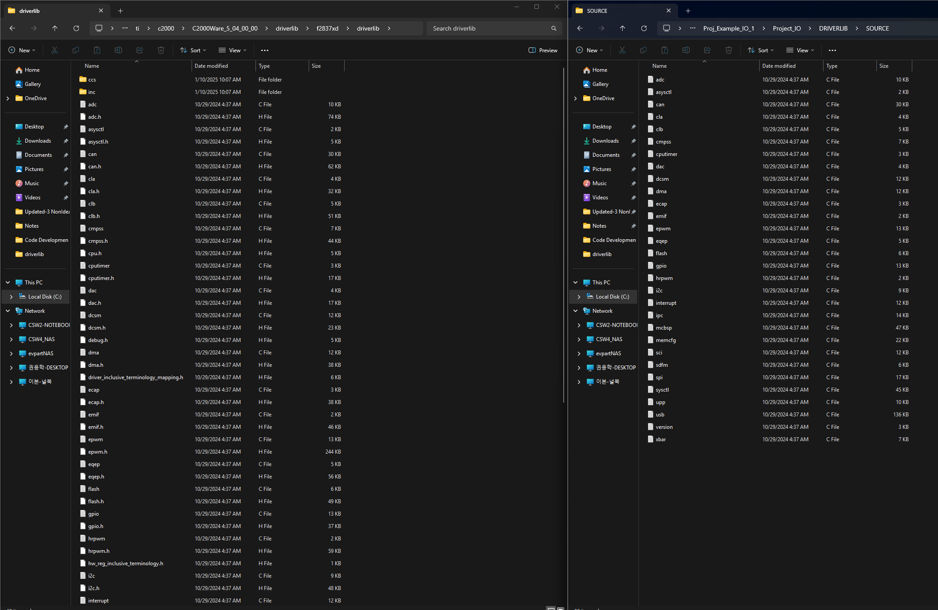
Transfer Driver Library files : Source files
C2000Ware_5_04_00_00\driverlib\f2837xd\driverlib
Workspace Folder >>Project Folder >> DRIVERLIB >> SOURCE
Copy all Source file (.c)
Paste

Slide 15
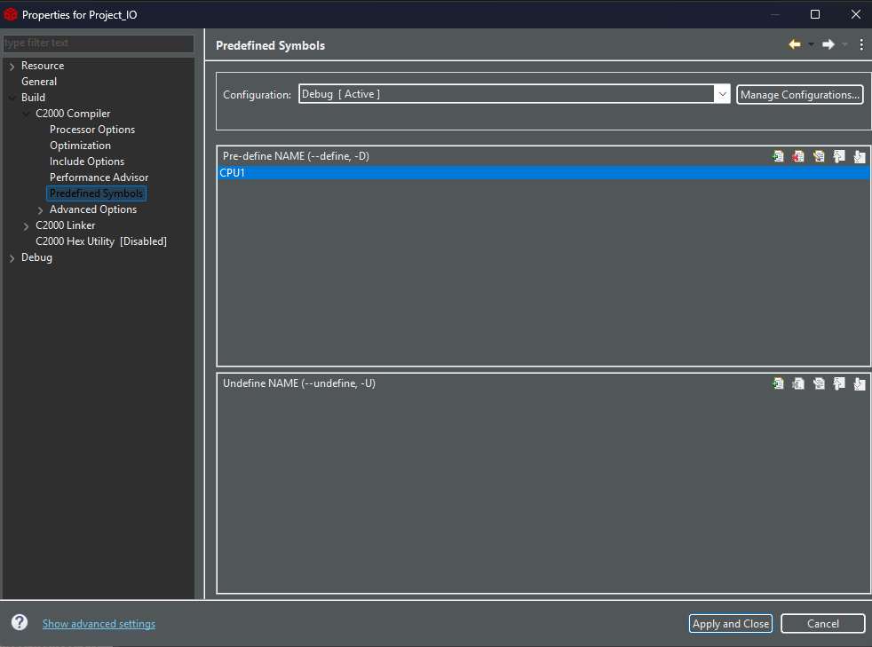
Add Predefined Symbols
“CPU1” is added

Slide 16
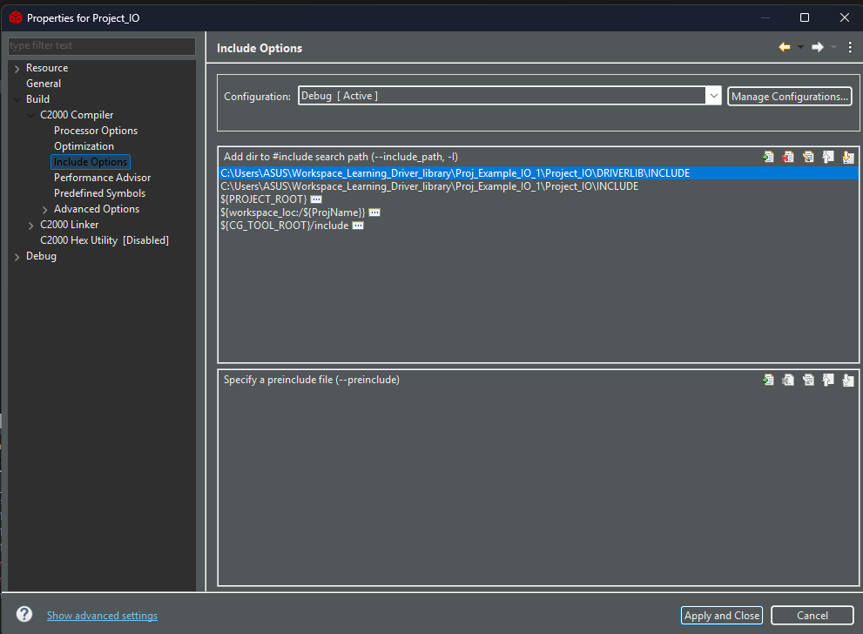
Include Path Configuration
Project’s Driver library and device support header files path are added in the Include Paths

Slide 17
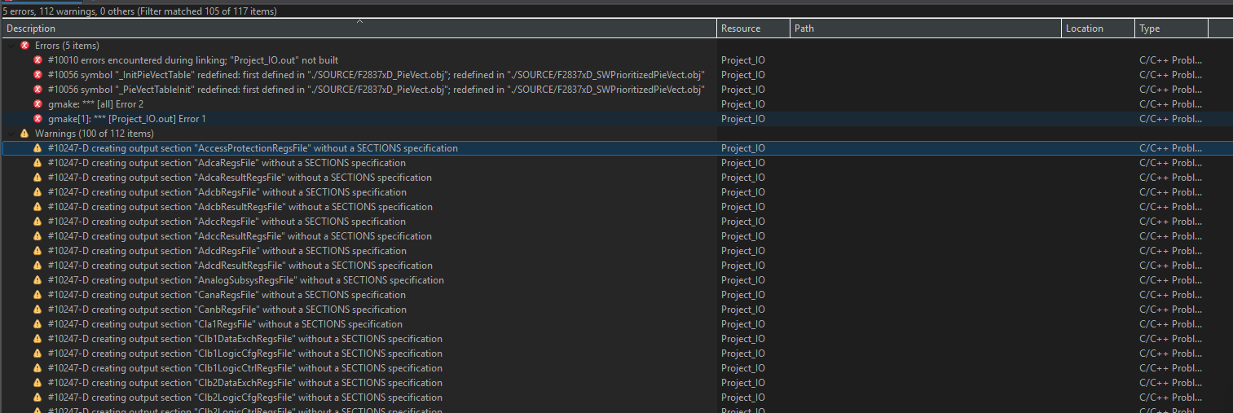
Build
After Building the project, I got following errors.

Slide 18
Thank You

