Slide 1
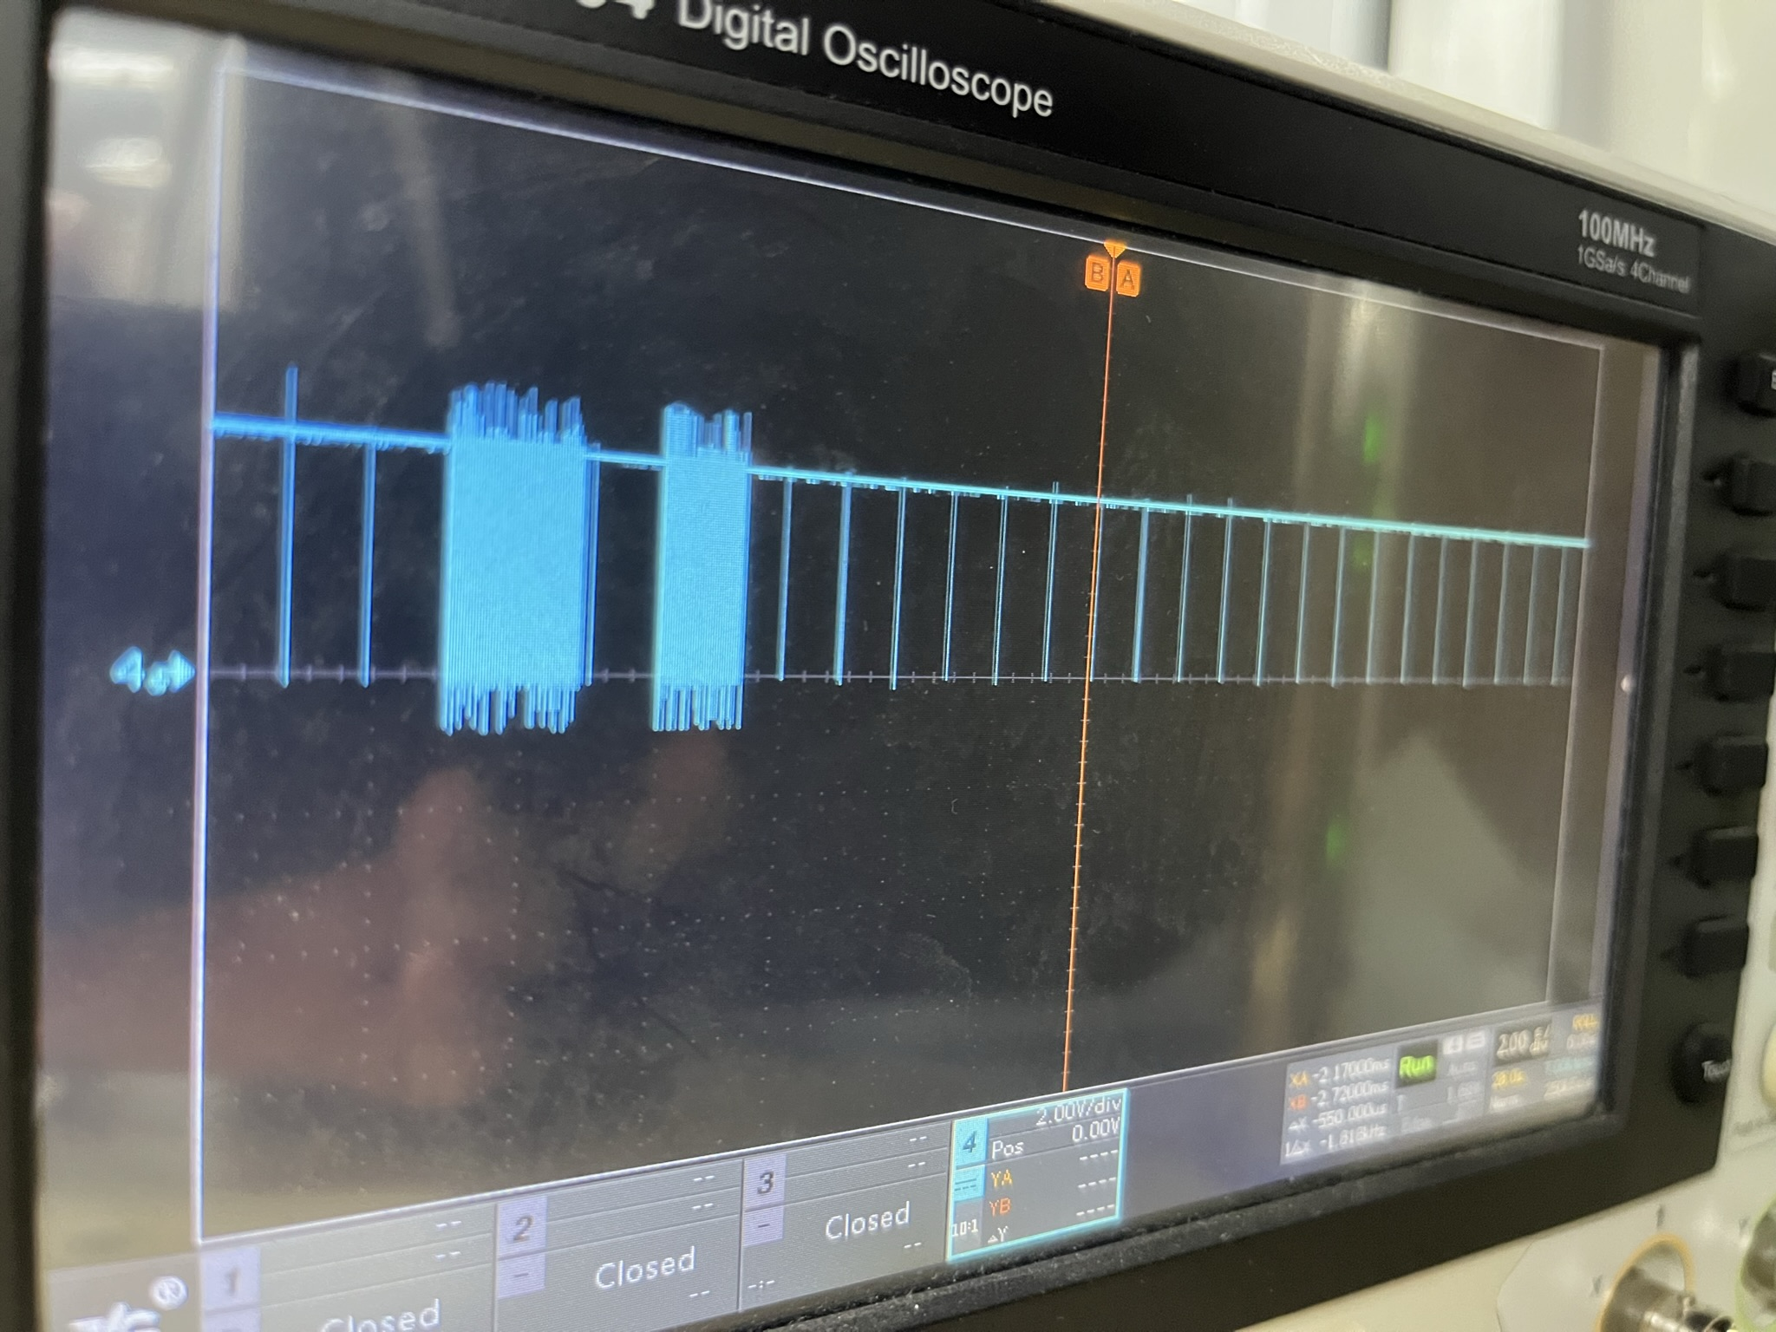
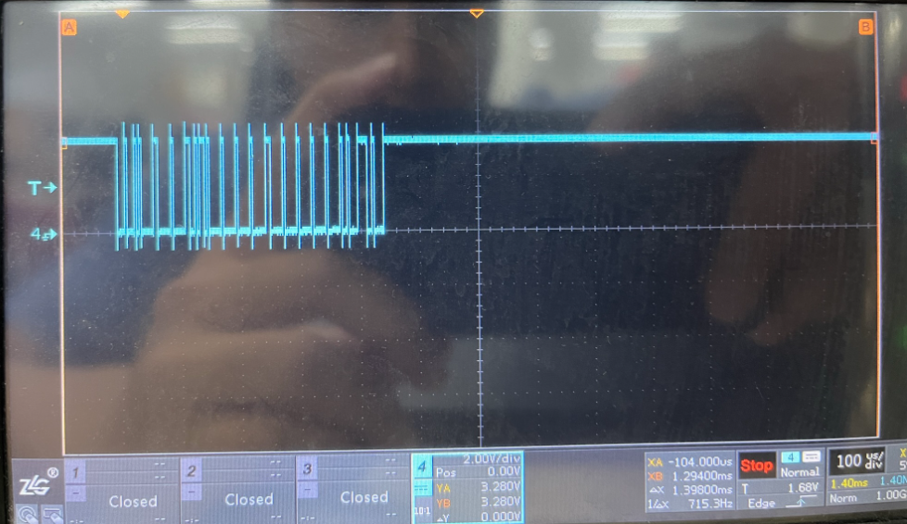
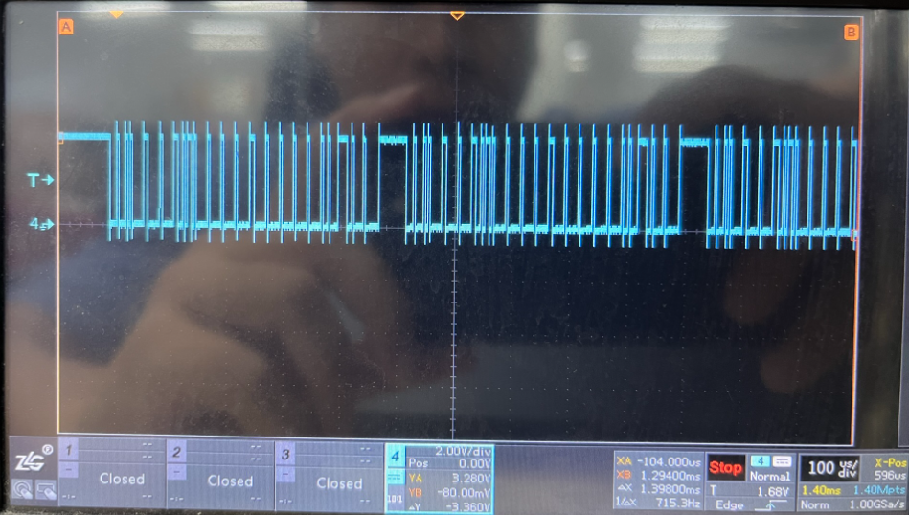
Good signal
Bad signal
Good signal
Bad signal

Slide 2
Time(s) Ch ID DLC Data
122.042834 1 114 Rx d 8 01 2C 00 00 08 00 00 00 Length = 0 BitCount = 0 ID = 276
122.043384 1 114 Rx d 8 01 2C 00 00 08 00 00 00 Length = 0 BitCount = 0 ID = 276
122.043938 1 114 Rx d 8 01 2C 00 00 08 00 00 00 Length = 0 BitCount = 0 ID = 276
122.044491 1 114 Rx d 8 01 2C 00 00 08 00 00 00 Length = 0 BitCount = 0 ID = 276
122.045045 1 114 Rx d 8 01 2C 00 00 08 00 00 00 Length = 0 BitCount = 0 ID = 276
122.051296 1 114 Rx d 8 01 2C 00 00 08 00 00 00 Length = 0 BitCount = 0 ID = 276
122.927160 1 114 Rx d 8 01 2D 00 00 08 00 00 00 Length = 0 BitCount = 0 ID = 276
123.940403 1 114 Rx d 8 01 2D 00 00 08 00 00 00 Length = 0 BitCount = 0 ID = 276
124.953589 1 114 Rx d 8 01 2D 00 00 08 00 00 00 Length = 0 BitCount = 0 ID = 276
125.966815 1 114 Rx d 8 01 2D 00 00 08 00 00 00 Length = 0 BitCount = 0 ID = 276
126.980529 1 114 Rx d 8 01 2D 00 00 08 00 00 00 Length = 0 BitCount = 0 ID = 276
128.001665 1 114 Rx d 8 01 2C 00 00 08 00 00 00 Length = 0 BitCount = 0 ID = 276
128.002214 1 114 Rx d 8 01 2C 00 00 08 00 00 00 Length = 0 BitCount = 0 ID = 276
128.002773 1 114 Rx d 8 01 2C 00 00 08 00 00 00 Length = 0 BitCount = 0 ID = 276
128.003317 1 114 Rx d 8 01 2C 00 00 08 00 00 00 Length = 0 BitCount = 0 ID = 276
128.003876 1 114 Rx d 8 01 2C 00 00 08 00 00 00 Length = 0 BitCount = 0 ID = 276
128.004420 1 114 Rx d 8 01 2C 00 00 08 00 00 00 Length = 0 BitCount = 0 ID = 276
128.004979 1 114 Rx d 8 01 2C 00 00 08 00 00 00 Length = 0 BitCount = 0 ID = 276
128.005532 1 114 Rx d 8 01 2C 00 00 08 00 00 00 Length = 0 BitCount = 0 ID = 276
Bad
Good
Bad

