Slide 1
CCS Set-up for TMS320F28379D

Slide 2
Independent Project Set-Up Process for CCS
The following software are installed and these are downloaded from ti official website
ControlSuite
C2000Ware
CCStudio Version: 12.8.1.00005

Slide 3
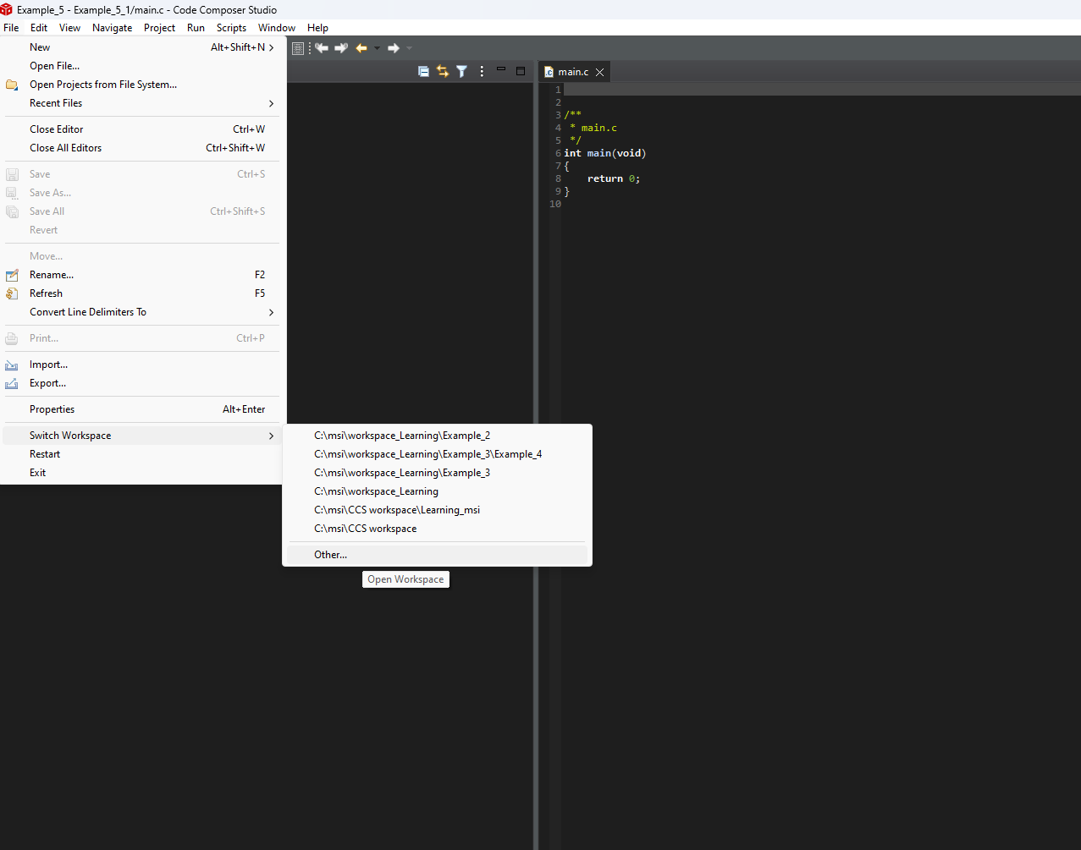
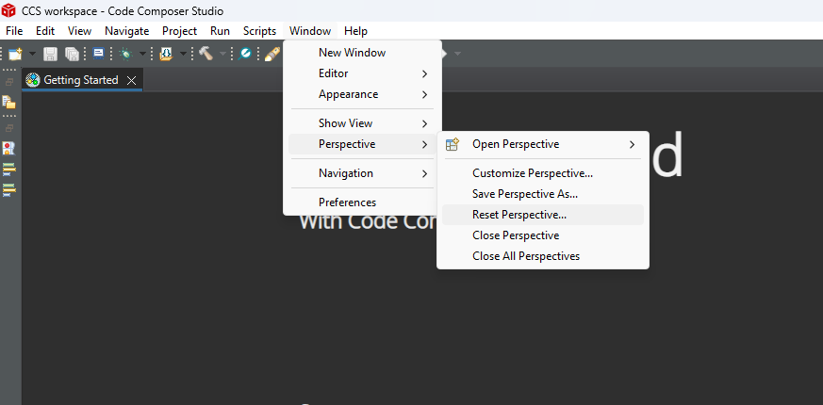
CCStudio Start-Up
Create New workspace for new project
Name the workspace and save in your main workspace folder, as shown below in the figure
After making the new workspace, Reset Perspective as shown below in the figure

Slide 4
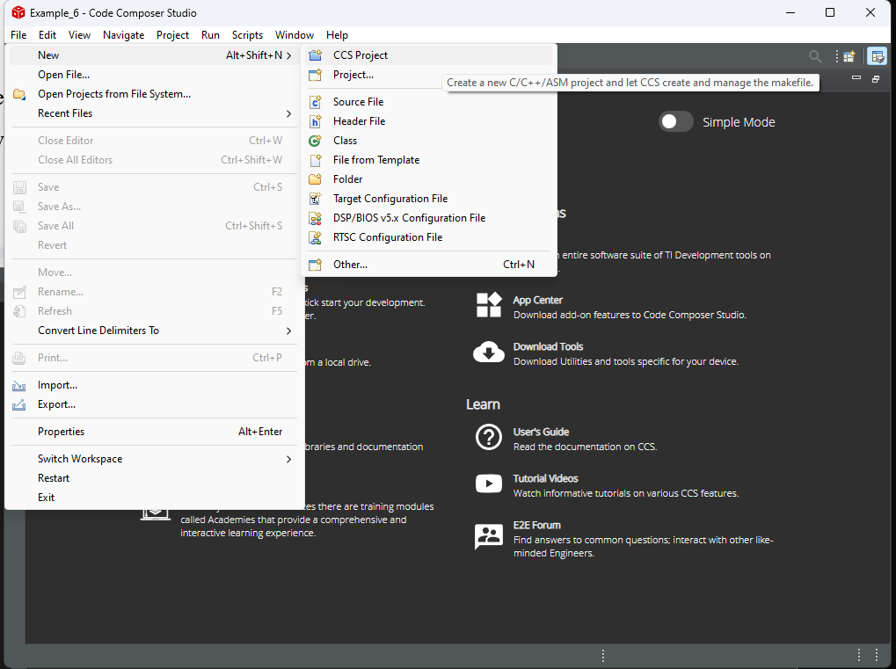
CCStudio Start-Up
Create new project in CCS Project

Slide 5
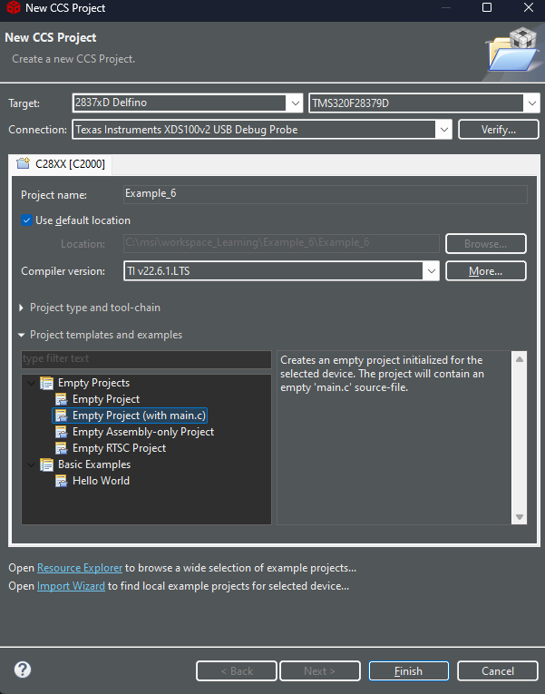
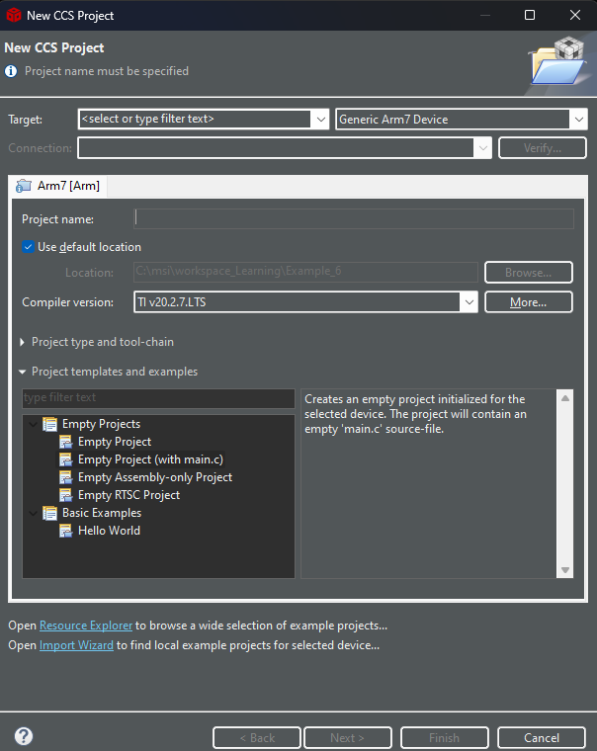
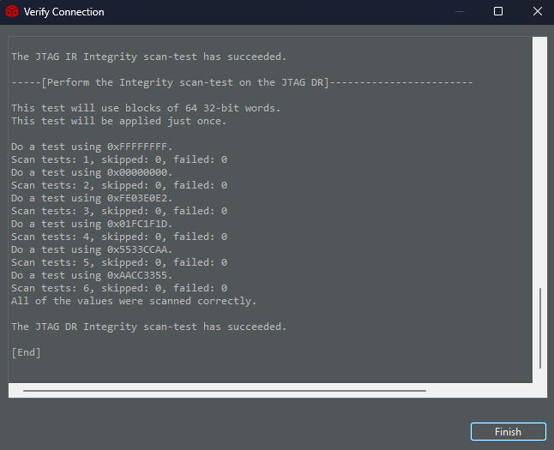
CCStudio Start-Up

Slide 6
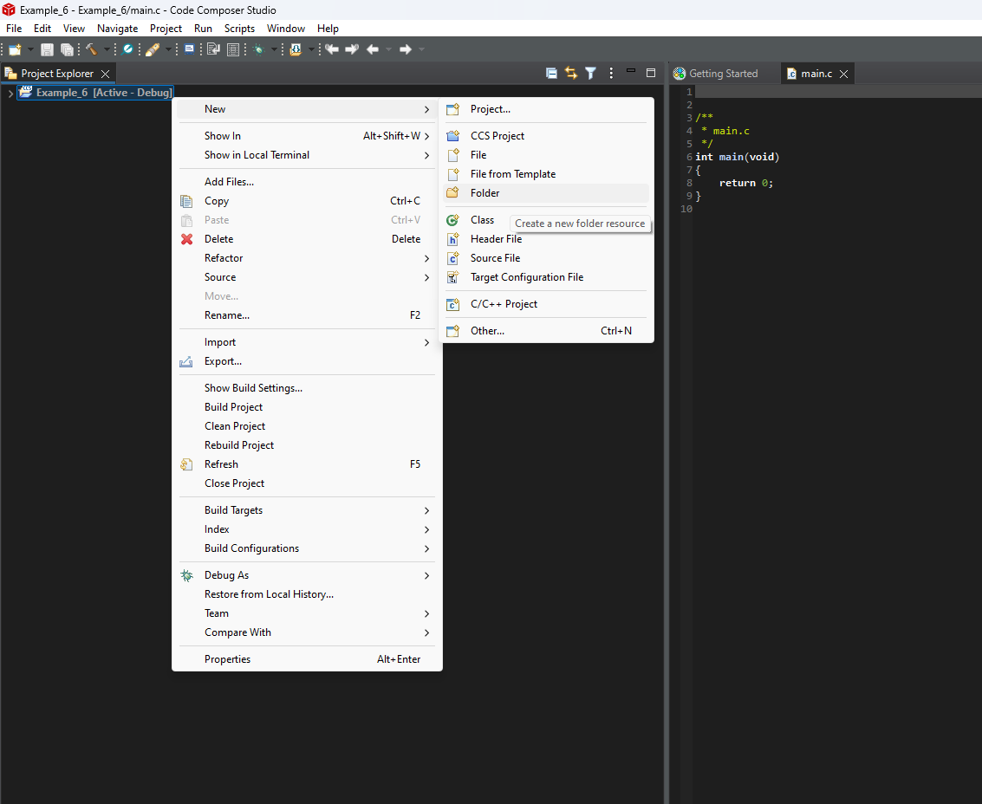
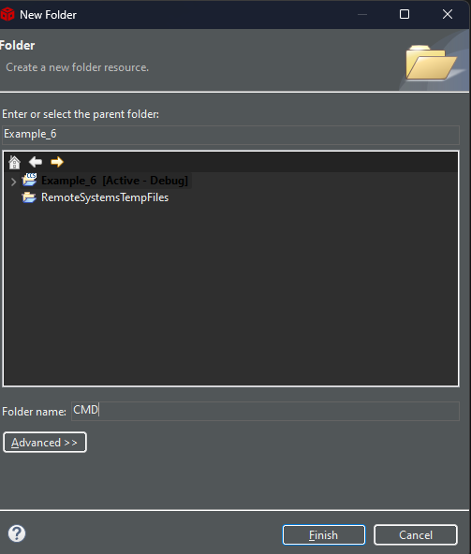
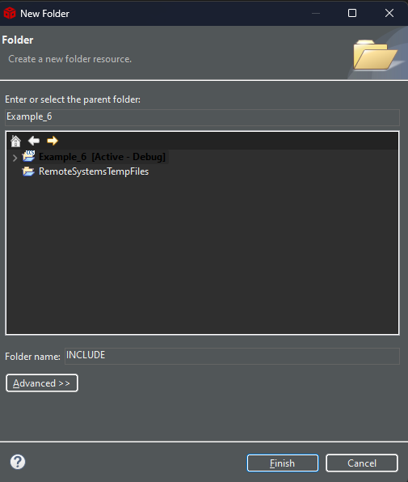
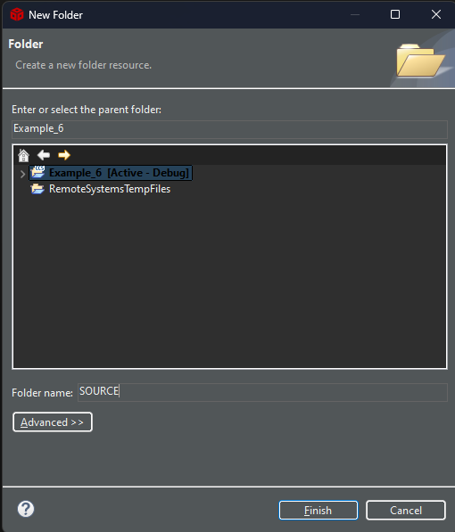
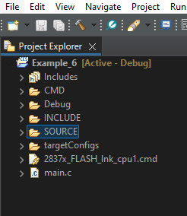
Create Folder In The Project
Folder CMD
Folder INCLUDE
Folder SOURCE
Verify: Folders are in The Project

Slide 7
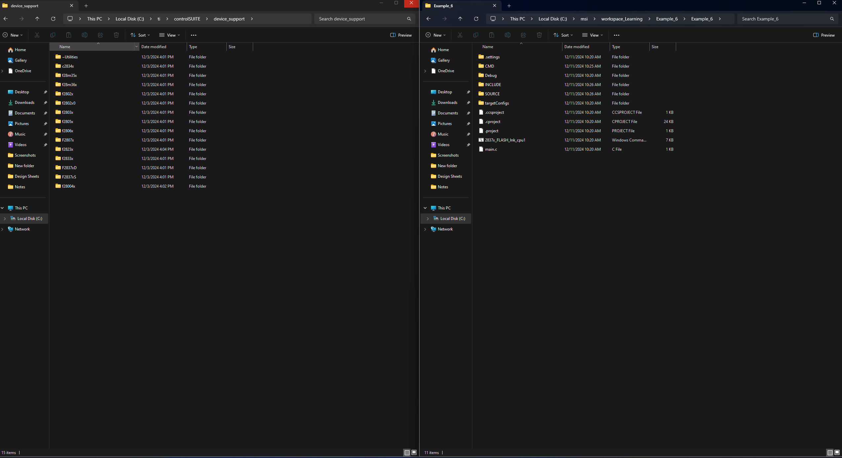
Importing lib files into the Project
Workspace Folder
Control SUITE >> Device support
Example_6

Slide 8
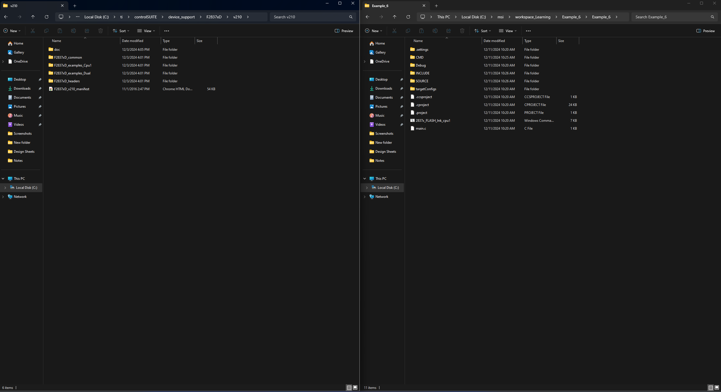
Importing lib files into the Project
Control SUITE >> Device support >>F2837xD>>v210
Workspace Folder
Example_6

Slide 9
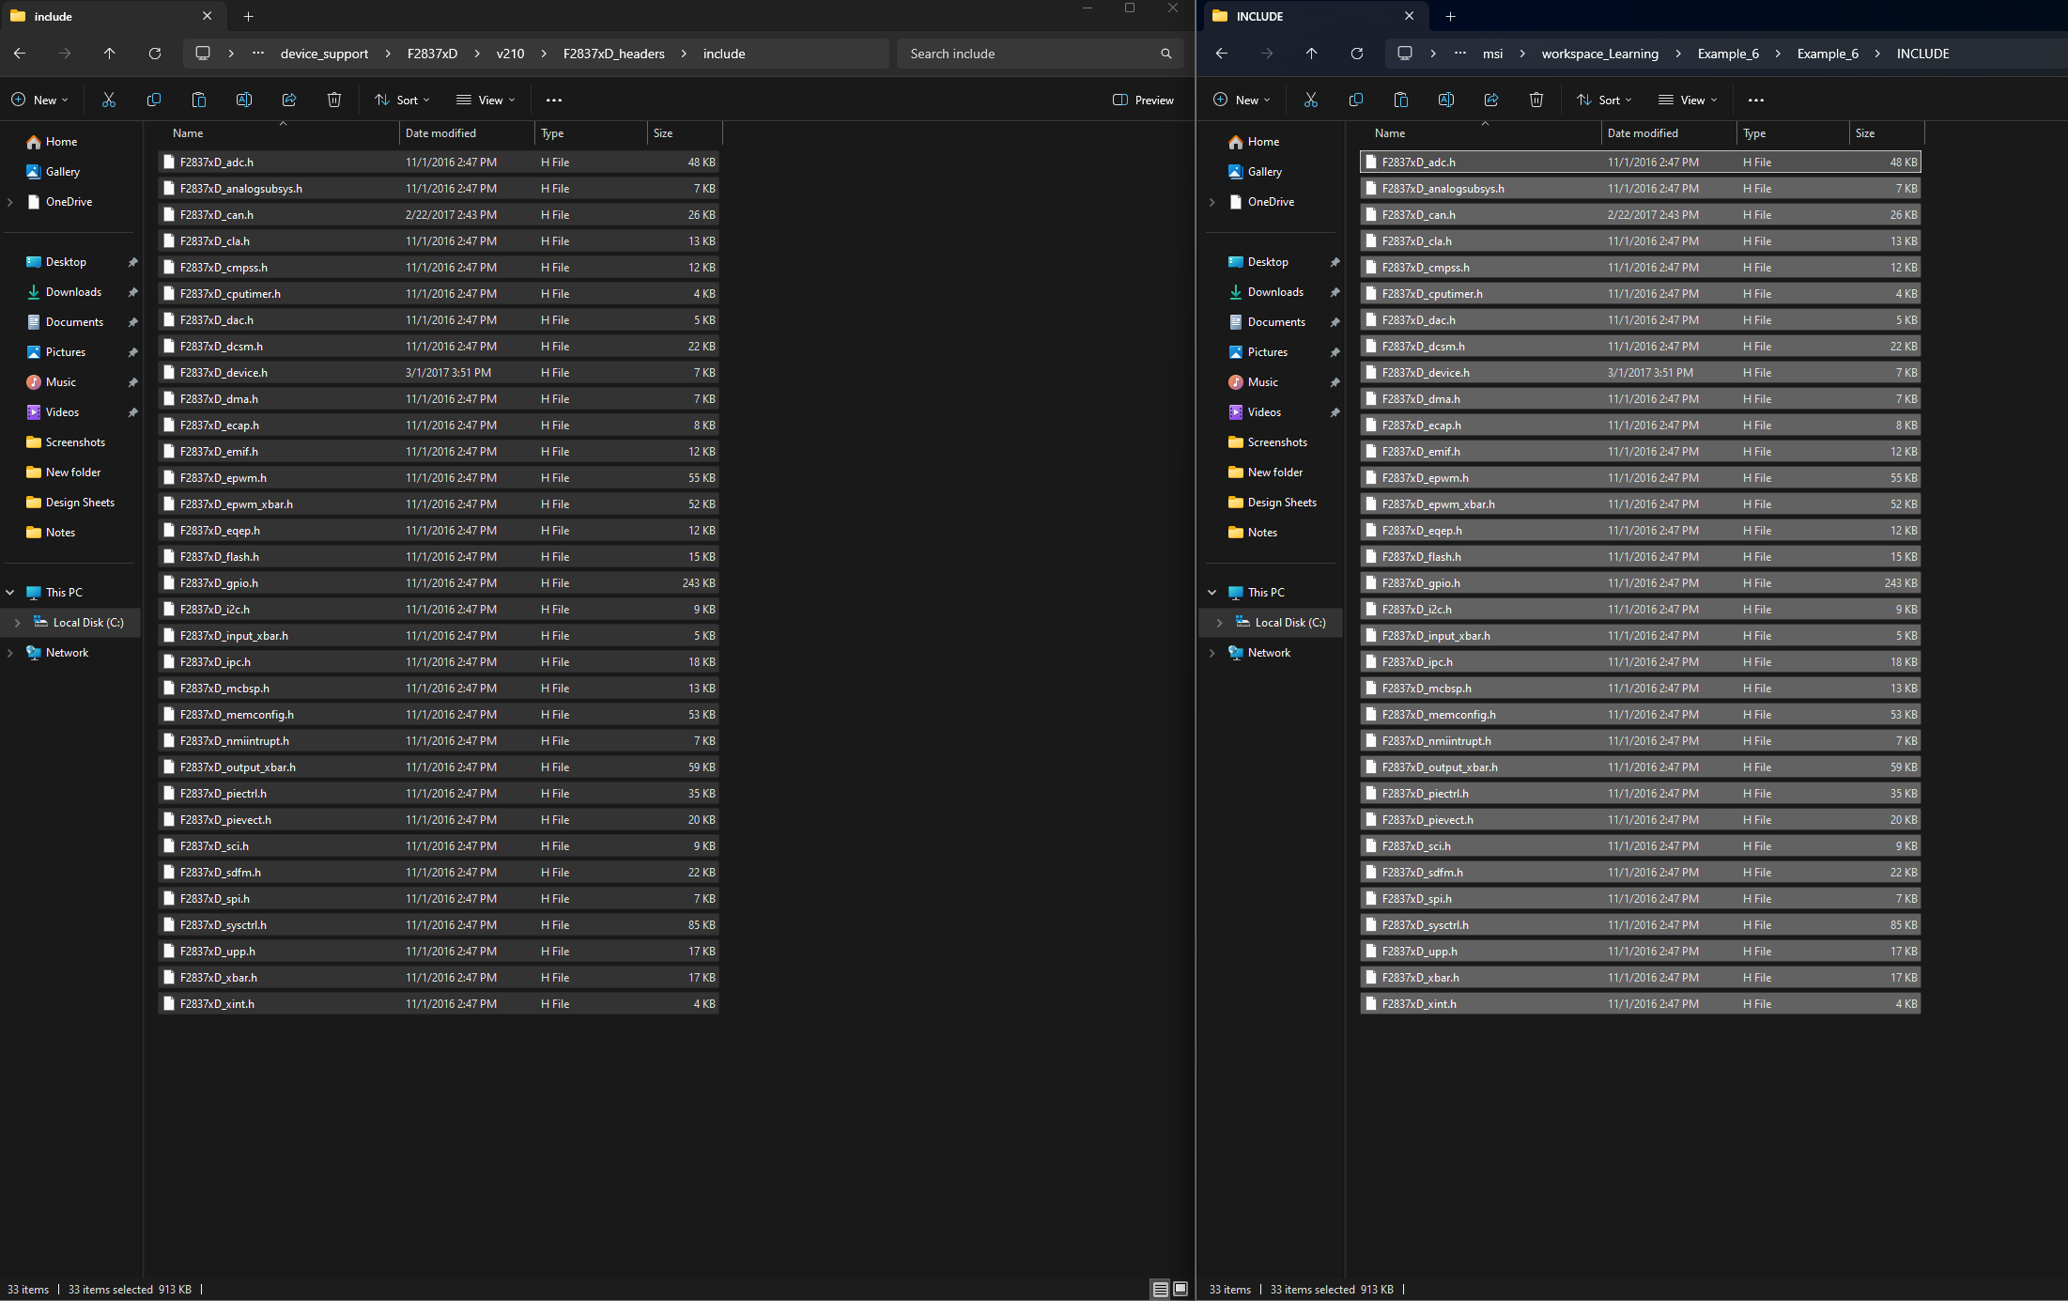
Importing lib files into the Project
Control SUITE >> Device support > F2837xD > v210 > F2837xD_header > Include
Workspace Folder >> INCLUDE
Paste
Copy

Slide 10
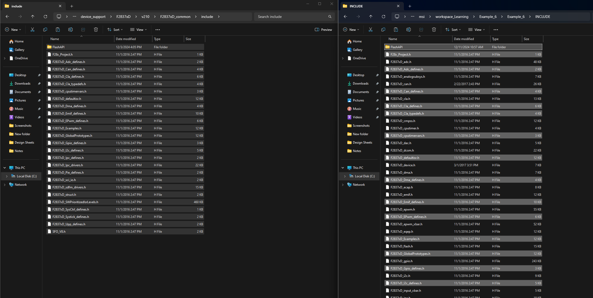
Importing lib files into the Project
Control SUITE >> Device support > F2837xD > v210 > F2837xD_Common> include
Workspace Folder >> INCLUDE
Paste
Copy

Slide 11
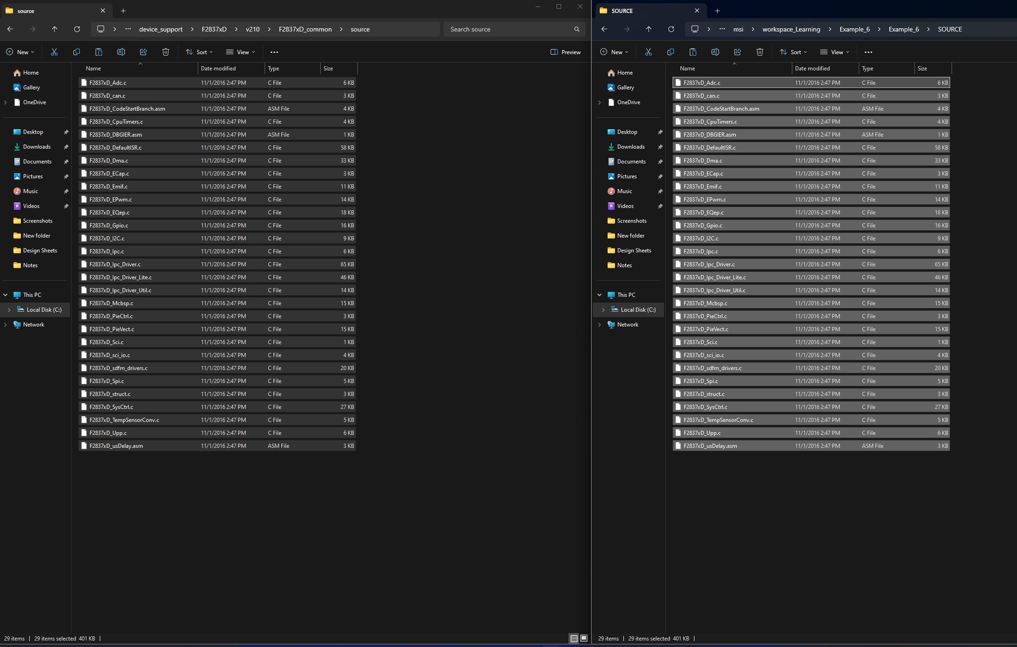
Importing lib files into the Project
Control SUITE >> Device support > F2837xD > v210 > F2837xD_Common> source
Workspace Folder >> SOURCE
Paste
Copy

Slide 12
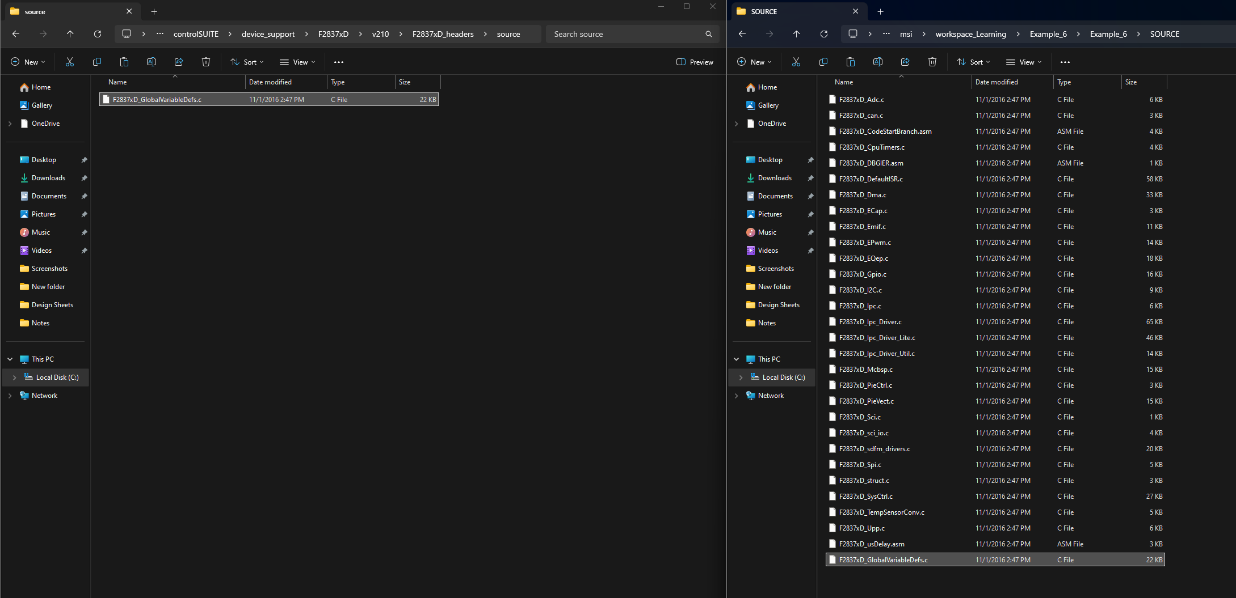
Importing lib files into the Project
Control SUITE >> Device support > F2837xD > v210 > F2837xD_headers > source
Workspace Folder >> SOURCE
Copy
Paste

Slide 13
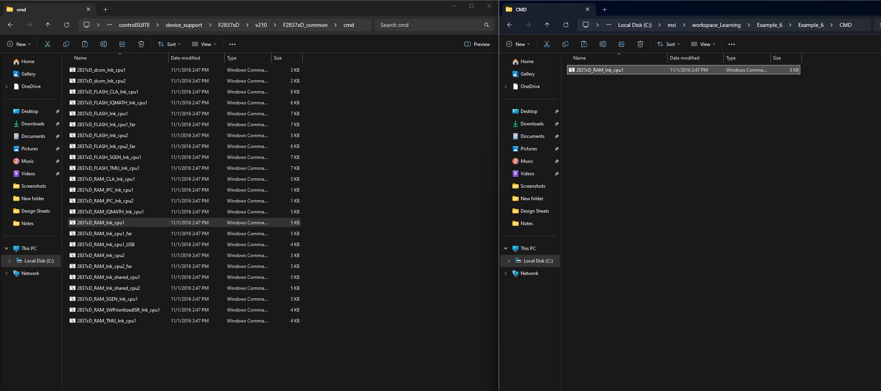
Importing lib files into the Project
Control SUITE >> Device support > F2837xD > v210 > F2837xD_common > cmd
Workspace Folder >> CMD
Paste
Copy

Slide 14
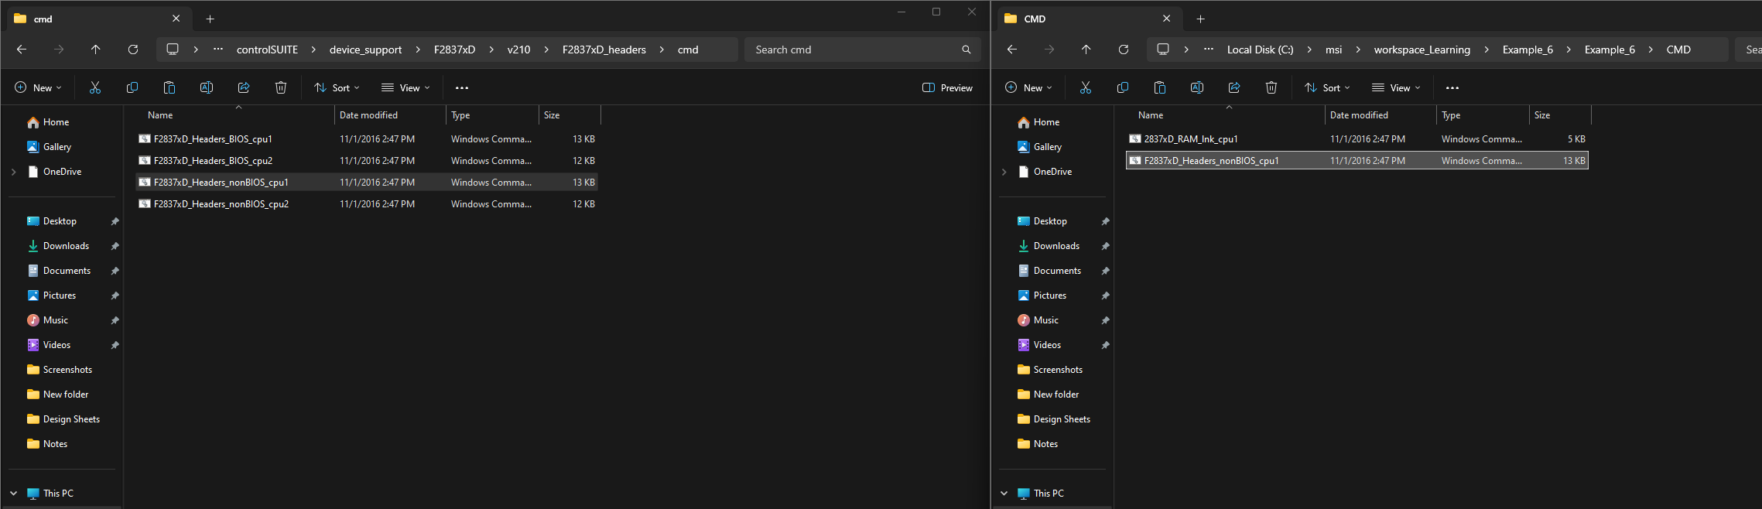
Importing lib files into the Project
Control SUITE >> Device support > F2837xD > v210 > F2837xD_headers > cmd
Workspace Folder >> CMD
Paste
Copy

Slide 15
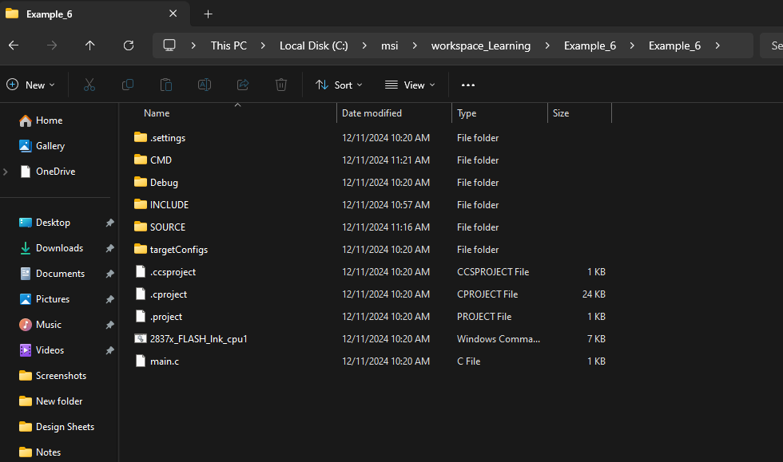
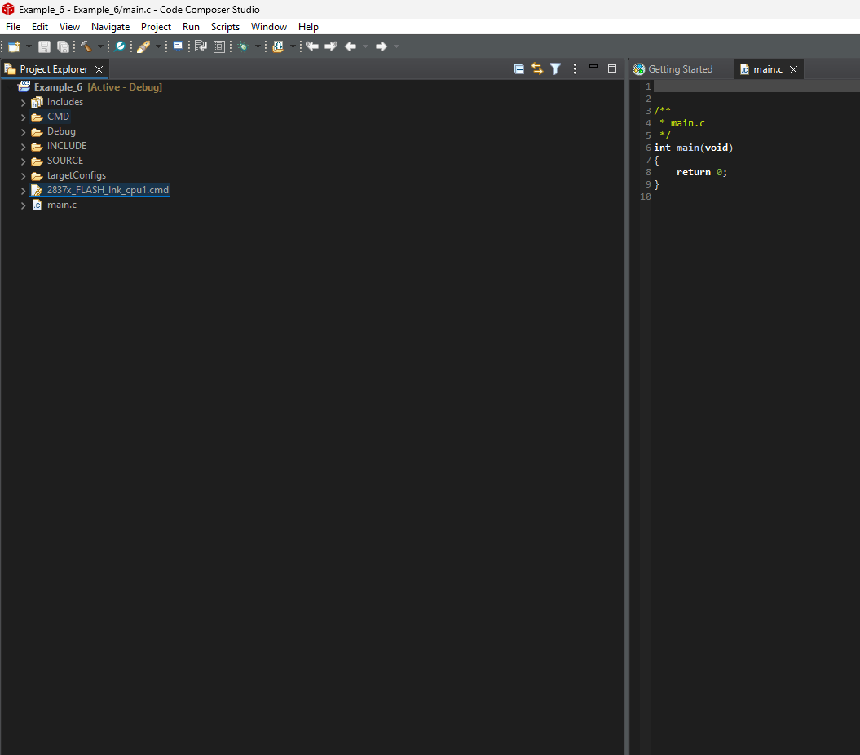
Project Files Confirmation
Delete this RAM & FLASH file
Confirm these project files present in the project Folder

Slide 16
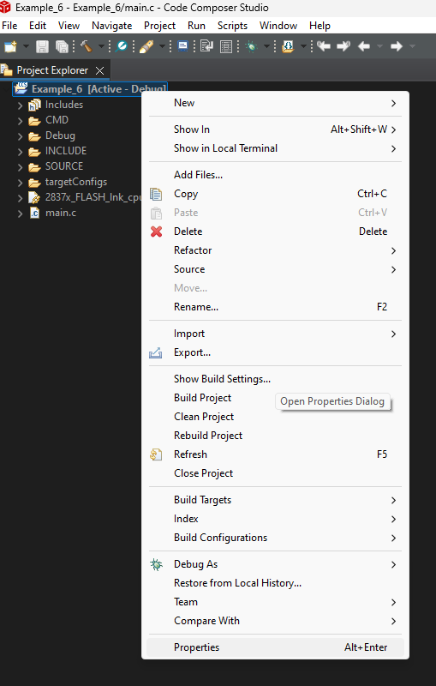
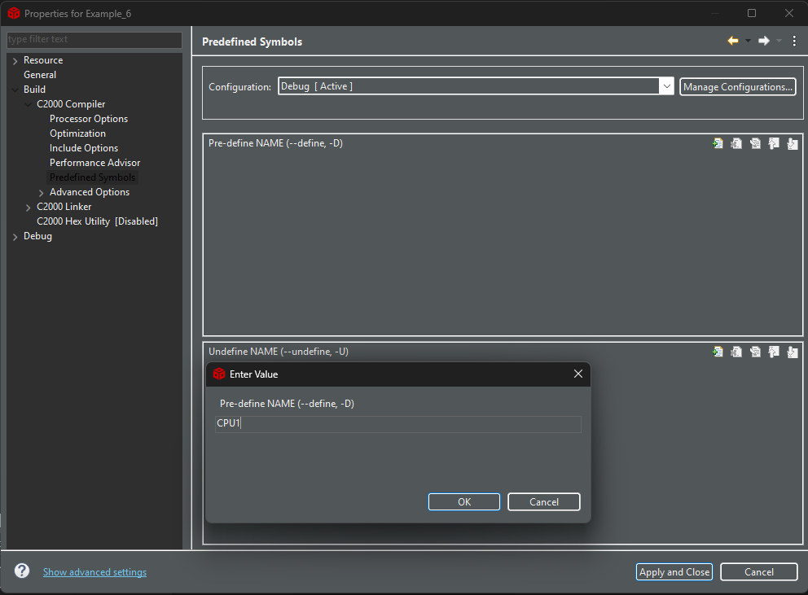
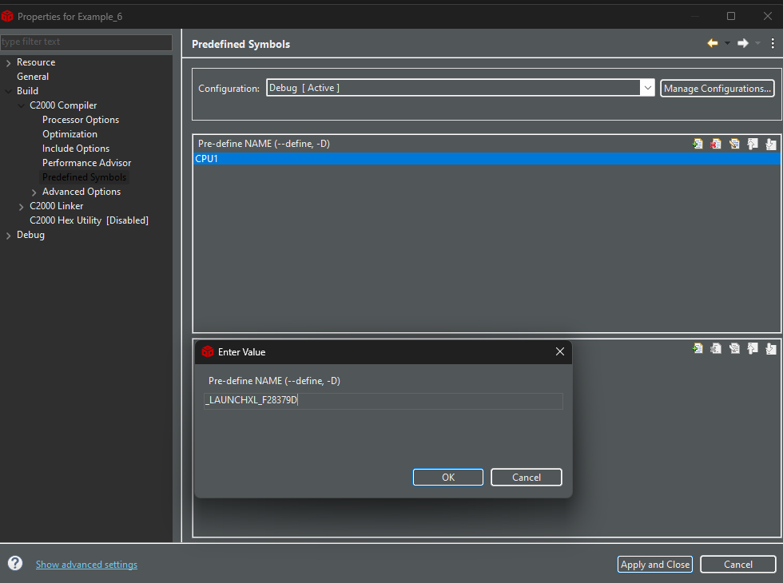
Add Predefined symbol_1
Predefined “CPU1”
Predefined “_LAUNCHXL_F28379D”

Slide 17
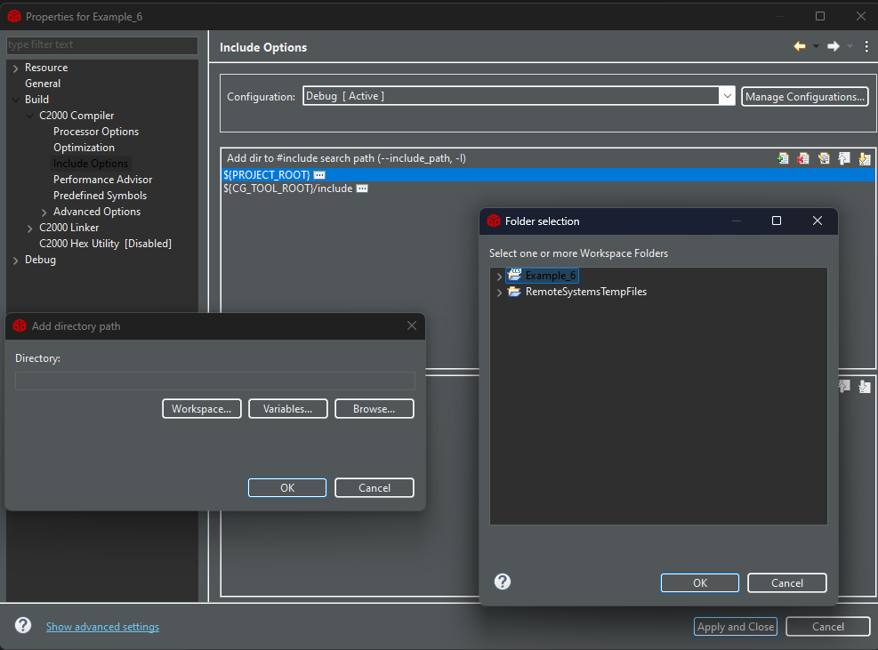
Include Path Directory
1
2
4
3

Slide 18
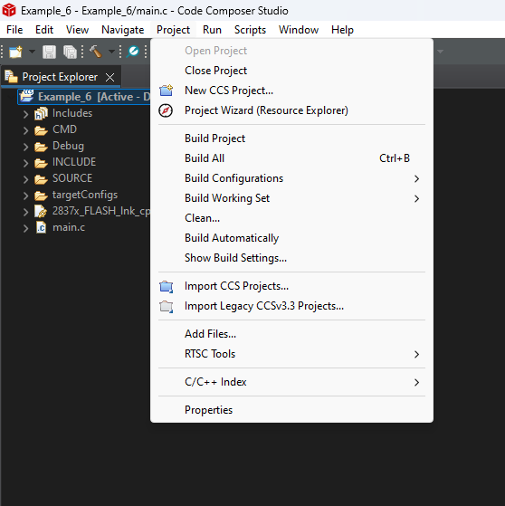
Build the code

Slide 19
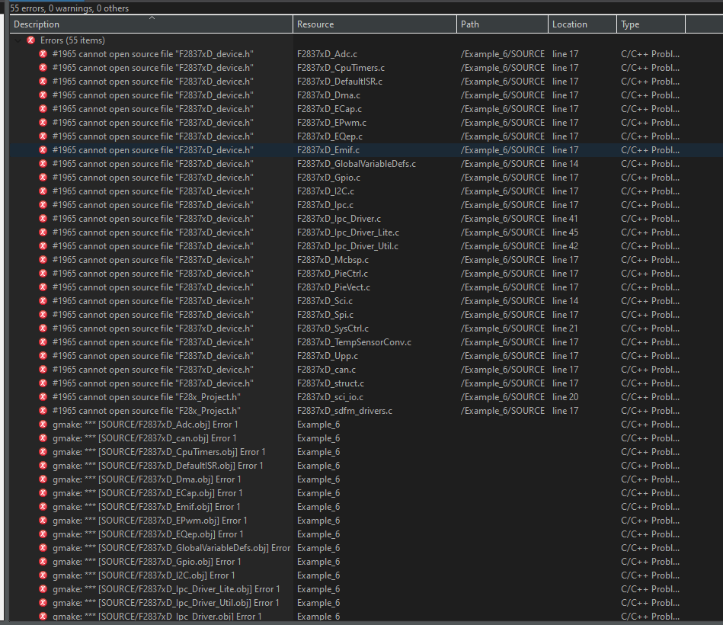
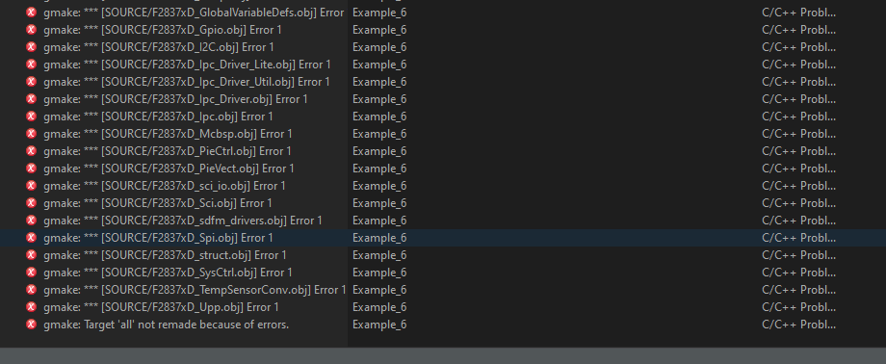
Errors After Building the Project

Slide 20
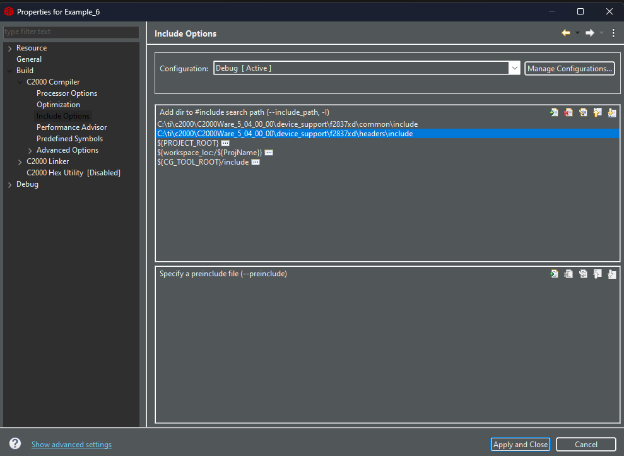
Include the Path Directory
The two path directories are added

Slide 21
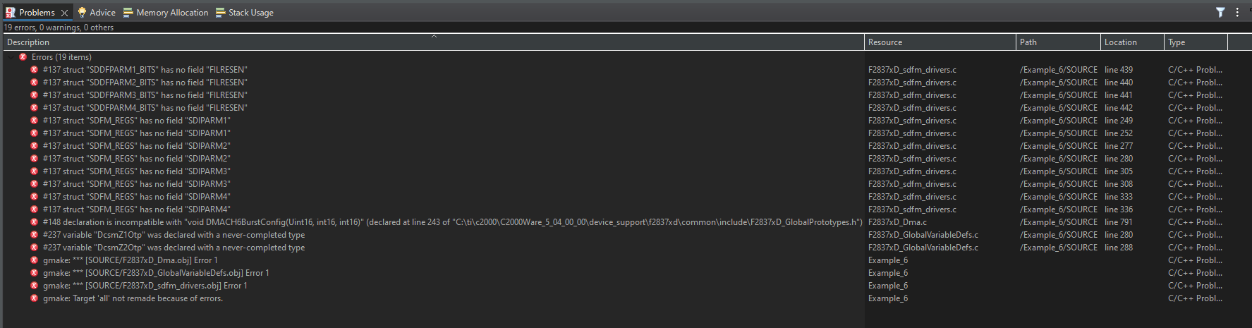
Errors After Building the Project
After adding the path directories, following errors comes up

Slide 22
Thank you

