Slide 1
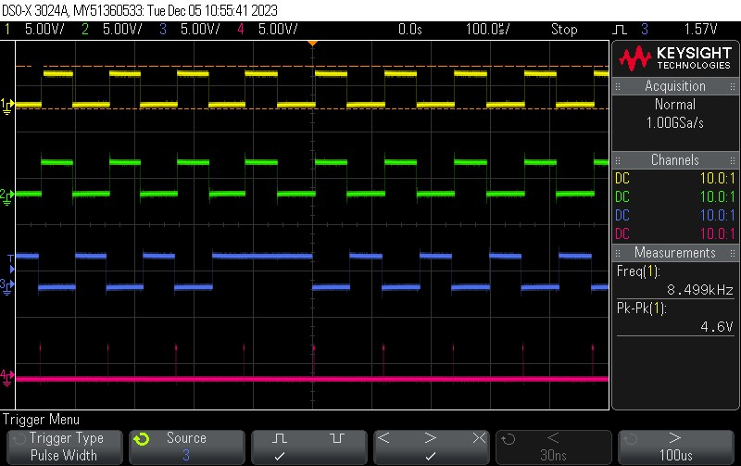
Missing AQ Event on Sync
Picture of reproduced error with signal names, and AQ settings
ePWM | CAU | CBU | CAD | CBD | ZRO
1A | Set |  |  | Clear | Clear
3A | Set | Clear |  |  | Clear
3B |  |  | Clear | Set | Clear
ePWM1A
CAU
CBD
ePWM3A
CAU
CBU
ePWM3B
CAD
CBD
ZRO
Trigger setting:
Pulse width > 100us means short occurring on ePWM3B
SYNCOUT ZRO Event ePWM1

Slide 2
Analysis on Missing AQ Event on Sync
ePWM | CAU | CBU | CAD | CBD | ZRO
1A | Set |  |  | Clear | Clear
3A | Set | Clear |  |  | Clear
3B |  |  | Clear | Set | Clear
ePWM1A
CAU
CBD
ePWM3A
CAU
CBU
ePWM3B
CAD
CBD
ZRO
Analysis of waveforms:
After sync even, ePWM3 starts to count up is shown with the TBCTR illustration.
CAD event is never reached before the sync event from ePWM1
Resolution: Updating counter direction for ePWM3 after sync to be count down instead of count up solves the issue.
CTR DIR = UP
TBCTR
SYNCOUT ZRO Event ePWM1

Slide 3
Resolution & Summary for missing AQ event on Sync
Resolution:
Disabled PHEN for ePWM1
EPwm1Regs.TBCTL.bit.PHSEN = TB_DISABLE;
Set PHSDIR to count down for ePWM3
EPwm3Regs.TBCTL.bit.PHSDIR = TB_DOWN;
Summary:
Trigger setting is never reached on scope
Outputs are running normal

