Slide 1
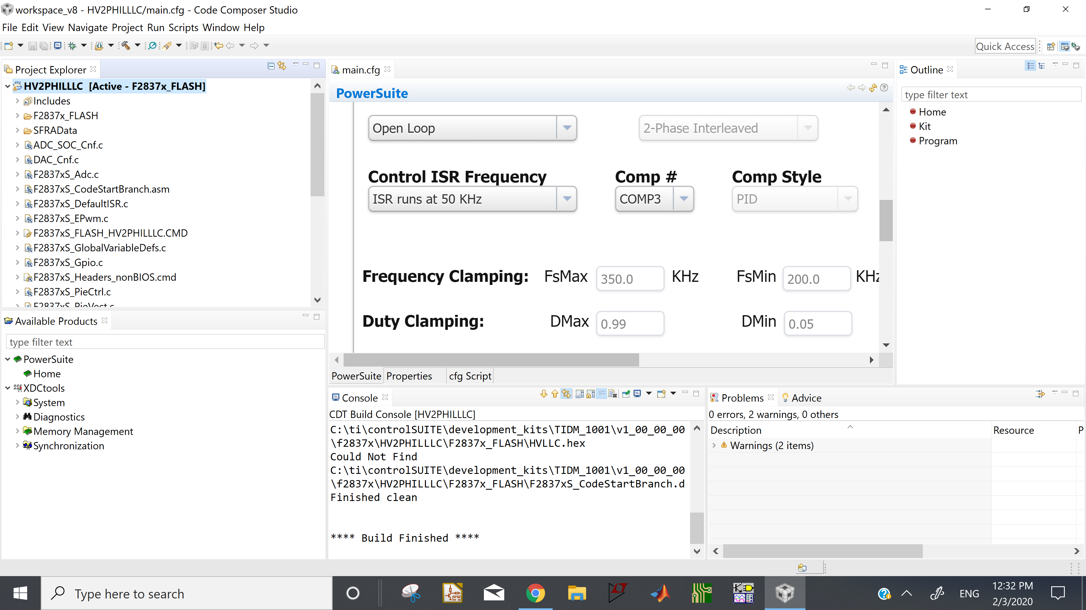
Build output report after “clean project”

Slide 2
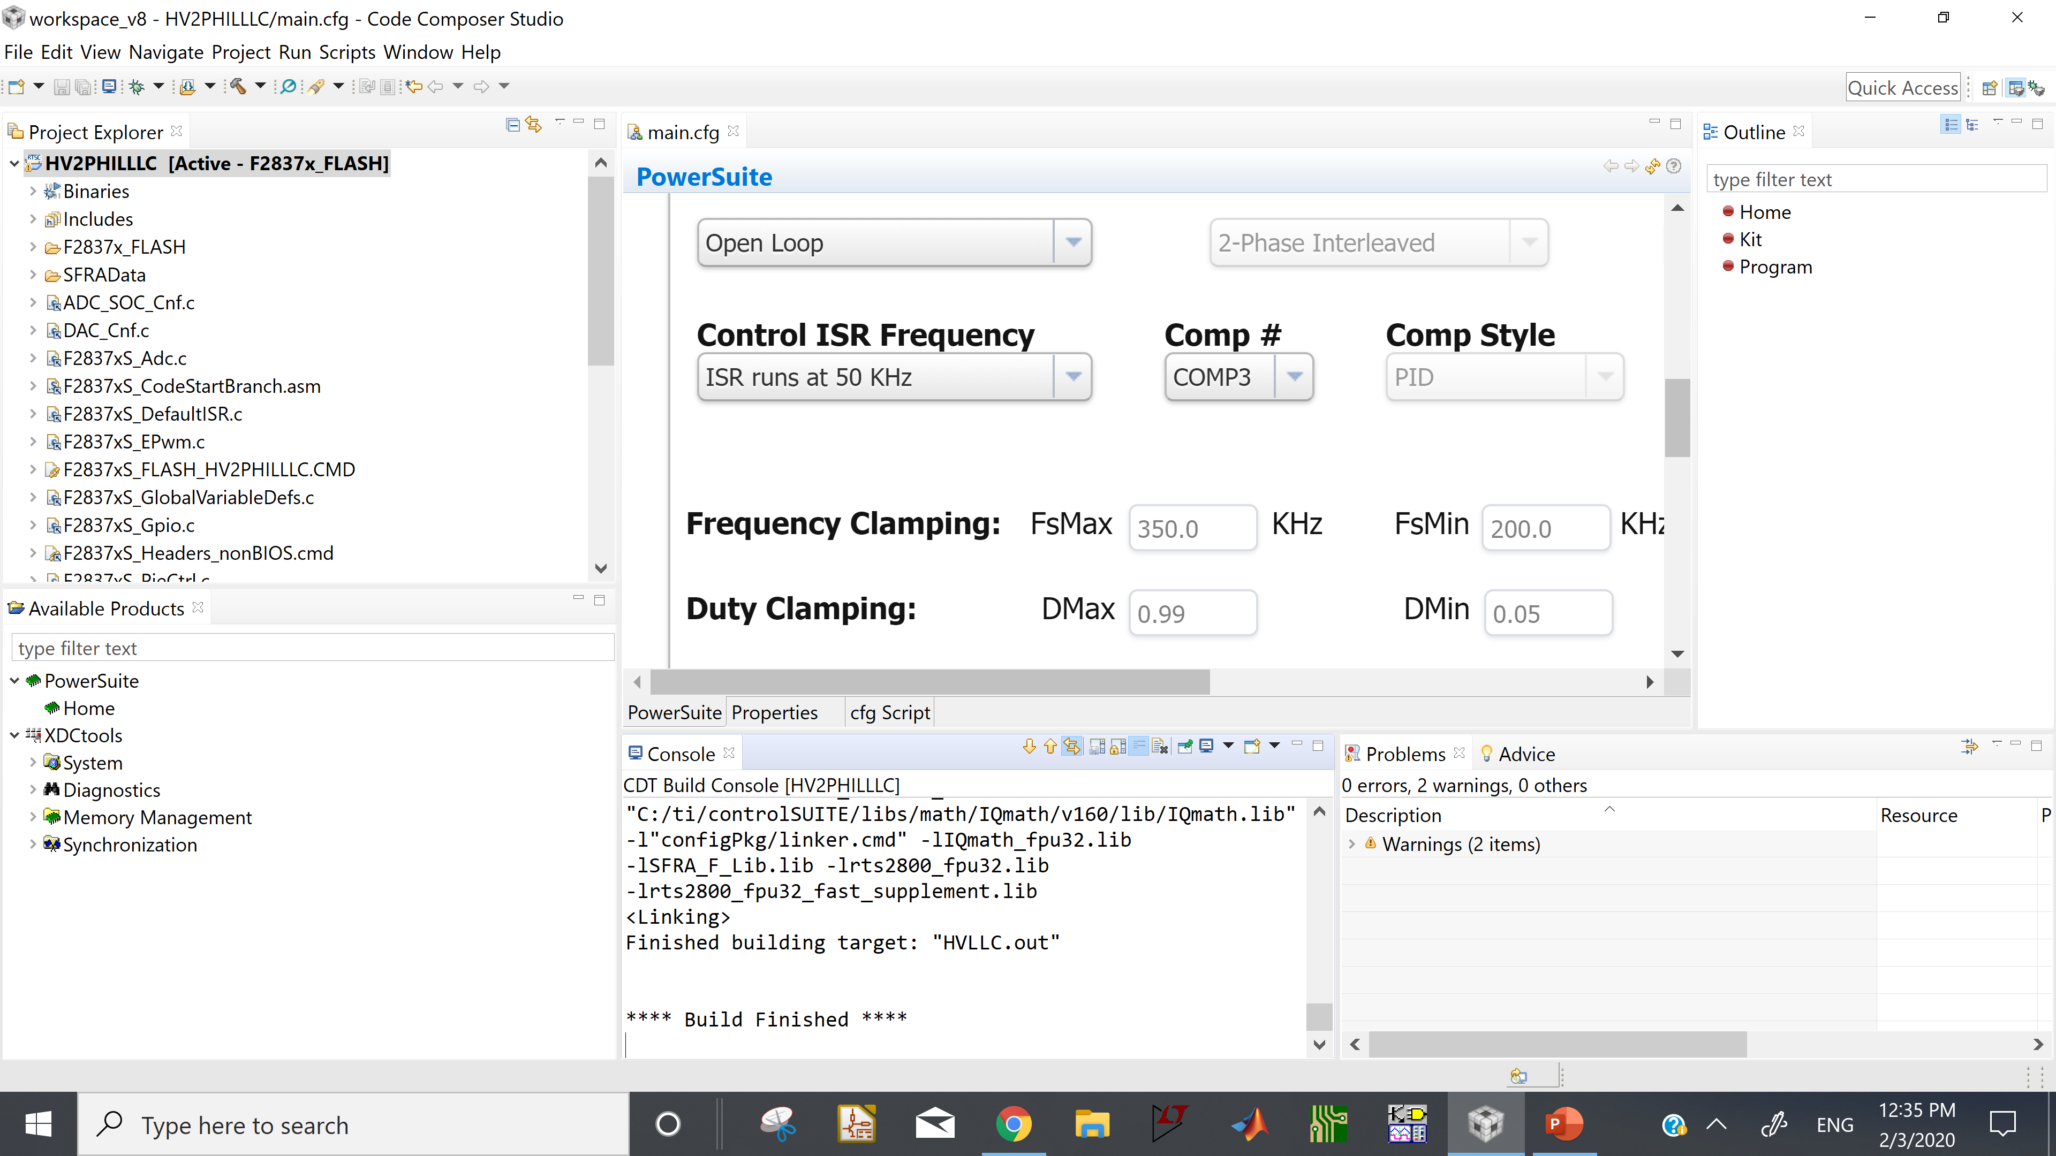
Build output report after “build all” from Project

