Slide 1
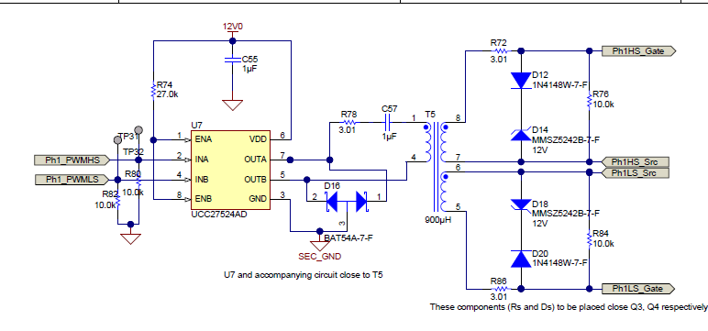
TIDM-1001 SCH: Ph1 High side drive
12v dr has fallen to 200mV
12v dr has fallen to 200mV
Suspect this driver chip

