Slide 1
Ext circuit, DPT connection
Choke (PWM)
Ext switch (to trigger 200us PWMs)
PWMs wire
12V aux power
5V DSP power

Slide 2
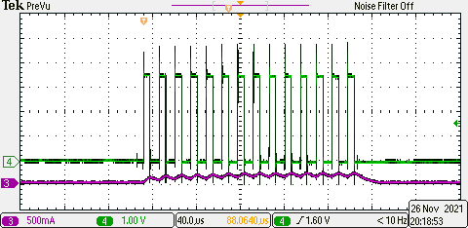
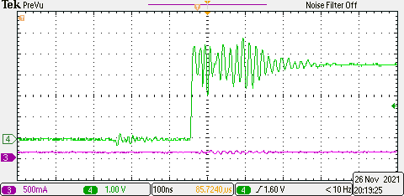
10Vdc,
Green: PWM
Red: inductor current

Slide 3
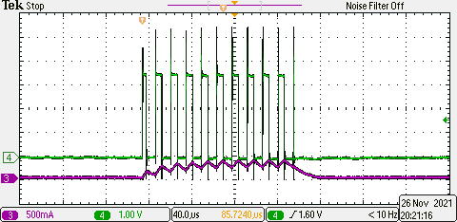
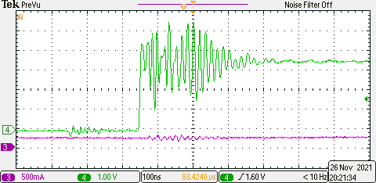
20Vdc,
Green: PWM
Red: inductor current
We could see
PWM not enough PWM pulse(PWM generation stop)

Slide 4
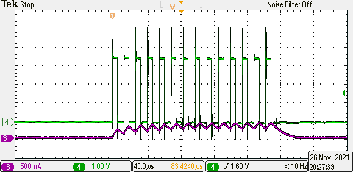
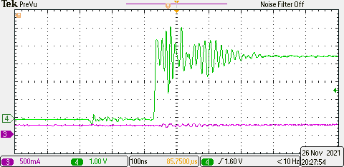
If I add choke, this voltage could increase to 30V
At 20V with choke,

Slide 5
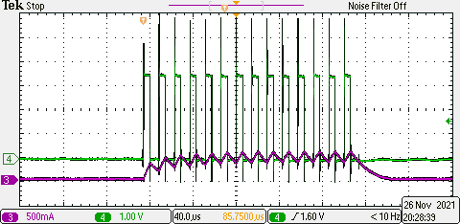
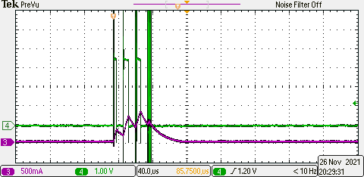
At 30V with choke
At 50V with choke

Slide 6
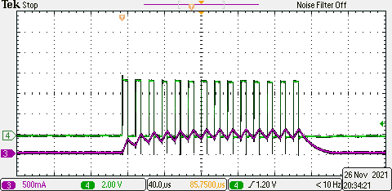
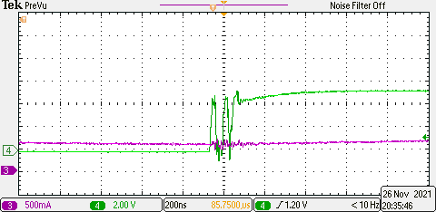
Below is the low side driver voltage, (vgsl), 30V. (with choke)

