Slide 1
TPSxH1x0 Current Limit Tolerance
2017
Power Switches

Slide 2
TPSxH1x0 Current Limit Specification
The current limit accuracy specification for the TPSxH1x0 devices (dK_{CL}/K_{CL}) reflects the performance of the device for a short circuit condition
  Example, when the OUT pin is connected via low impedance to ground
For applications in which the load current slowly increases (ex., creeps up due to higher system load), the data sheet specification needs to be modified
This document details the performance for the TPSxH1x0 under this current creep condition

Slide 3
TPSxH1x0 Current Limit Tolerance Details
Current limit function in the TPSxH1x0 is based on current mirror ratio scheme
  The current mirror ratio is only defined when FET is in saturation region
Current limit tolerance defined in the datasheet corresponds to when the FET is in the saturation region, VDS > RON x ID
  This region corresponds to a scenario in which the load current changes suddenly, such as a short circuit condition
Current limit tolerance is not defined in the datasheet when FET in the linear region, VDS = RON x ID
  This region corresponds to a scenario in which the current creeps up slowly
  In other words, the load current needs to have a fast increase for the current limit in the data sheet to be applicable
Load current with slow increment will not meet the datasheet specification
An overshoot up to 25% of the upper current limit is expected when there is a slow increase in current (load current creeping)

Slide 4
Load current increment verse time Illustration
Current
Overshoot up to 25% of upper Limit
Ilim x (1 + 15%)x(1+25%)
Data sheet upper current limit Ilim x (1 + 15%)
Load current
Typical current limit Ilim
Data sheet lower current limit
Ilim x (1 -15%)
Time
Current creeping behavior
Overshoot duration
(load current over the data sheet limit)

Slide 5
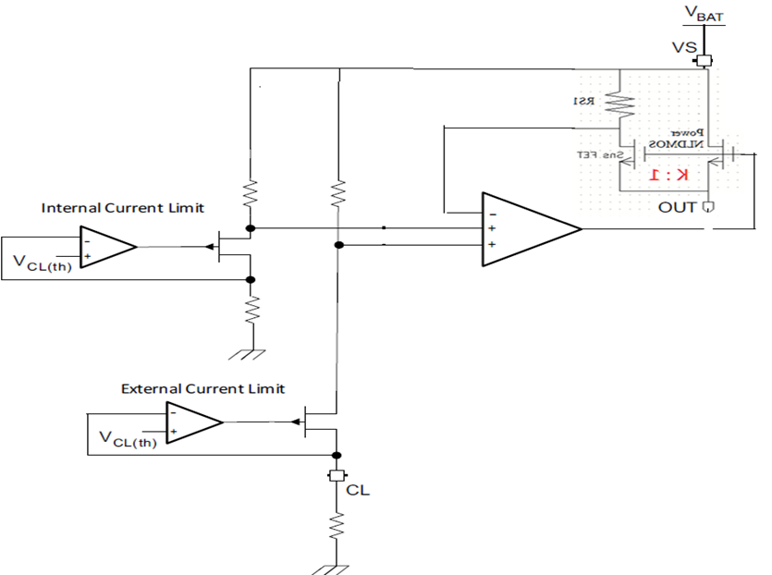
Load Current Creeping Behavior Details
Load current starts off below the current limit. At this point, the FET is in the linear region
The load current begins to increase slowly, and reaches the upper limit Ilim x (1 + 15%). The FET stays in linear region
The load current continues to slowly increase above the upper limit and once the load current hits Ilim x (1 + 15%) x (1 + overshoot), the FET enters the saturation region
The current loop pulls down the FET gate drive and enters the saturation region. The current ratio is coming back to the specified value and load current come back to Ilim x (1 + 15%)

Slide 6
Design Example
Current limit set to Ilim = 1A
  Data sheet specification (i.e., short circuit current limit):
    Lower limit = 1A x (1-0.15) = 0.85A
    Upper limit = 1A x (1+ 0.15) = 1.15A
Expected accuracy during slow current creep condition
  Overshoot = 1.15A x (1+ 0.25) = 1.437A

