Slide 1
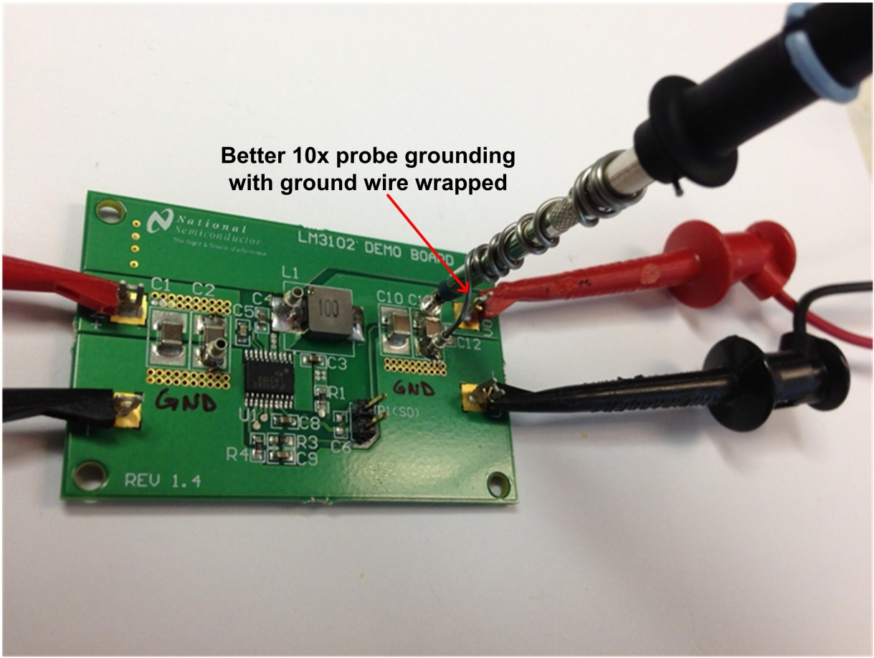
Improved measurement (example)
Understanding → Measuring → Reducing Noise
Notes:
Here is an improved way to take the same measurement. In this case the GND wire is wrapped around the barrel of the probe. The loop area is much much smaller.
This will result in much cleaner measurement…
But don’t take my word for it, here is an example.

Slide 2
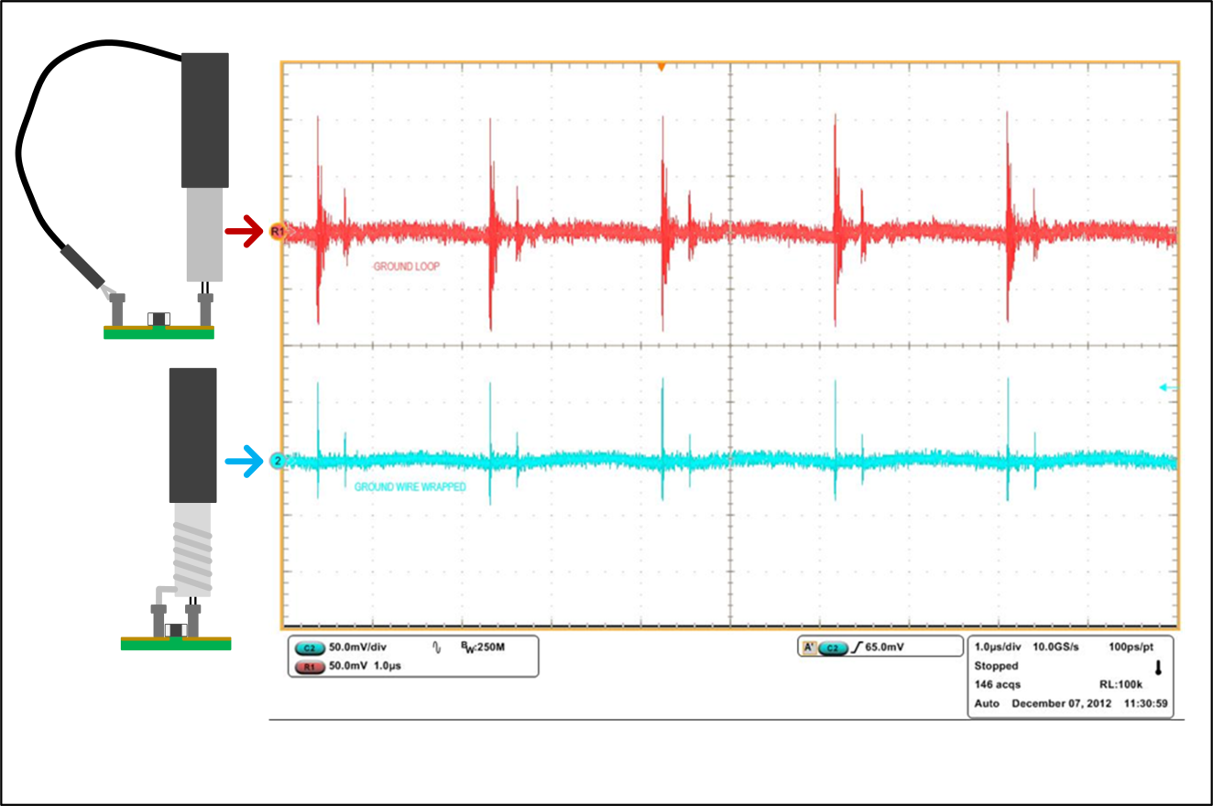
Comparison
~200mV pk-pk
~2x difference in measured noise!
The circuit is exactly the same.
The difference is the measurement technique.
~100mV pk-pk
Understanding → Measuring → Reducing Noise
Notes:
The top waveform in this scope shot uses the large GND loop. The measurement of the HF noise is about 200mV pk-pk.
The bottom waveform has the improved measurement technique. The measurement of the HF noise is about 100mV pk-pk.
The circuit is exactly the same!
The difference is how we measure.
Let’s assume that the target HF noise for the application was 75mV. With the first measurement, you may conclude that you need a ton of filtering to get to the target. With the improved measurement you can see that we may be quite close to the target.
Some engineers may want to improve the measurement even further. One way to do this is to make a 1x probe. Here is an example.

Slide 3
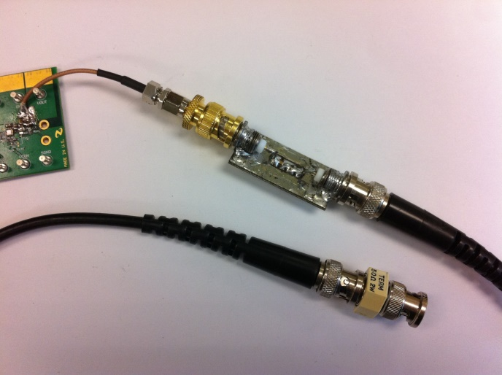
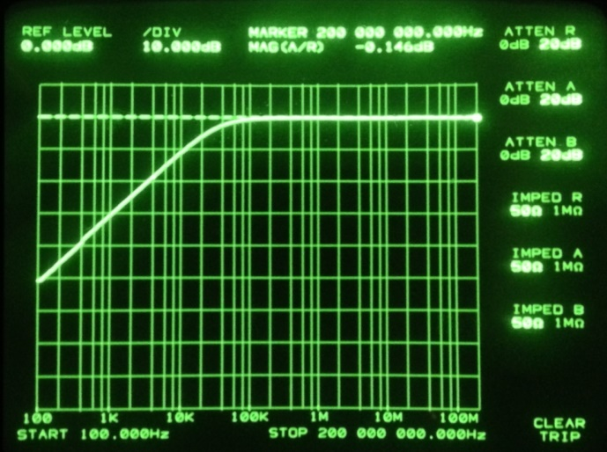
Making a 1x probe (example)
Short coax cable soldered to the output
0.1µF coupling capacitor
50Ω termination
Probe frequency response
High pass filter with cutoff frequency at 31.8kHz. OK for most modern switchers with loaded output.
Probe OK for 250MHz scope BW
Understanding → Measuring → Reducing Noise
Notes:
Here is one way to make a 1x scope probe. A short piece of coax cable can be soldered directly to the measurement point. There is an AC coupling cap and an external 50ohm termination resistor.
The cap and the 50ohm termination form a cutoff frequency at 31.8kHz in this case. Here is the frequency response of the probe. This probe is suitable for measurements of up to 250MHz BW.

