Slide 1
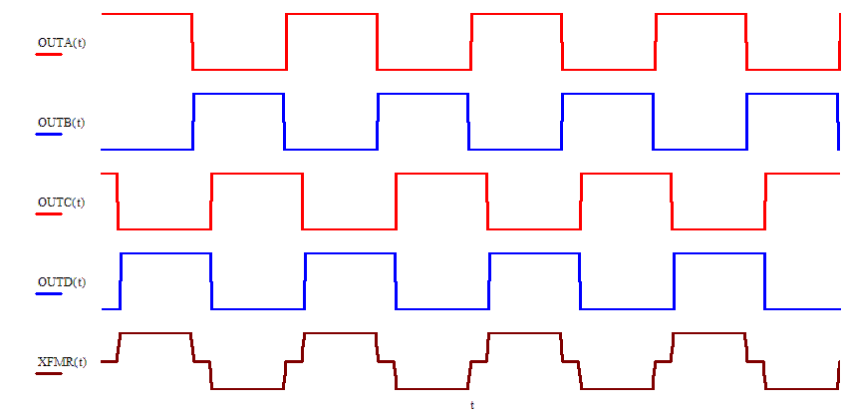
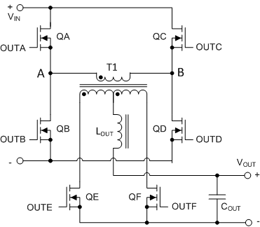

Phase Shifted Full Bridge
PA Leg
Left Leg
QA, QB
AP Leg
Right Leg
QC, QD
$$V_{OUT}=D V_{IN} \frac{N_{S}}{N_{P}}$$
Buck Derived topology
OUTA, OUTB – reference pair
D controlled by phase shifting OUTC & OUTD
QE, QF are SRs, Diode rectification is possible
Mouse over the waveforms to play the animation
TI Information – Selective Disclosure
1
Notes:
The graphic shows the gate drives to QA and QB (red and blue) on top. QC and QD (red and blue) in the middle.
The voltage across the transformer is shown in brown at the bottom.
These waveforms are all at 50% duty cycle – less 1% or 2% to allow time for ZVS transitions.
OUTA and OUTB are the reference pair, they don’t change.
OUTC and OUTD are phase shifted with respect to the reference pair to control the duty cycle.
Power transfer from primary to secondary happens when ‘diagonal pairs’ of switches are on. – QA and QD or QB and QC
The transformer duty cycle is simply the proportion of the switching cycle for which voltage is applied to the transformer
I’m going to play the animation now –

