Slide 1
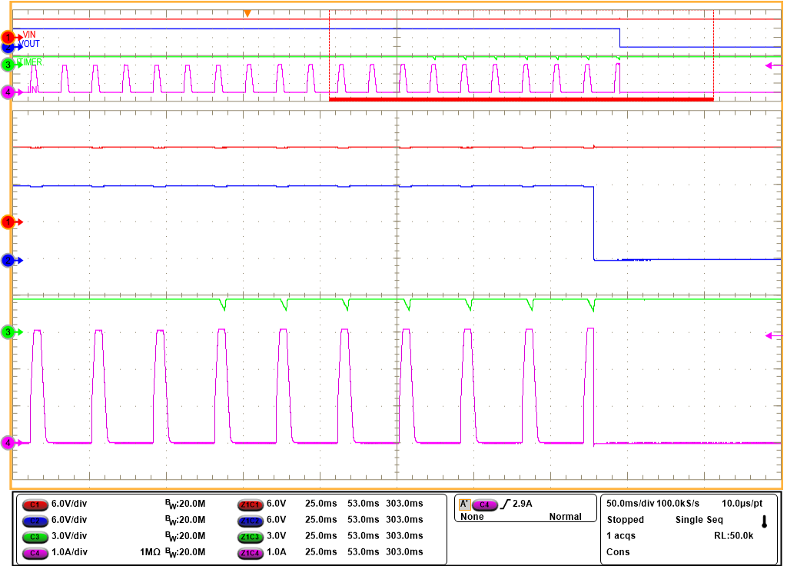
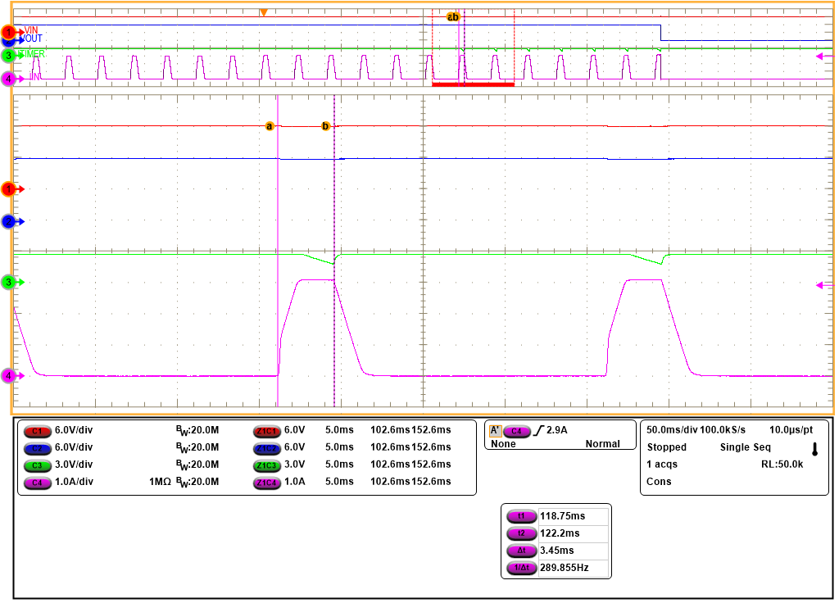

EVM setup: ILIM = 3A, ITIMER = 2ms;
4ms/16ms CR load cycle
Increased the load and captured using the trigger
Here we see the load is triggering the fault timer but before the timer expires, the fault condition is cleared and once it triggers (higher load condition applied), the device goes into latch off mode and doesn’t perform any retries.
Here we see when the load is detected as more than ILIM; ITIMER is discharging for 2ms as intended but after that the load goes away due to cycling
Here we see when the load is on for 4ms but is taking some time to reach the max load condition.

Slide 2
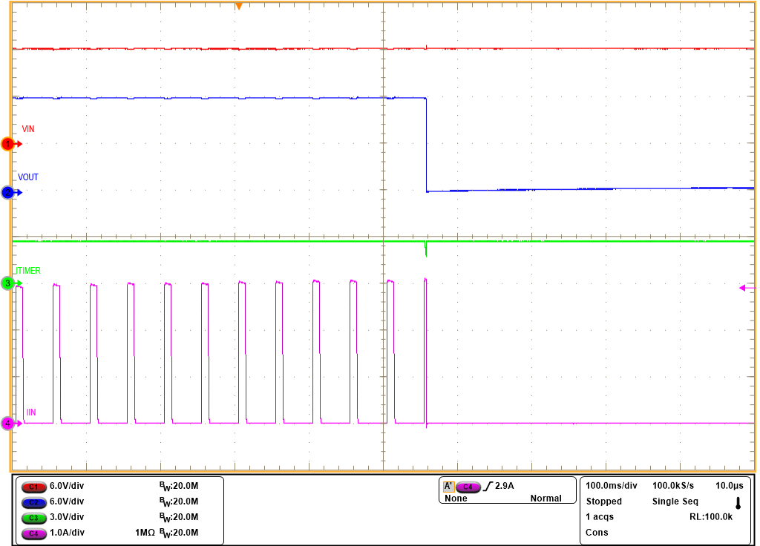
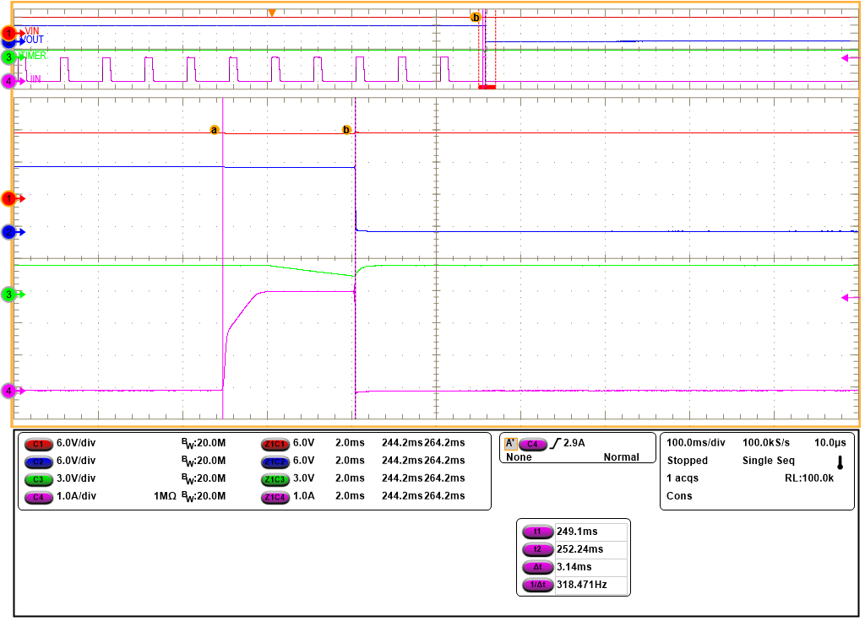
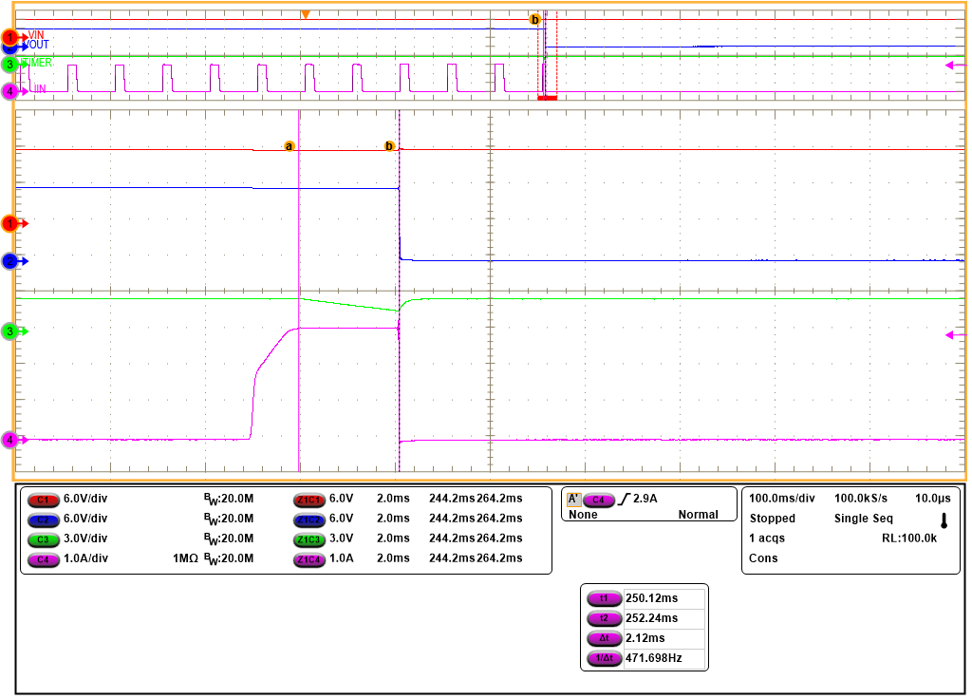
EVM setup: ILIM = 3A, ITIMER = 2ms;
10ms/40ms CR load cycle
Increased the load and captured using the trigger
Here we see the load is not triggering the fault and once it triggers, the device goes into latch off mode and doesn’t perform any retries.
Here we see when the load is detected as more than ILIM; ITIMER is discharging for 2ms as intended. Since the load will still remain on for 10ms so the fault is triggered.
Here we see when the load is on for ~4ms but is taking some time to reach the max load condition.

