Slide 1
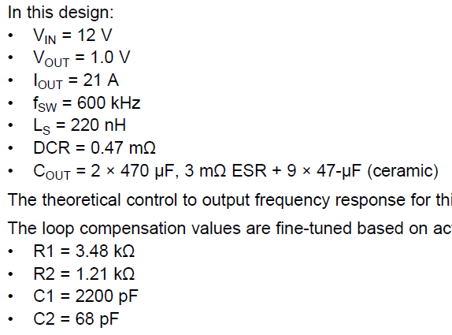
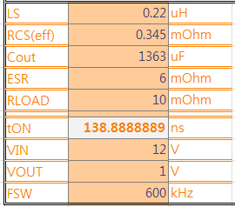
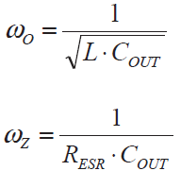
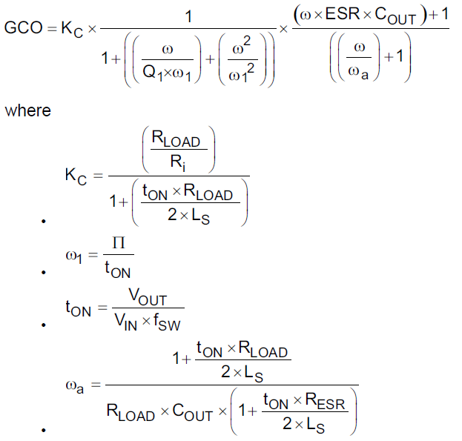
Datasheet 8.2 Typical Application (p39)
The table is from excel sheet that I made for convenience to calculate
I arbitrarily set RLOAD as DS didn’t indicate its value
: ESR Zero
= 1/(6mOhm*1363uF)
= 122279 Hz
fz = 19.46 kHz
: Complex Conjugate Pole of the LC Output Filter
= 1/sqrt(0.22uH*1353uF)
= 57748.5 Hz
fo = 9.19 kHz
: Pole
= 73022.9071 Hz
fa = 11.691 kHz

Slide 2
Mag[dB]
Kc
fo
-40dB/dec
9.19k
fa
11.691k
-60dB/dec
Fcoss (crossover frequency) is located below 60 kHz, which is targeting Fcoss. (fsw/10)
→Type 2 compensation required
fz
19.46k
-40dB/dec

Slide 3
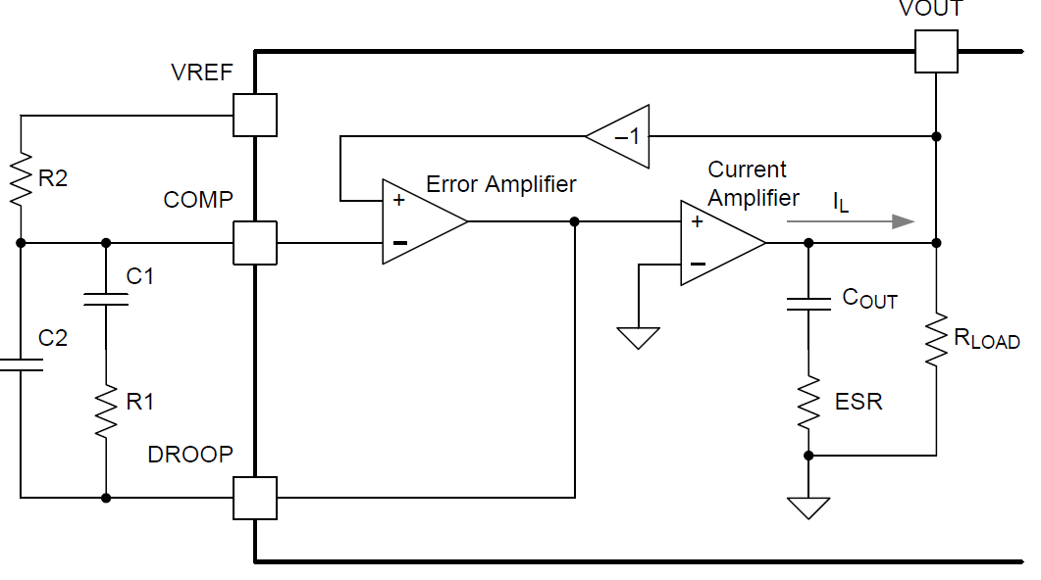
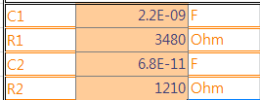
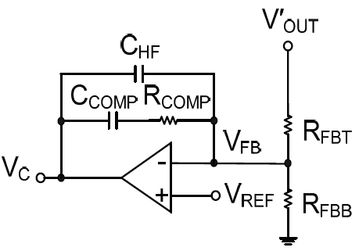
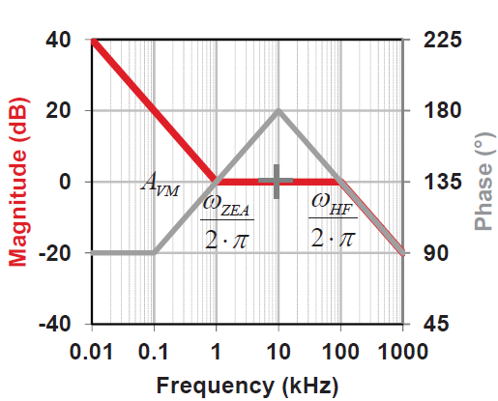
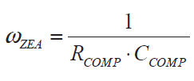

Datasheet 8.2 Typical Application (p39)
Typical Type 2 Compensation
When it comes to type 2 compensation, is this pole usually recommended to be located at ESR zero? So I expected f_HF would be fz, 19.46 kHz.
: Zero
= 1/(R1*C1)
= 2*pi* 20.78 kHz
fzea = 20.78 kHz
: Pole
= 1/(R1*C2)
= 2*pi* 693.35 kHz
f_HF = 693.35 kHz
When it comes to type 2 compensation, is this pole usually recommended to be located at output filter pole to boost the phase properly? So I expected fzea would be at fo, 9.19 kHz.

