Slide 1
TLC6C5724-Q1 EVM Programming
Ben van der Waal

Slide 2
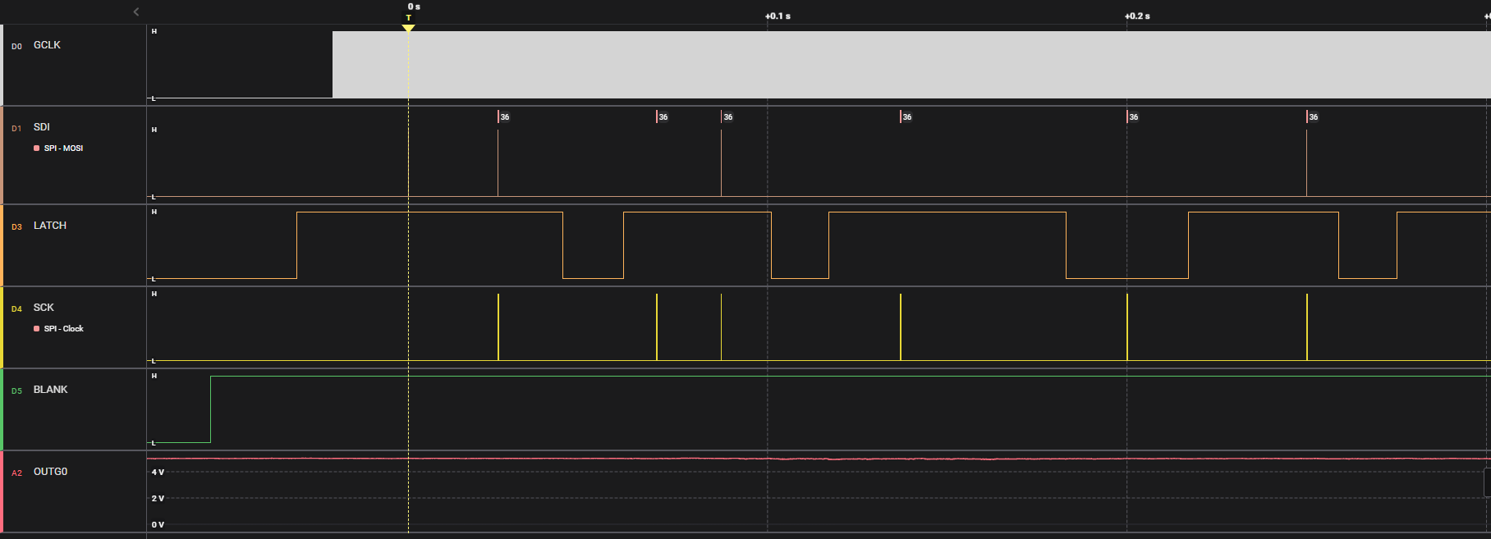
Initialization EVM (1/2)
After GUI is started, TLC6C5724EVM is initialized, LEDs are still off fGCLK=2M

Slide 3
Initialization EVM (2/2)
Write command 0x5AF (GS read)
Toggle LATCH (high → low → high)
Read grayscale
Write command 0x5AC (FC-BC-DC read)
Toggle LATCH (high → low → high)
Read FC-BC-DC
Make LATCH low
Write grayscale (all zero)
Make LATCH high
Write FC-BC-DC
  LED_ERR_MASK = 1b; GS_MODE = 01b (12-bit mode); TIMING_RESET = 1b (enabled); AUTO_REPEAT = 1b (enabled)
Toggle LATCH (high → low → high)

Slide 4
Initialization EVM Log
GUI has a log pane to check commands. Below is initialization which matches description on previous page.
22-Feb-202312:03:55oneui: server: hwcomm: regwrite: [FC_BC_DC_Data @ 0x01] => 0,0,0,0,0,0,0,0,0,0,16,56,0,0,0,0,0,0,0,0,0,0,0,0,0,0,0,0,0,0,0,0,0,0,0,0
22-Feb-202312:03:55client:log: regops: write [FC_BC_DC_Data @ 0x01] = 0,0,0,0,0,0,0,0,0,0,16,56,0,0,0,0,0,0,0,0,0,0,0,0,0,0,0,0,0,0,0,0,0,0,0,0
22-Feb-202312:03:55oneui: server: hwcomm: regwrite: [GSData @ 0x00] => 0,0,0,0,0,0,0,0,0,0,0,0,0,0,0,0,0,0,0,0,0,0,0,0,0,0,0,0,0,0,0,0,0,0,0,0
22-Feb-202312:03:55client:log: regops: write [GSData @ 0x00] = 0,0,0,0,0,0,0,0,0,0,0,0,0,0,0,0,0,0,0,0,0,0,0,0,0,0,0,0,0,0,0,0,0,0,0,0
22-Feb-202312:03:55oneui: server: hwcomm: regread: [FC_BC_DC_Data @ 0x01] <= 0x5ac000000000000000001000000000000000000000000000000000000000000000000000 (1677038635238)
22-Feb-202312:03:55oneui: server: hwcomm: regread: [GSData @ 0x00] <= 0x000000000000000000000000000000000000000000000000000000000000000000000000 (1677038635238)
22-Feb-202312:03:55client:log: regops: read [FC_BC_DC_Data @ 0x01] = 0x00
22-Feb-202312:03:55client:log: regops: read [GSData @ 0x00] = 0x00
22-Feb-202312:03:55oneui: server: hwcomm: Device connect
22-Feb-202312:03:53oneui: server: Board selected: tlc6c5724evm
22-Feb-202312:03:53oneui: server: hwcomm: Using board - TLC6C5724

Slide 5
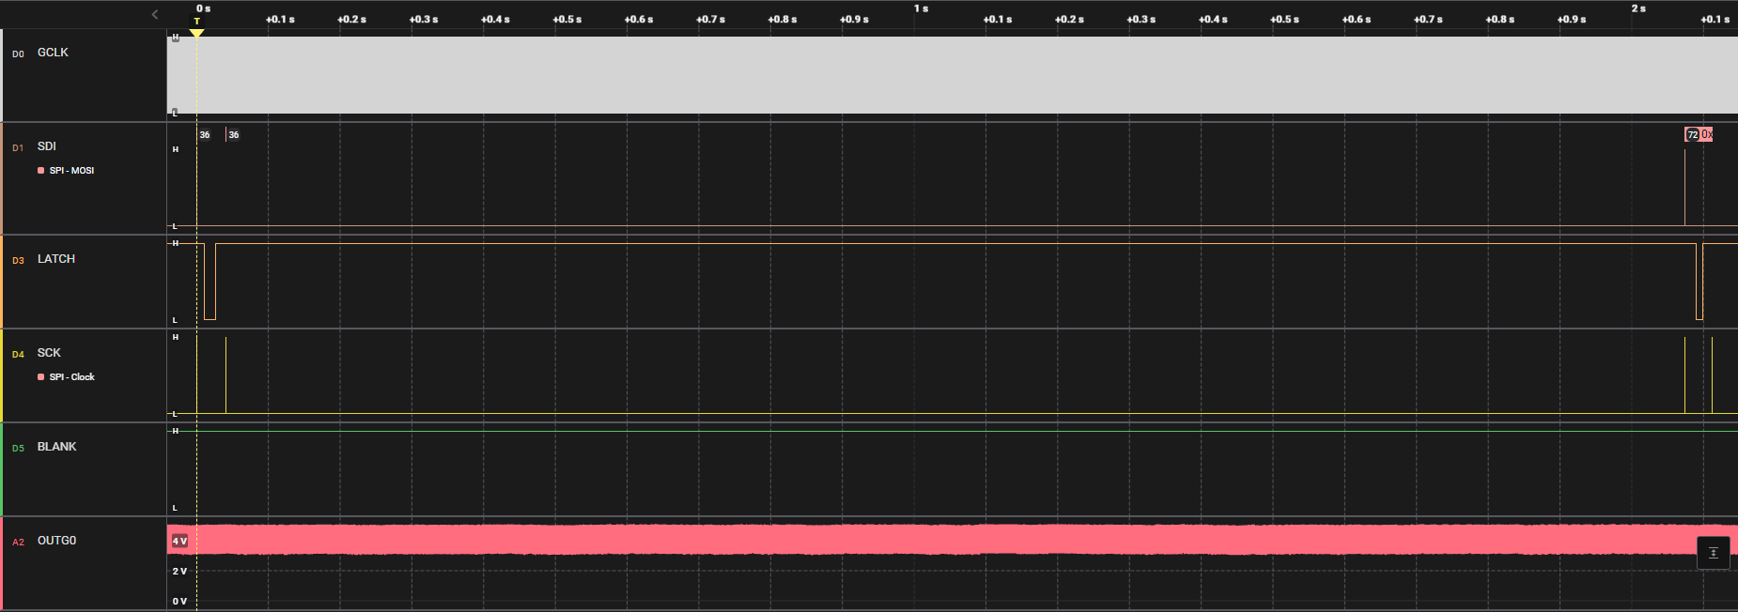
Running EVM (1/2)
In both Quick Start Page and Advanced Settings Page
About every 2 seconds read out SID

Slide 6
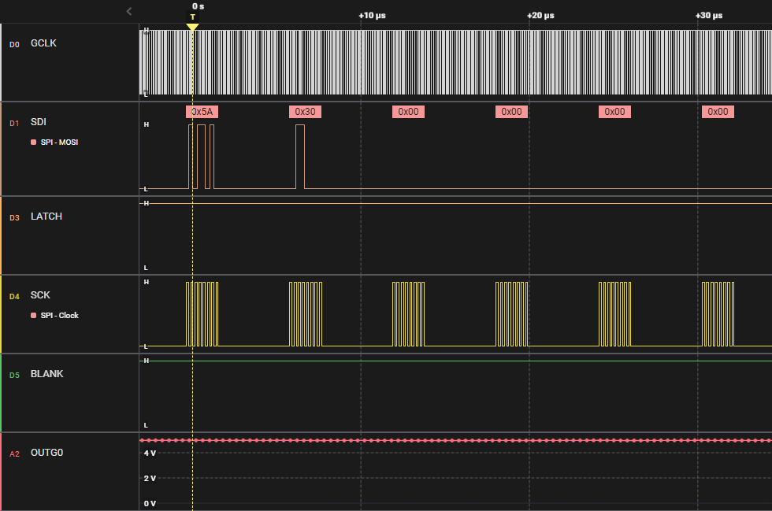
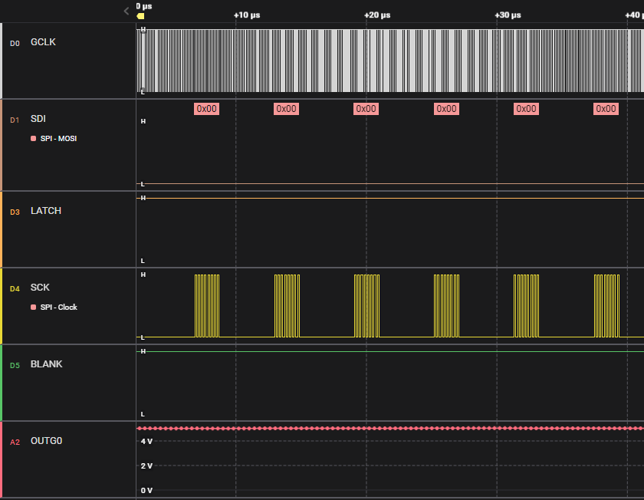
Running EVM (2/2)
Send command 0x5A3 (SID read) – LATCH is high
  Other bits are all zero
Toggle LATCH (high → low → high)
During read SIN all zero and LATCH is high (no toggle afterwards)
Note BLANK is always high

Slide 7
Initialize All Channel Values
In Advanced Settings Page, initialize all channel values
All grayscale are written
Write FC-BC-DC register
LEDs turn on with 50% duty cycle

Slide 8
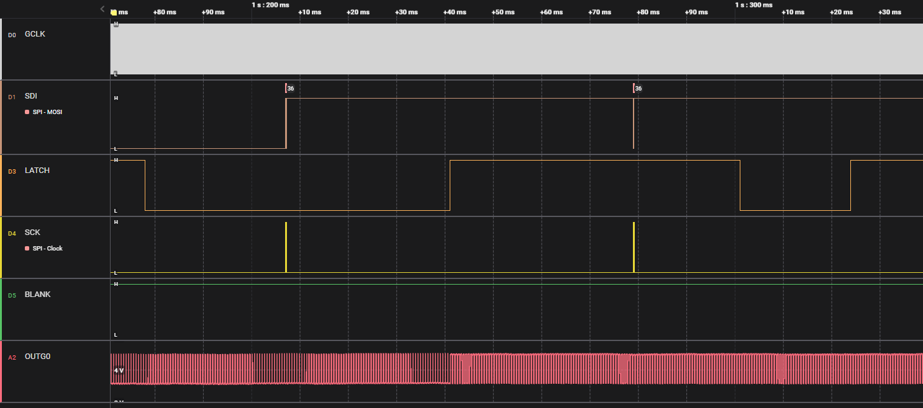
Send Grayscale change (1/2)
When changing grayscale or FC-BC-DC values, the EVM always send both registers with first grayscale and then FC-BC-DC
Send GS data
Send FC-BC-DC data

Slide 9
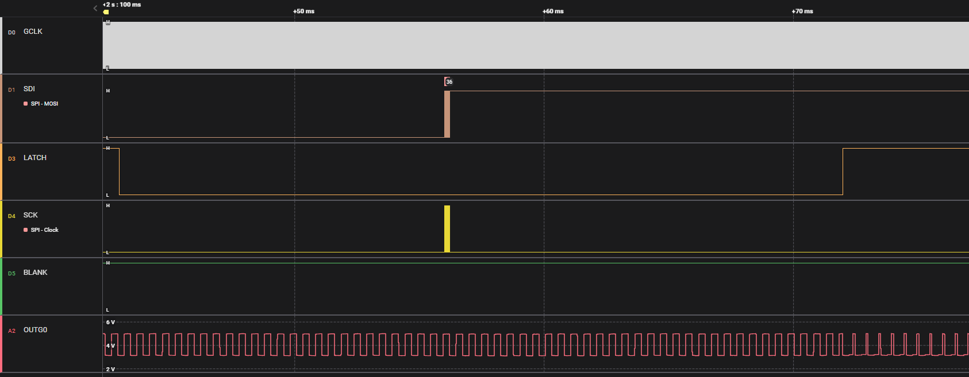
Send Grayscale change (2/2)
When LATCH becomes high, the new duty cycle is directly used
Send GS data
LATCH is pulled low
LATCH is pulled high and duty cycle changes

Slide 10
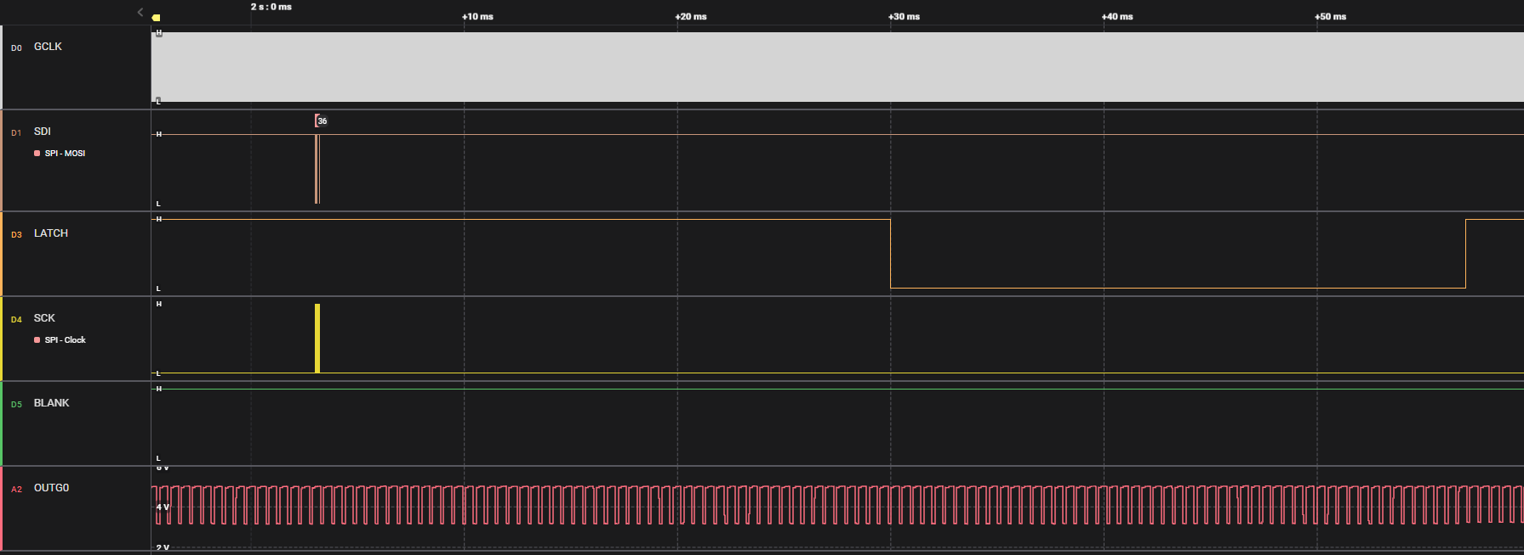
Send DC change
When changing grayscale or FC-BC-DC values, the EVM always send both registers with first grayscale and then FC-BC-DC
After toggling LATCH, output remains on. BLANK remains high.
Send FC-BC-DC data

Slide 11
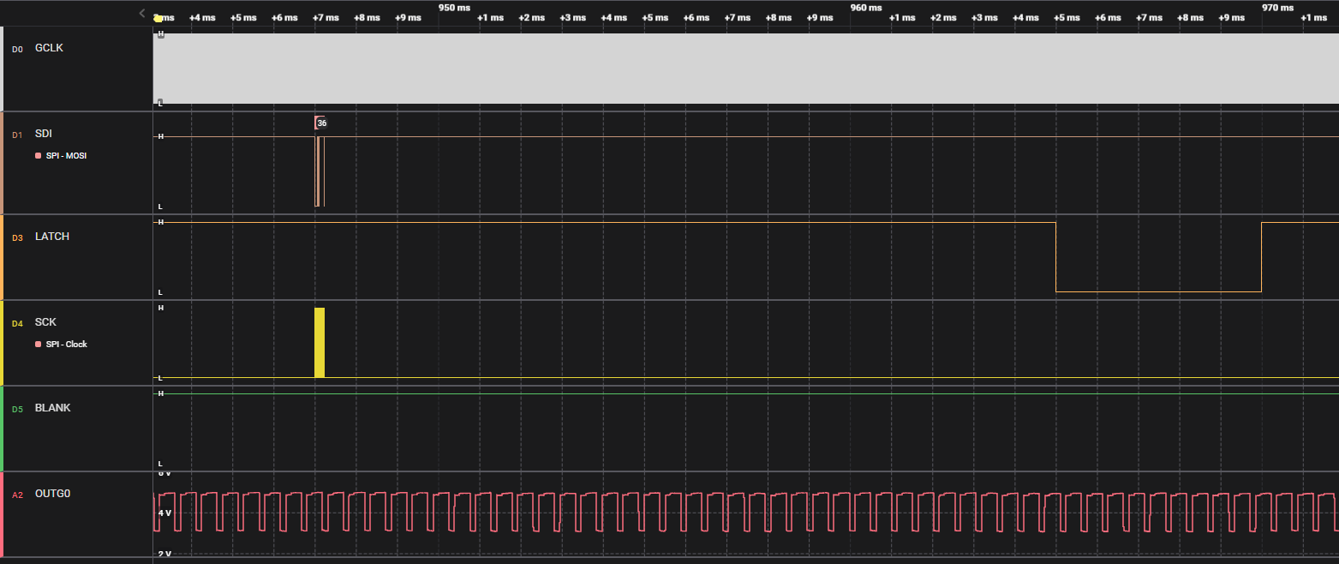
Send BC change
When changing grayscale or FC-BC-DC values, the EVM always send both registers with first grayscale and then FC-BC-DC
After toggling LATCH, output remains on. BLANK remains high.
Send FC-BC-DC data

