Slide 1
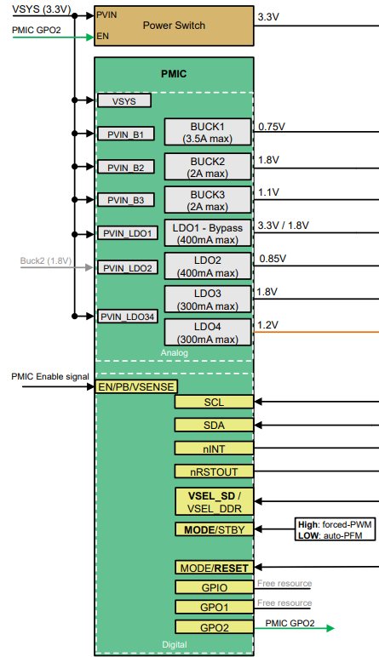
POWER-Block _ Detailed configuration
BQ24072 : No SYSOFF
USB_C type Connector
USB-PD Controller
BAT Charger
VDD_SYS
VDD_3.3V : BLE/GPS/ power stage
USB : DP/DM
VDD_1.8V : LTE
BAT : +/-
VDD_3.3V : E-Paper/SENSOR
USB To
UART 2
USB To
UART 1
BLE-I2C
Battery Cell
Li-Polymer
3.7V/3000mAh
SRX
Fuel Gauge
UART1/UART2 Select need to review possible approaches for event handling.!!!
BLE-I2C
nRSTOUT :
Reset-output for BLE/GPS/LTE
LTE Reset Check!!!
PMIC Reset
* Fuel-Gauge : BQ27427(50uA) , MAX17262 (ADI)_(5uA)
* PMIC : TPS65220 // Normal
P25 : EN/PB/VSENSE
* Charger : BQ24072-1.5A or BQ25616-3A (Under review )
PMIC-ON : Active “ L “ 600ms
PMIC-OFF : Active “ L “ 8s
* USB-PD : MAX77958 (ADI) or TI (Recommendation needed)
MODE/RESET Configuration : DATA-SHEET P49 reference

