Slide 1
What is the competible PD controller with TPS23861?
What is the Role of Bridge rectifier?
P.S
Please tell me when you need something I should inform
PD Part
DC5V
(15W)
PSE Part
10~30V
DC/DC Converter
(TPS54360BDDAR)
PD Controller
(?)
LM5122
(Boost Controller)
Bridge Rectifier
VPWR DC48V
4A
DC48V
(1,2,3,6 pin)
HX1260FNL
(Common Mode Noise filter)
TPS23861
(PSE)
RJ45 8pin
Mode A
(End Span)

Slide 3
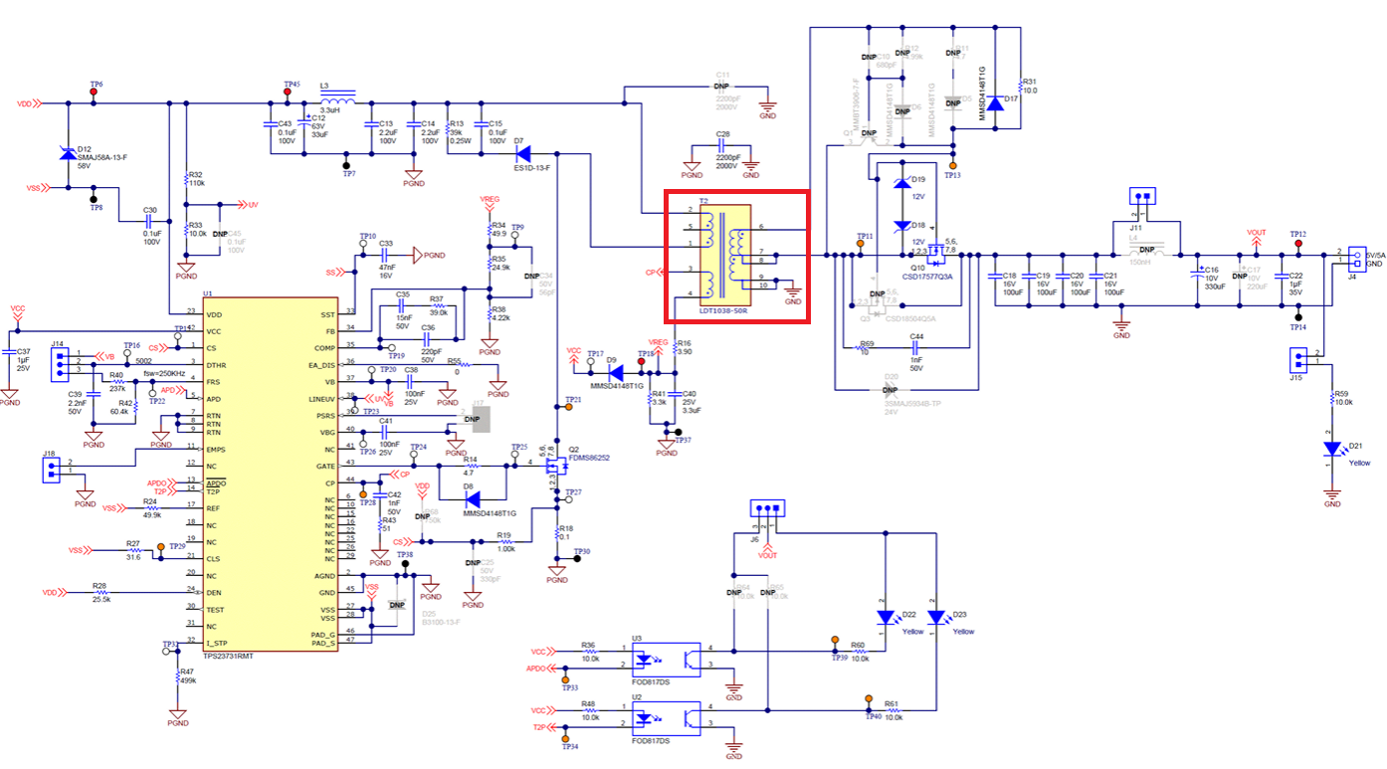
Quote :
Please correct me if you want a 5-V output from a PoE + DC/DC. You can refer TPS23731EVM (https://www.ti.com/tool/TPS23731EVM-095), which is 5-V 5-A if so.
Is this transformer isolation part essential for the protocol 802.3?
(Distance between PSE-PD : about 1m)

