Slide 1
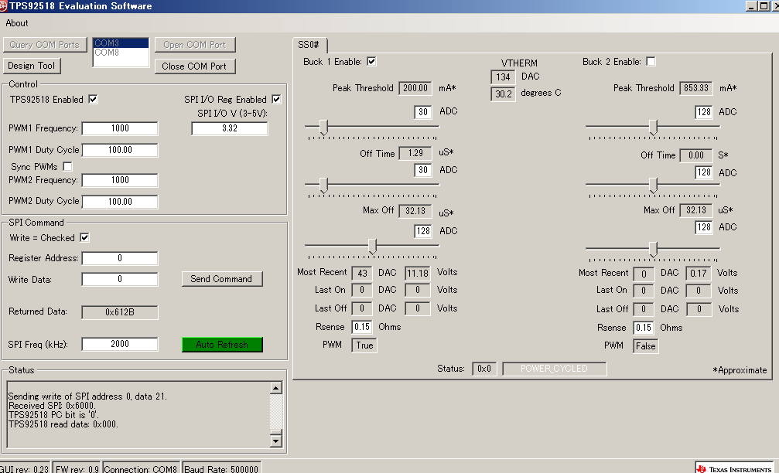
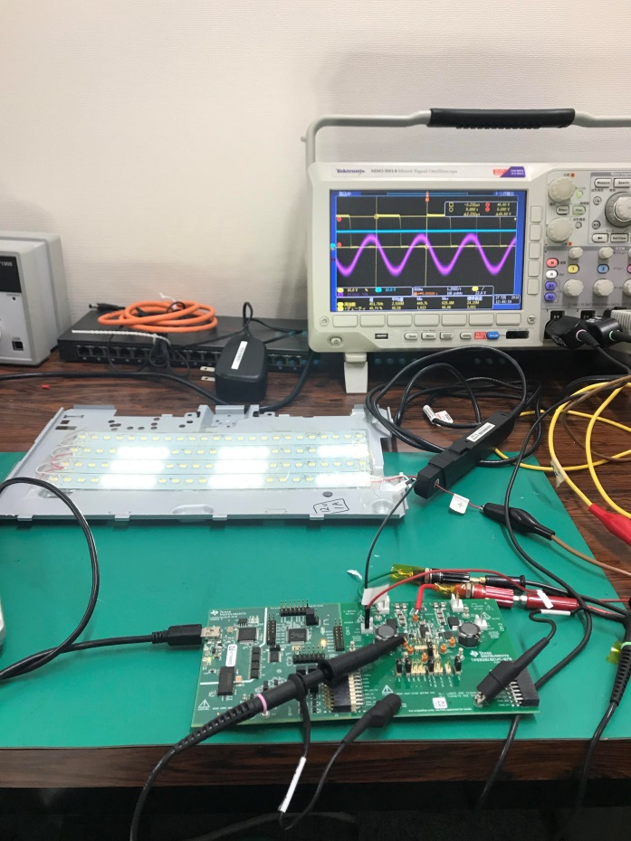
Evaluation using 12V_LED
Confirm whether ILED was constant or Not depend on VIN=24V/48V
Where: VLED=12V, Peak_threshold=30、 TOFF=30
PK=30
TOFF=30
Rsense=0.15
Conclusion
Not constant.
Even though same TOFF=30/ PKTH=30, ILED (average) were changed.
In photo2, Ipeak =263mA( Vin=48V) and in photo4, Ipeak=220mA (Vin=24V)
Ipeak-peak is controlled same by TPS92518 in the both of Vin=48V/ Vin=24V. ( approx. 140mA)
Is this proper ( inherent) operation of TPS92518 ?
Why Ipeak is changed even though Peak threshold(PKTH) is same?

Slide 2
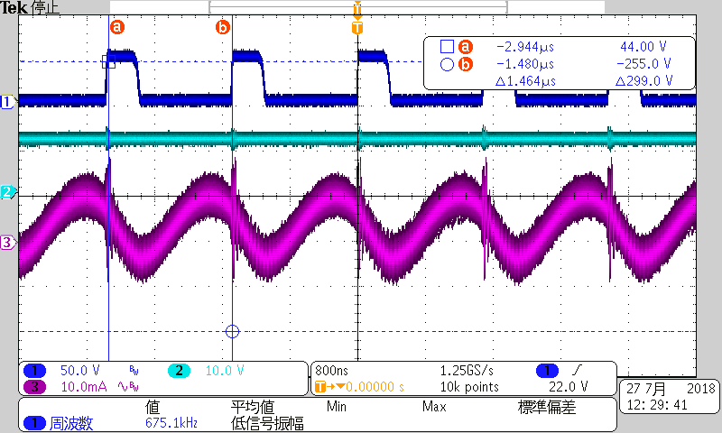
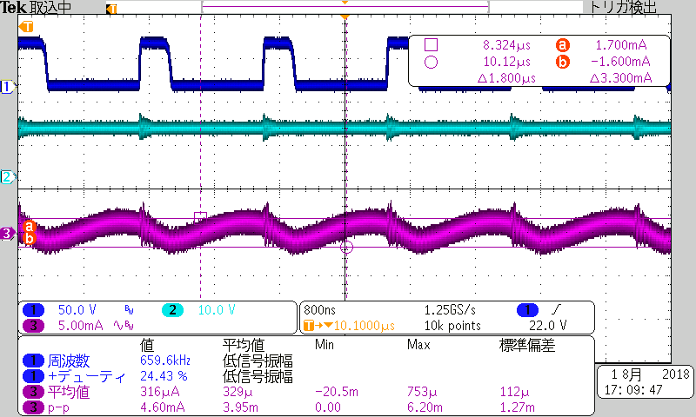
VIN=48V PKTH_DAC=30
VLED=12V TOFF=30
MAXOFF=128 Rsense=0.15
Photo1
SW1
VLED
ILED
Ac mode
(After L）
Result
SW=675KHz duty=25% Vpk=48V
ILED=195mA(Fluke DC Amp）、Ipk-pk=3.3mA

Slide 3
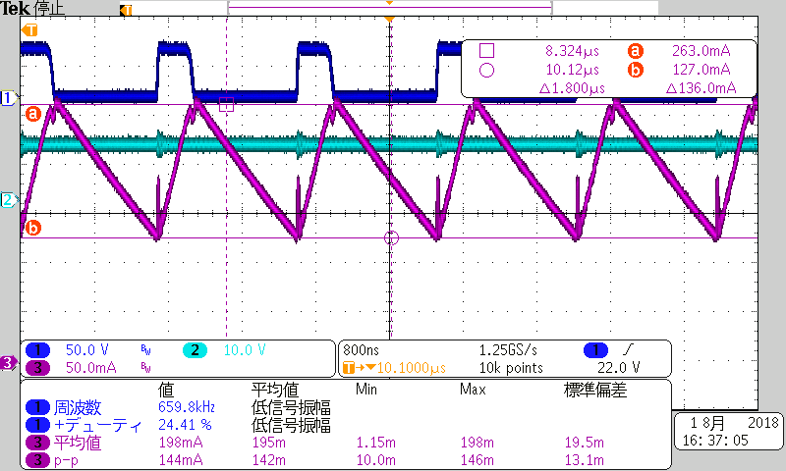
VIN=48V PKTH_DAC=30
VLED=12V TOFF=30
MAXOFF=128 Rsense=0.15
Photo2
SW1
VLED
ILED
DC mode
(Before L）
Result
SW=675KHz duty=25% Vpk=48V
ILED=195mA(Fluke DC Amp）、Ipk-pk=136mA

Slide 4
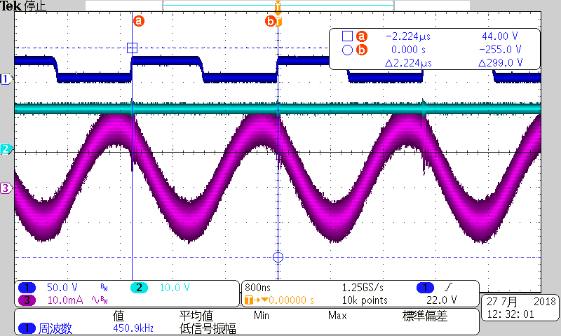
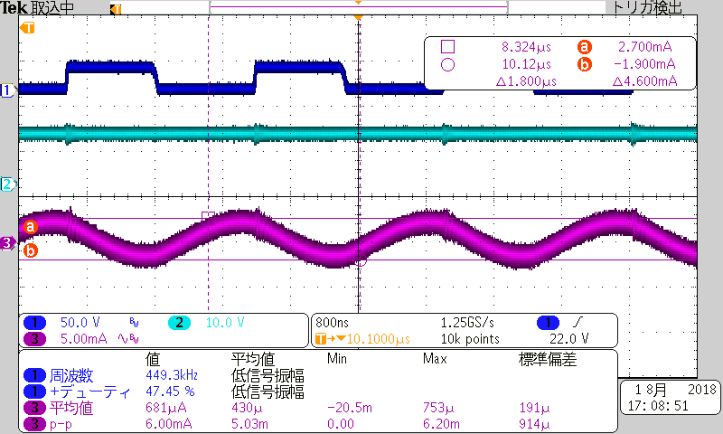
VIN=24V PKTH_DAC=30
VLED=12V TOFF=30
MAXOFF=128 Rsense=0.15
Photo3
SW1
VLED
ILED
AC mode
(After L）
Result
SW=450KHz duty=48% Vpk=24V
ILED=145mA(Fluke DC Amp）、Ipk-pk=4.6mA

Slide 5
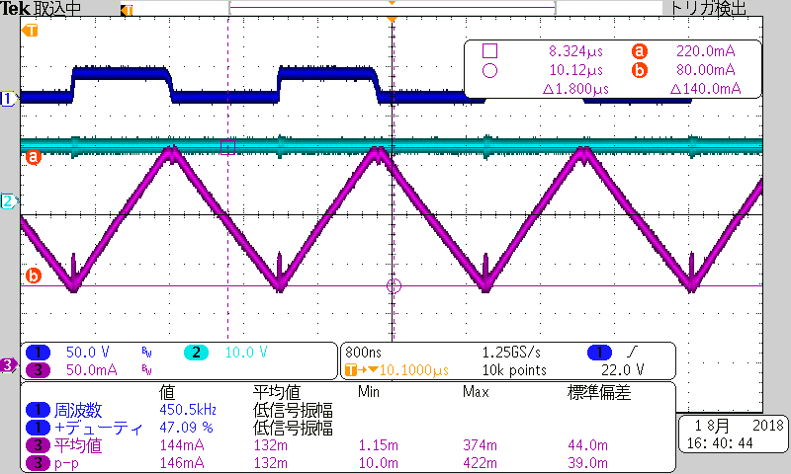
VIN=24V PKTH_DAC=30
VLED=12V TOFF=30
MAXOFF=128 Rsense=0.15
Photo4
SW1
VLED
ILED
DC mode
(Before L）
Result
SW=450KHz duty=48% Vpk=24V
ILED=145mA(Fluke DC Amp）、Ipk-pk=140mA

