Slide 1
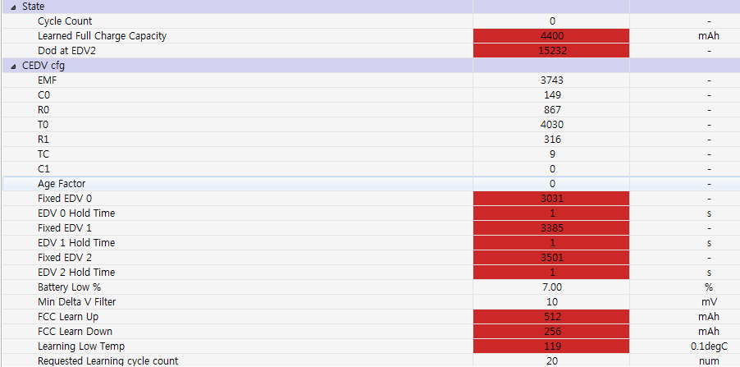
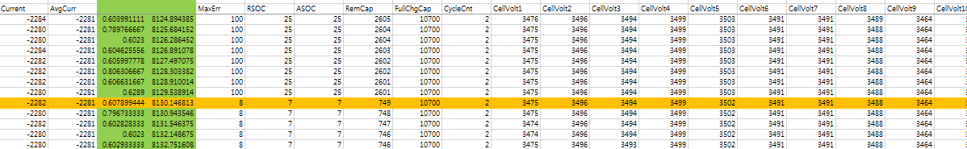
Default gg : bq78350_R1_v1_03_build_22.srec used
Updated EDV
★ EDV change only and charging/discharging test
Phenomenon : RSOC dropped 25%->7%(battery low %)
-> RSOC is not updated on modified (Fixed) EDV2 3250mV
-> But instead, RSOC is updated when voltage is 3501mV which is Fixed EDV2 3501mV in Default gg

Slide 2

CEDV Gauging configuration 설정이 잘못 된 건지?

