Slide 1



WIDE V_{IN}
LM76005
Wide V_{IN} DC-DC Converters & Controllers
Buck Switching Regulators (BSR)
Dynamic Output Voltage Change
June 2020

Slide 2
Agenda
Introduction to Dynamic Output Voltage
Method 1: Resistor Switch Network
Method 2: DC Bias Voltage on FB node

Slide 3
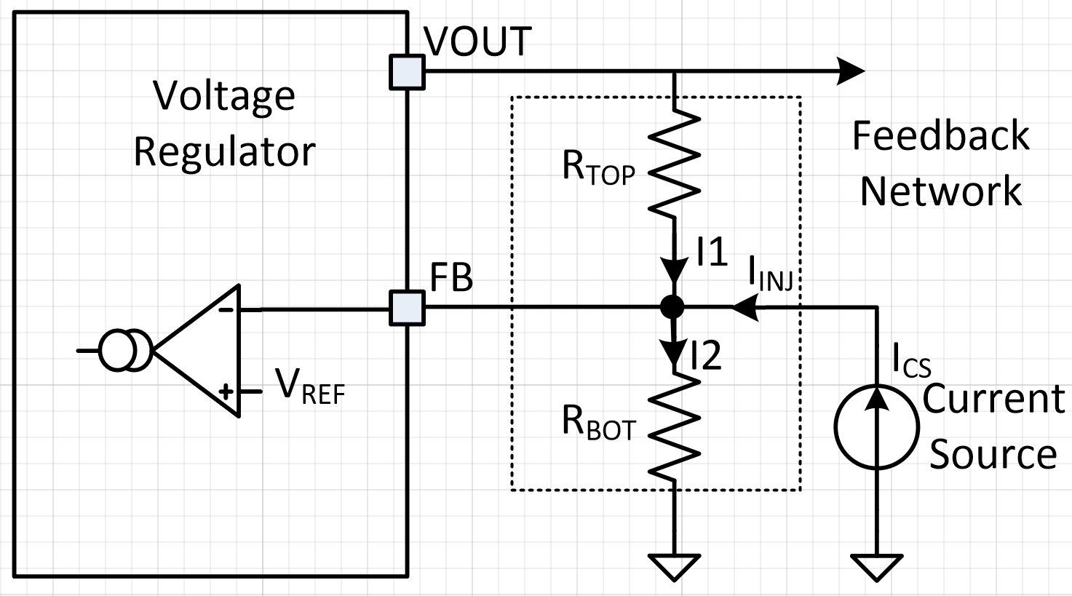
Dynamic Output Voltage Change : Basic Concept
I_{INJ} Increase, I₂ Constant, I₁ Decreases;
Consequently, V_{OUT} Decreases

Slide 4
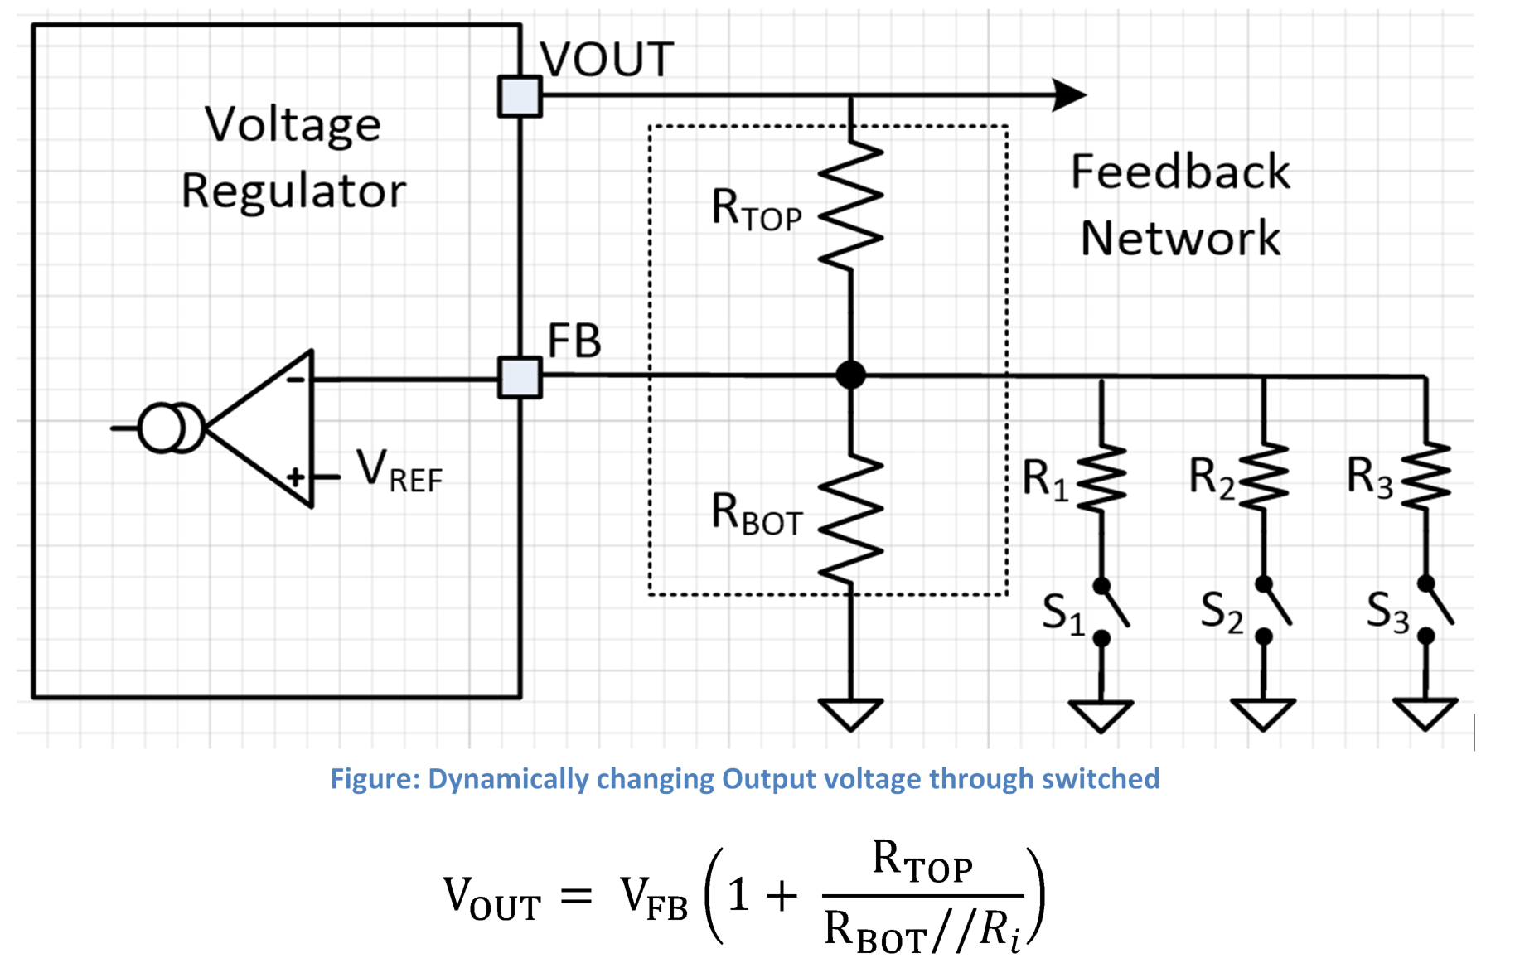
Dynamic Output Voltage Change : Method 1 (Switches)
Drawbacks:
Any abrupt resistor switching or V_{OUT} from lowest trim to highest trim can cause FB voltage to jump instantaneously and can cause false OVP or Pgood trigger.
Bulky overall solution.
DC-DC convertor has trans-conductance type error amplifier where attenuation due to FB bottom resistor has direct contribution in DC gain of the control

Slide 5
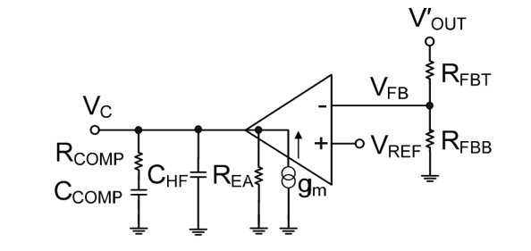
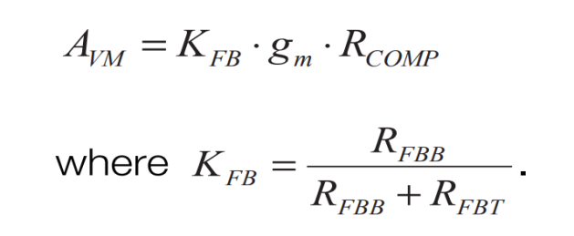
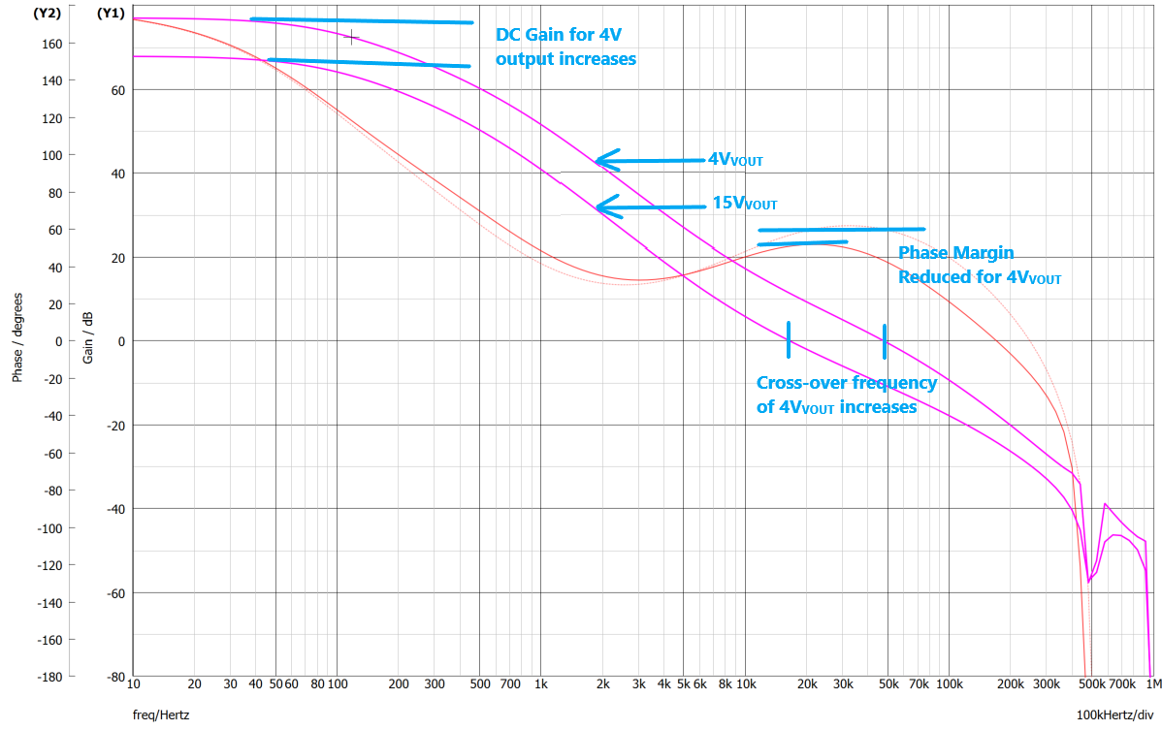
Dynamic Output Voltage Change : Method 1 (Stability)
DC GAIN = Control Loop Gain
+
Power Stage Gain
+
Feedback Network
Mid-Band Gain
Bottom FB resistor has direct contribution on Mid-band gain of control loop. Due to which cross-over frequency changes across V_{OUT} range, and consequently phase margin. Which is why this system is slightly difficult to compensate
Notes:
Do we want to add anything about main pole being at Cout,Rout?
Should we add anything about compensation poles?
Fz_ea: Comp, Rcomp
Fp_ea: Cocomp, rea
Fpea_<fzea
Esr zero
High frequency pole @ rcomp, chf

Slide 6
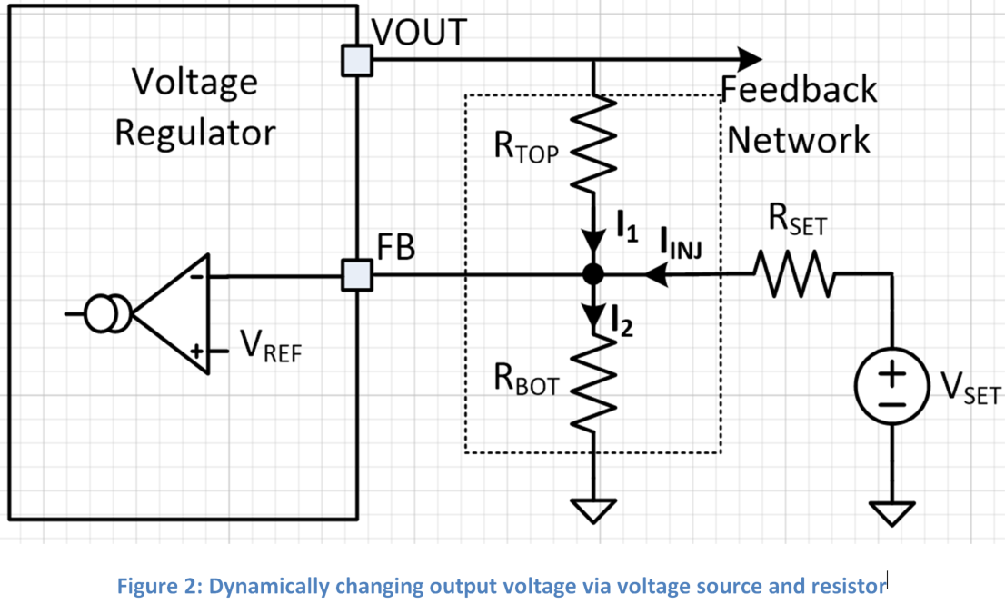
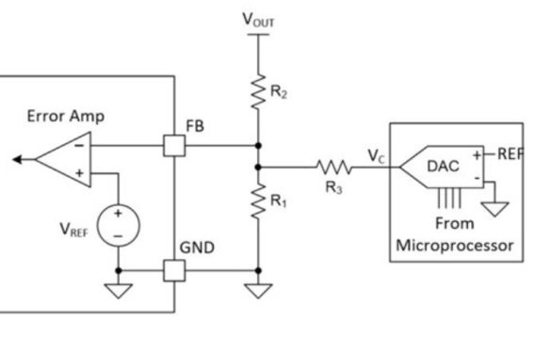
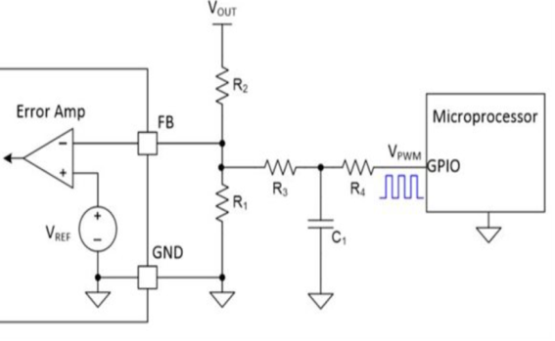

Dynamic Output Voltage Change : Method 2 (DC Bias Voltage)
$${ V}_{OUT}=V_{FB}\left(1+ \frac{R_{TOP}}{R_{BOT}}\right)−\left(\frac{V_{SET}−V_{REF}}{R_{SET}}\right).R_{TOP}$$
Increase VSET voltage to increase the injected current on the FB node to decrease the VOUT voltage

Slide 7

Dynamic Output Voltage Change : Method 2 (DC Bias Voltage)
For AC Simulation,
V_{SET} will become virtual
ground.
Irrespective of
Value of V_{SET}
$${ V}_{OUT}=V_{FB}\left(1+ \frac{R_{TOP}}{R_{BOT}}\right)−\left(\frac{V_{SET}−V_{REF}}{R_{SET}}\right).R_{TOP}$$
This implies DC gain and mid-band gain of the loop will remain constant while dynamically changing the output voltage

Slide 8
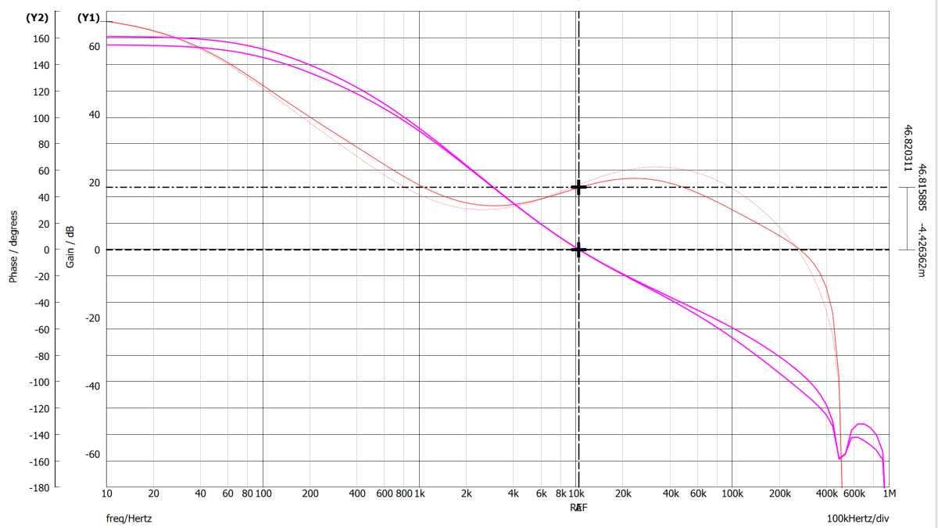
Dynamic Output Voltage Change : Method 2 (Stability)
No Significant change in Gain and Phase Margin. And constant cross-over frequency across V_{OUT} range.
That’s why this method is considered reliable and easy to compensate.

Slide 9
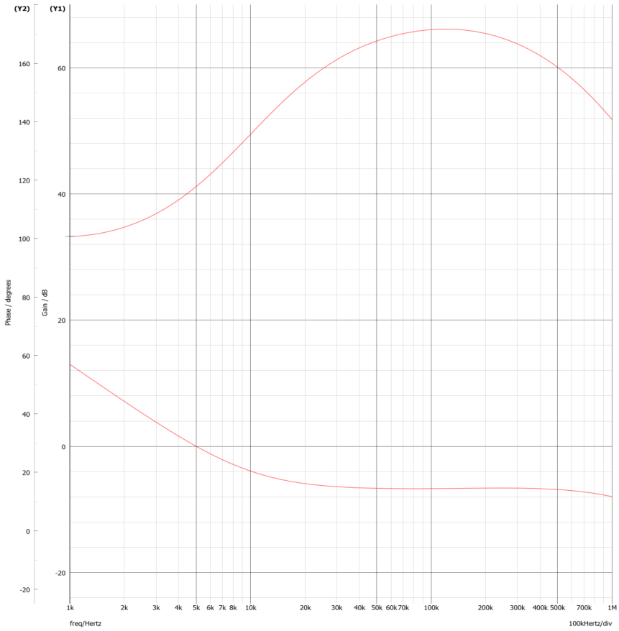
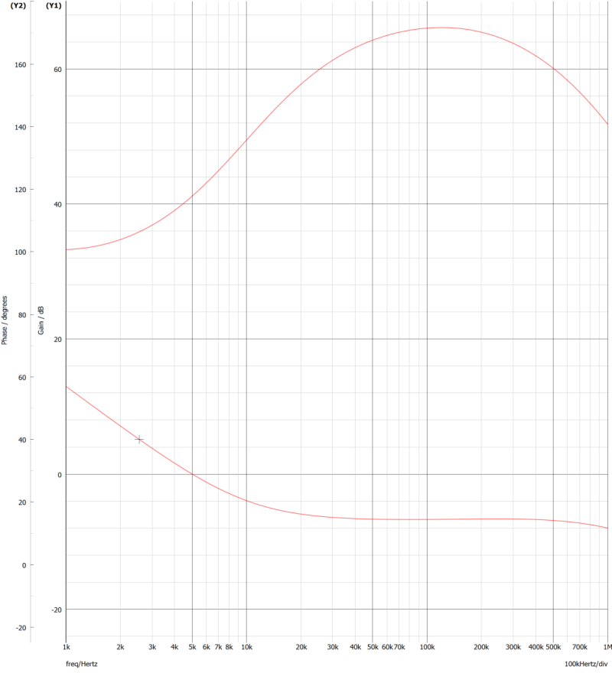
Dynamic Output Voltage Change : Method 2 (Stability, excluding Power Stage)
Transient Response of ‘Feedback-to-Comp’ (Excluding Powerstage)
15V_{VOUT}
4V_{VOUT}

Slide 10
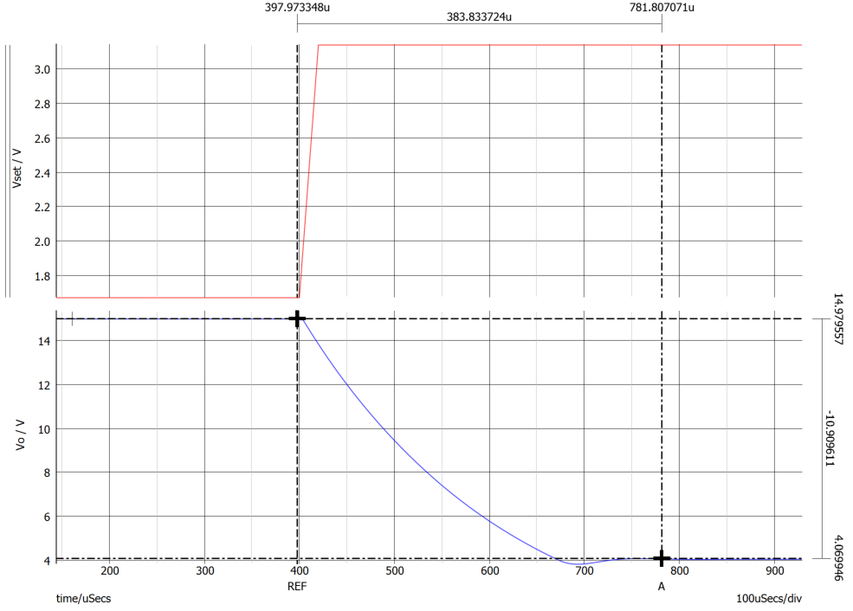
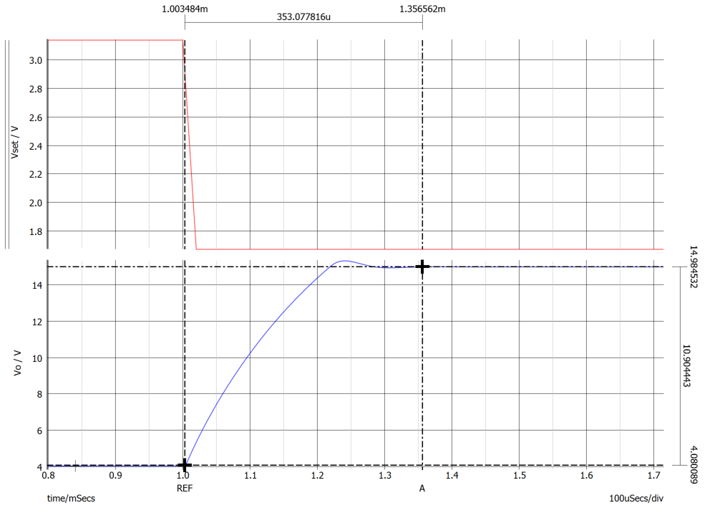
Dynamic Output Voltage Change : Method 2 (Slew Rate and Final Settled Value)
From Highest to Lowest voltage Trim
From Lowest to Highest voltage Trim
Settled to ~0.1% of programmed voltage in <0.5ms
Settled to ~0.1% of programmed voltage in <0.5ms

Slide 11

Dynamic Output Voltage Change : Method 2 (Design Steps)
Design Steps:
Set feedback network to regulate at highest trimmed voltage
  Take R_{TOP}=100K, and R_{BOT} & R_{SET} are in parallel and in combination will form a bottom feedback resistor
  This will allow the reduce the output capacitance significantly and reduces the solution size and cost.
Set V_{SET} equal to Feedback reference voltage for zero injection current for highest trimmed voltage.
Calculate the required V_{SET} for desired output voltage from equation given in slide number 8.
If PWM signal followed by RC filter is used to produce DC bias voltage, then the recommendation is to have PWM signal frequency greater than device bandwidth and corner frequency of RC filter should at least be twice of PWM signal for 40db attenuation.

Slide 12
Thank You

Slide 13
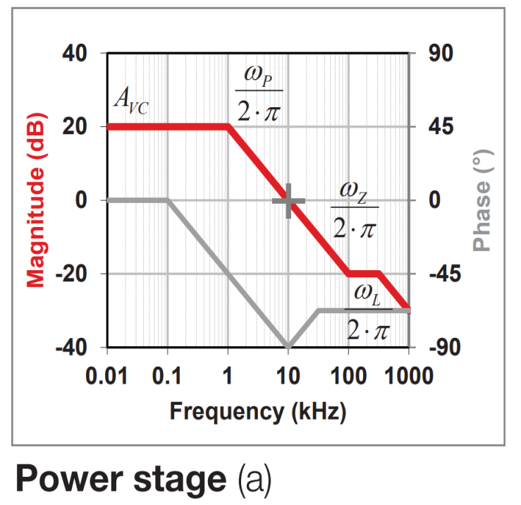
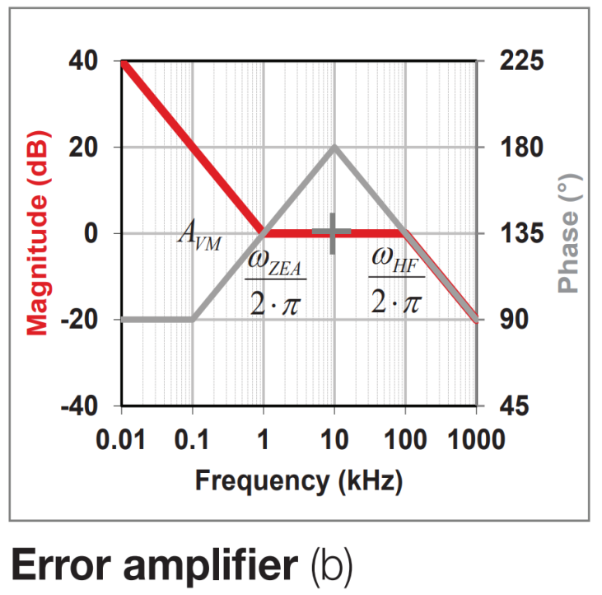
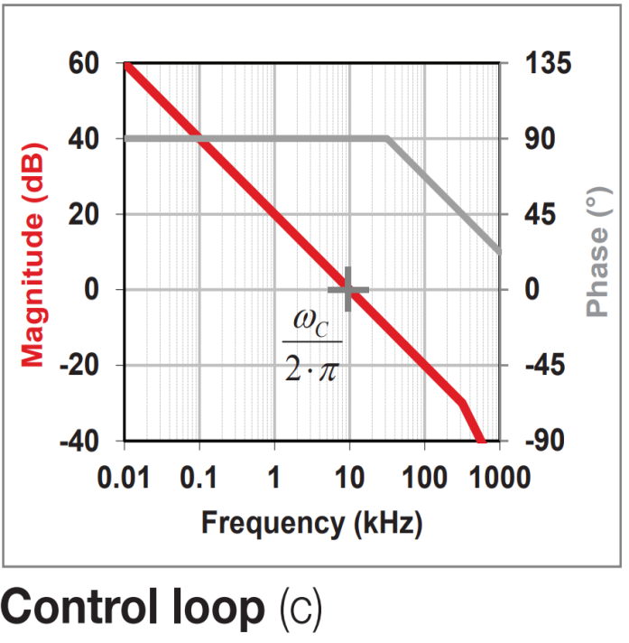
Current Mode Buck Converter (Bode Summary)

Slide 14
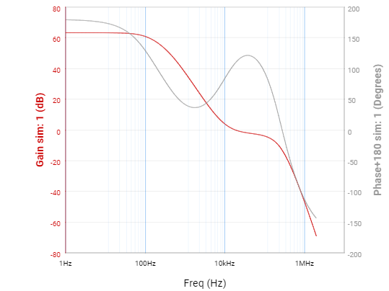
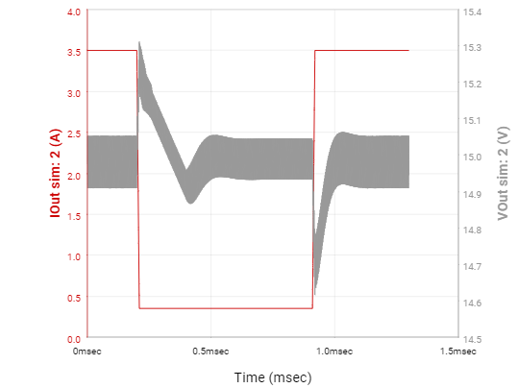
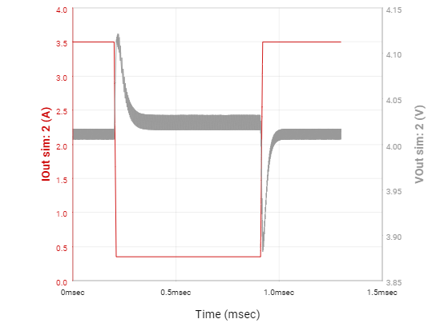
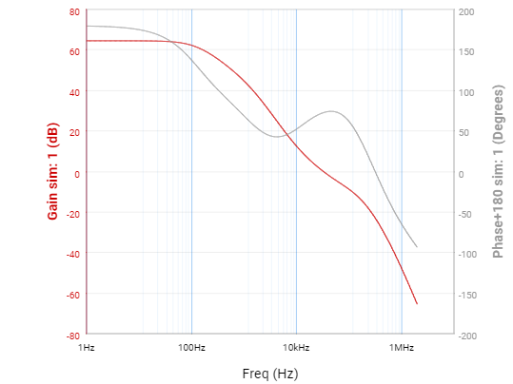
Dynamic Output Voltage Change : Method 1 (Recommendations)
Recommended BOM for the required Application: L_{OUT}=15uH; C_{OUT}=100uF; F_{SW}=500KHz (As per webench)
V_{OUT}=15.0V
V_{OUT}=4.0V

