Slide 1
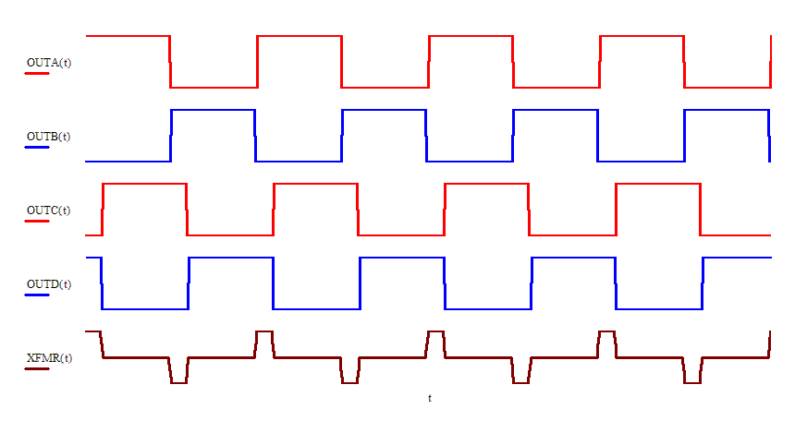
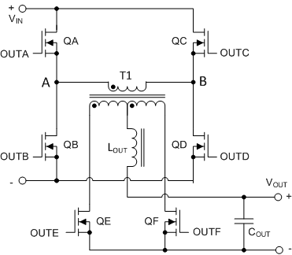

Phase Shifted Full Bridge
PA Leg
Left Leg
Leading Leg
QA, QB
AP Leg
Right Leg
Lagging Leg
QC, QD
$$V_{OUT}=D V_{IN} \frac{N_{S}}{N_{P}}$$
Buck Derived topology
OUTA, OUTB – reference pair
D controlled by phase shifting OUTC & OUTD
QE, QF are SRs, Diode rectification is possible
Mouse over the waveforms to play the animation
TI Information – Selective Disclosure
1

