Slide 1
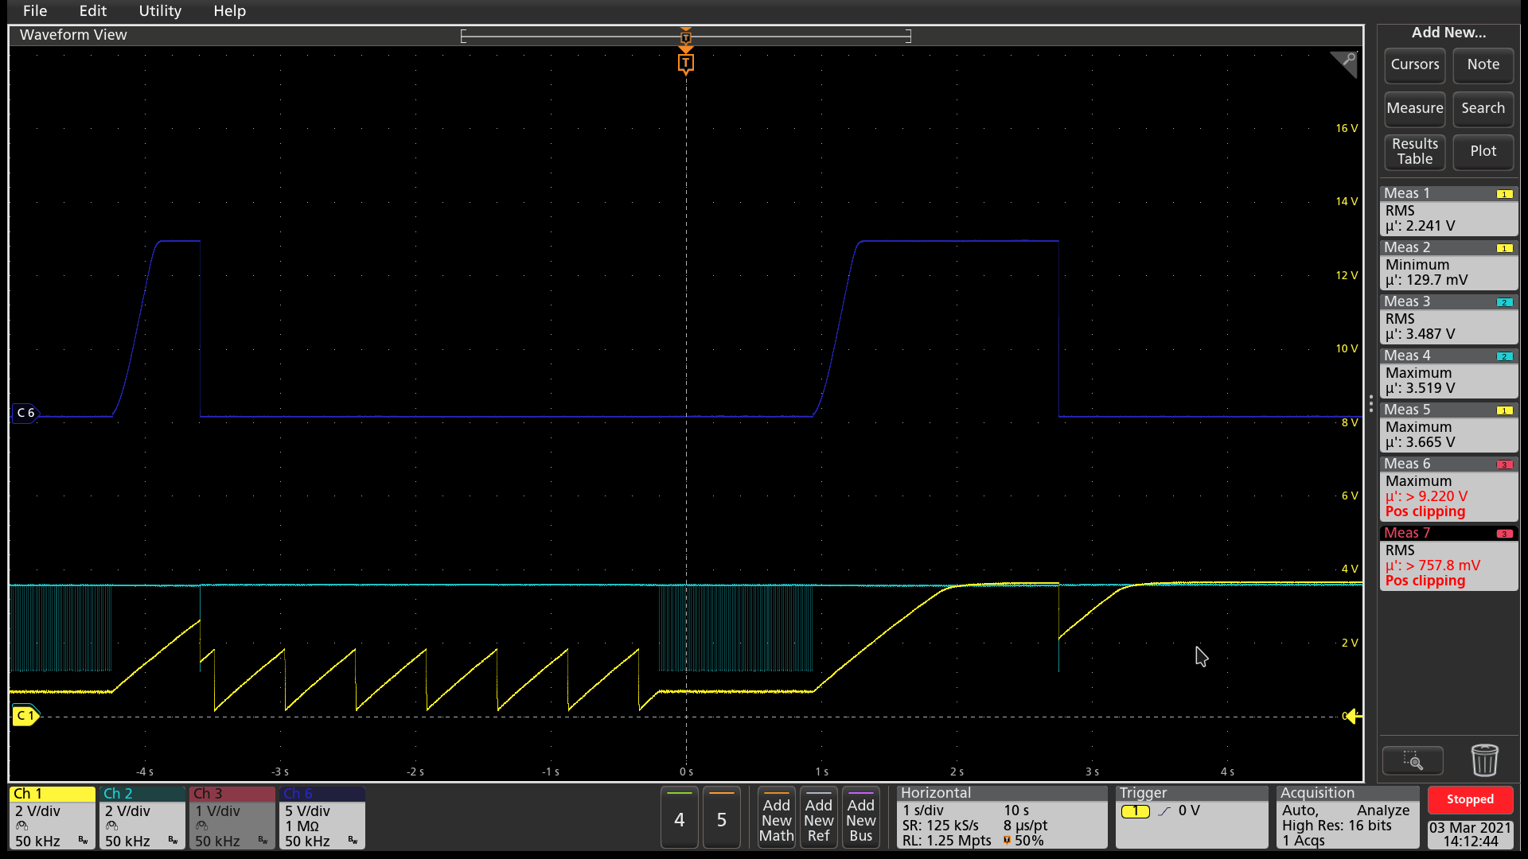
CH1 : SOFT START
CH2 : KFF
CH6 : VOUT
The SOFT START recovery immediately.
Output does not recovery when short changed OPEN.
Output short

