Slide 1
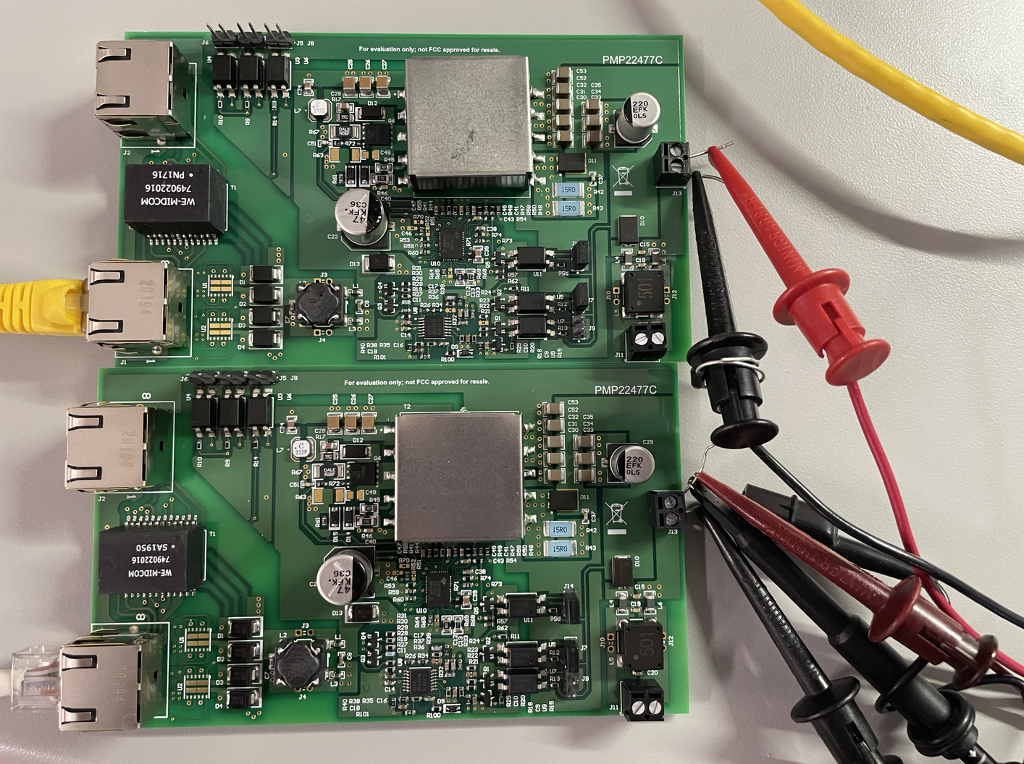
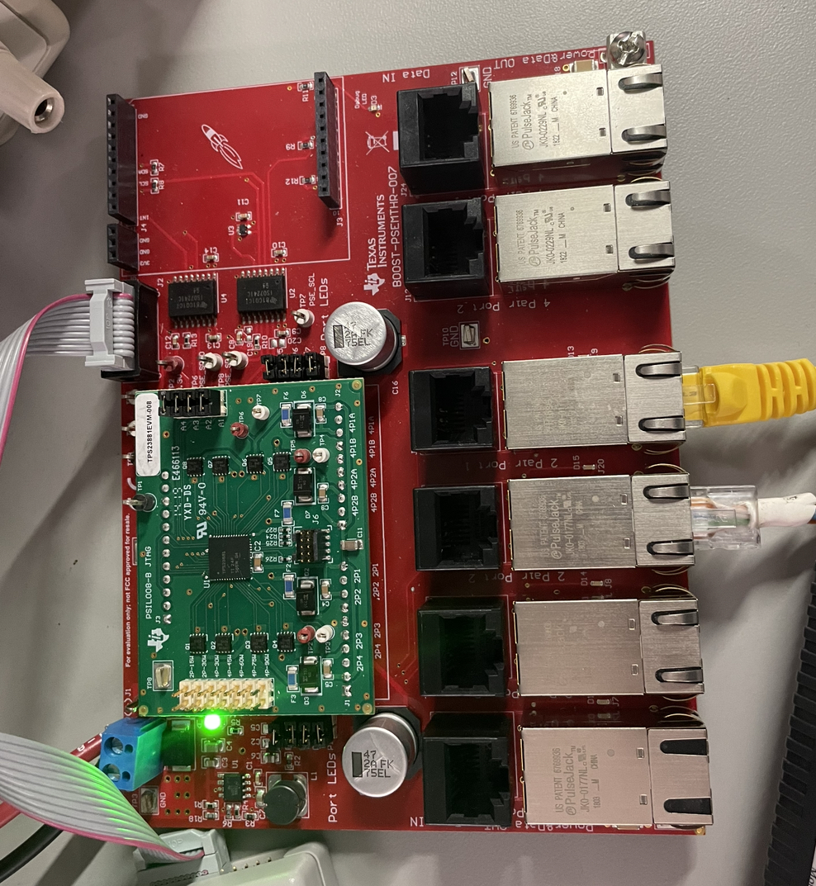
2 x PMP22477 Power Sharing & Limiting Test - Pictures
Test Setup:
50 V
TPS23881EVM x 1
Two 2-paris ports (30 W each) were used
PMP22477 x 2
Shorted the output sides; no dedicated oring circuit

Slide 2
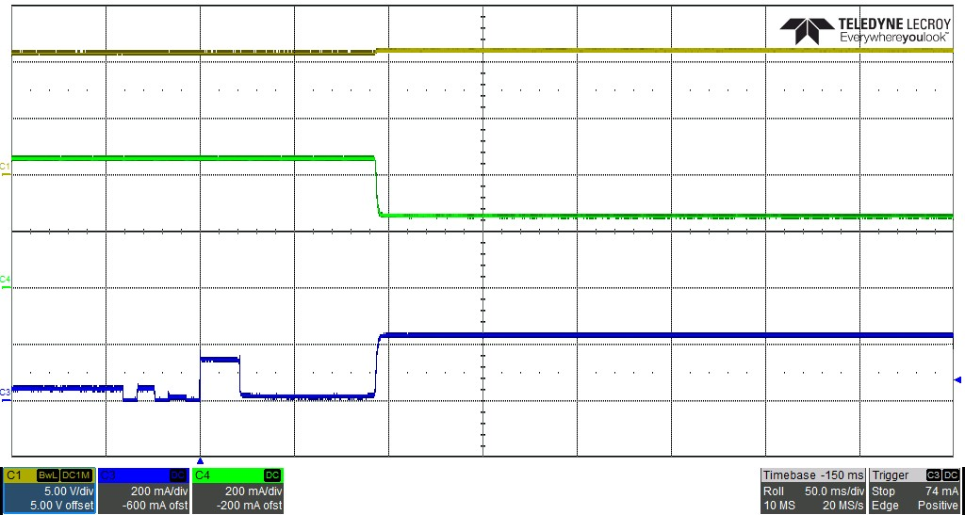
2 x PMP22477 Power Sharing & Limiting Test - 1
Test Condition: Insert PD2 when PD1 is exiting
  V_{DD} - V_{SS} = 50 V
  V_{out} = 12 V
  I_{out} = 1.8 A
  P_{lmt(PD1)} = 25.5 W
  P_{lmt(PD2)} = 25.5 W
50 V
V_{out}
I_{PD1} = 460 mA
I_{PD1} = 260 mA
I_{PD2} = 240 mA

Slide 3
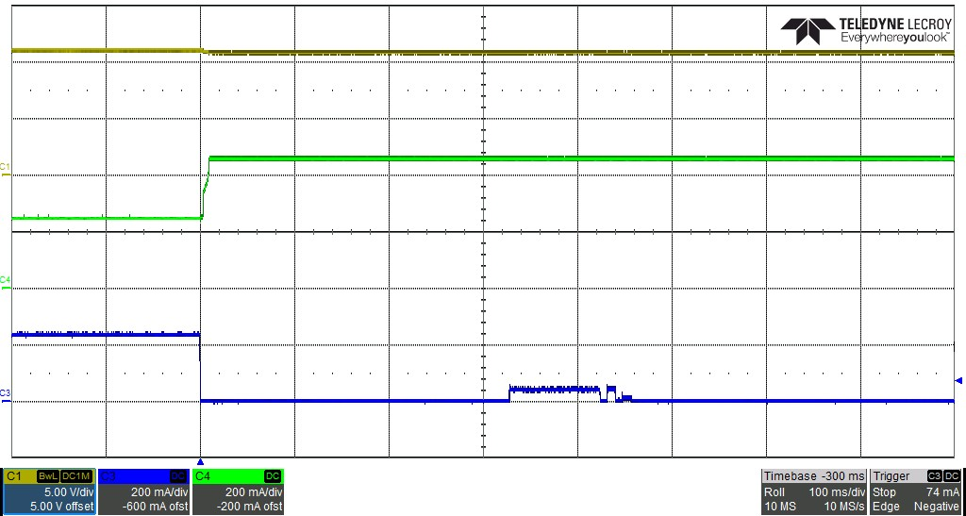
2 x PMP22477 Power Sharing & Limiting Test - 2
Test Condition: Remove PD2 when PD1 & PD2 are both exiting
  V_{DD} - V_{SS} = 50 V
  V_{out} = 12 V
  I_{out} = 1.8 A
  P_{lmt(PD1)} = 25.5 W
  P_{lmt(PD2)} = 25.5 W
50 V
V_{out}
I_{PD1} = 460 mA
I_{PD1} = 260 mA
I_{PD2} = 240 mA

Slide 4
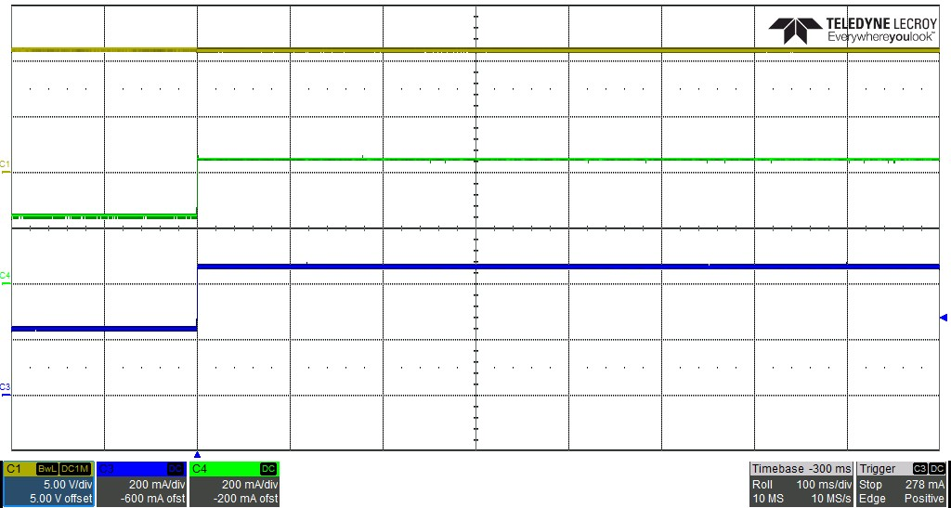
2 x PMP22477 Power Sharing & Limiting Test - 3
Test Condition: Increase I_{out} when PD1 & PD2 are both exiting
  V_{DD} - V_{SS} = 50 V
  V_{out} = 12 V
  I_{out} = 1.8 A -> 3.6 A
  P_{lmt(PD1)} = 25.5 W
  P_{lmt(PD2)} = 25.5 W
50 V
V_{out}
I_{PD1} = 450 mA
I_{PD1} = 240 mA
I_{PD2} = 460 mA
I_{PD2} = 240 mA

Slide 5
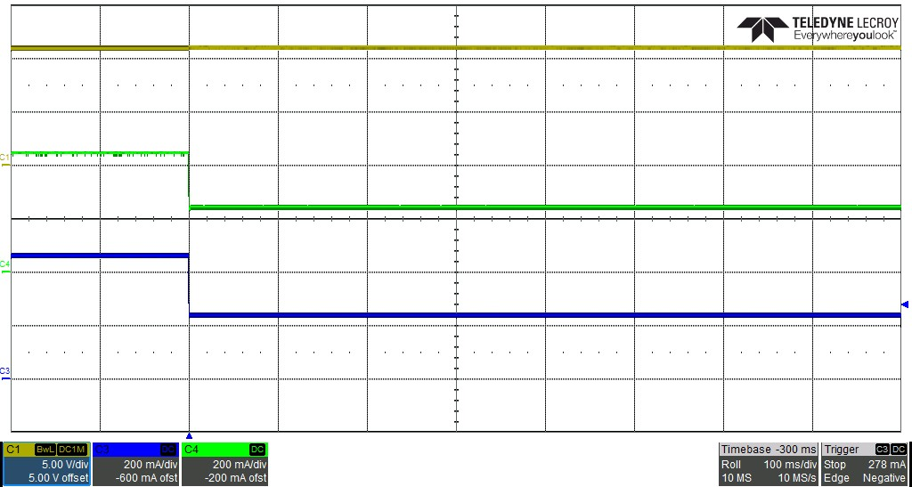
2 x PMP22477 Power Sharing & Limiting Test - 4
Test Condition: Reduce I_{out} when PD1 & PD2 are both exiting
  V_{DD} - V_{SS} = 50 V
  V_{out} = 12 V
  I_{out} = 3.6 A -> 1.8 A
  P_{lmt(PD1)} = 25.5 W
  P_{lmt(PD2)} = 25.5 W
50 V
V_{out}
I_{PD1} = 440 mA
I_{PD1} = 240 mA
I_{PD2} = 440 mA
I_{PD2} = 240 mA

Slide 6
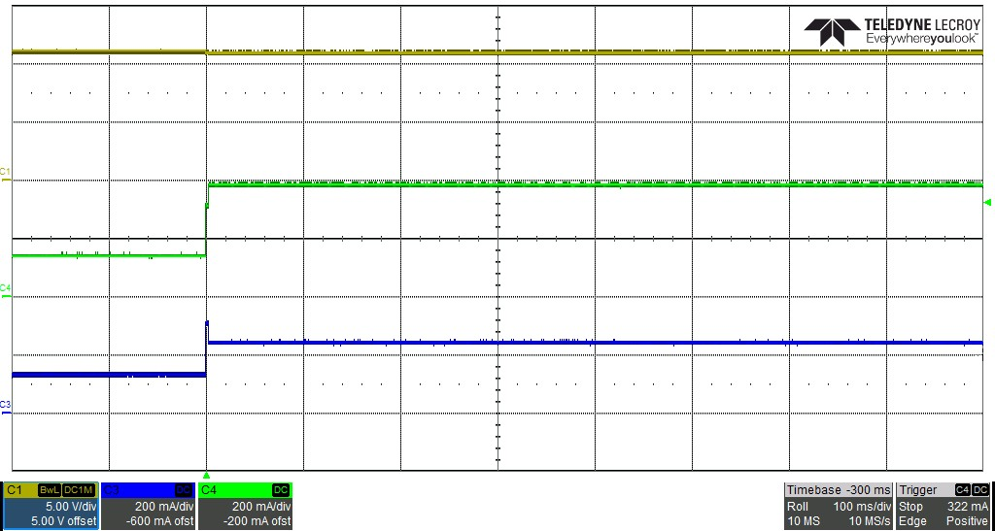
2 x PMP22477 Power Sharing & Limiting Test - 5
Test Condition: Increase I_{out} when PD1 & PD2 are both exiting; PD2 recaches power limitation
  V_{DD} - V_{SS} = 50 V
  V_{out} = 12 V
  I_{out} = 1 A -> 2.4 A
  P_{lmt(PD1)} = 25.5 W
  P_{lmt(PD2)} = 13 W
50 V
V_{out}
I_{PD1} = 390 mA
I_{PD1} = 120 mA
I_{PD2} = 120 mA
I_{PD2} = 240 mA

